Slide 1
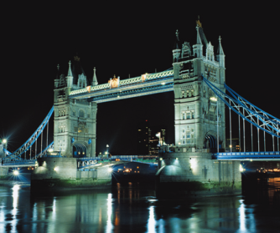
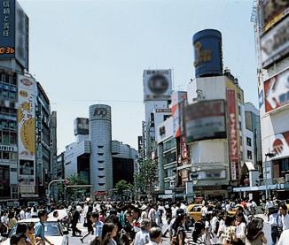
Great cities of the world
WWW.PPT818.COM

Slide 2
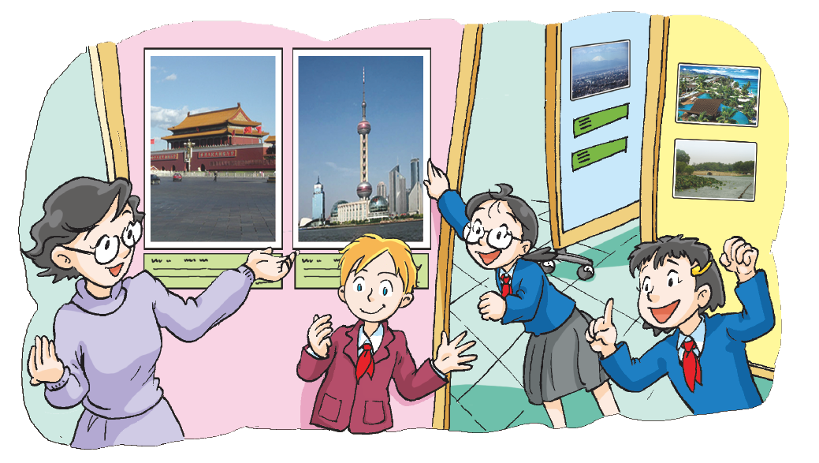
Recite the dialogue

Slide 3
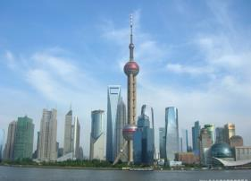
Make sentences
How long does it take to get to Shanghai from Beijing by plane?
How long does it take to travel by plane?
Beijing
Shanghai
It only takes about two hours by plane.

Slide 4
Make sentences
√
How long does it take to get to … from Beijing by …?
It takes about … by …

Slide 5
Make sentences
1. How long does it take to get to Hangzhou from Beijing by plane?
It takes about 2 hours by plane.
2. How long does it take to get to Hangzhou from Beijing by train?
It takes about 7 hours by train.

Slide 6
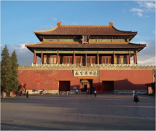
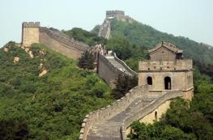
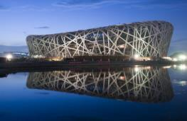
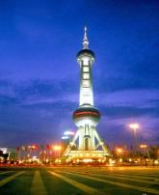
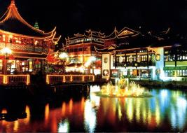
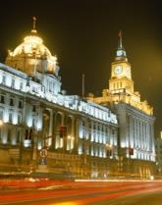
Do a quiz
Beijing
Which city is the capital of China?
首都

Slide 7
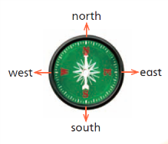
Do a quiz
Where is Beijing?
Beijing is in the north of China.

Slide 8
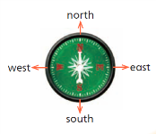
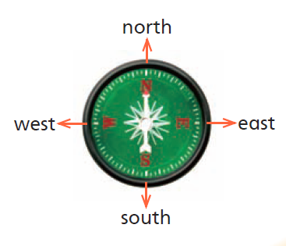
Do a quiz
Which city is in the east of China?
Shanghai is in the east of China.

Slide 9
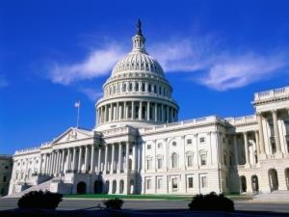
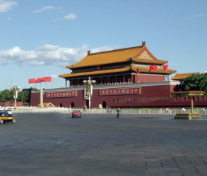
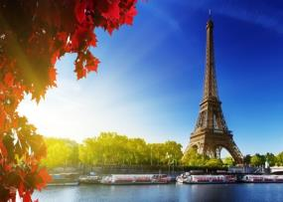
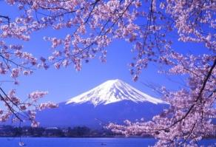
Think and say
Tokyo
Which city is the capital of Japan?

Slide 10
Do a quiz
London
Which city is the capital of the UK?

Slide 11
Do a quiz
Washington D.C.
Which city is the capital of the US?

Slide 12
Do a quiz
Paris
Which city is the capital of France?

Slide 13
Lookand learn
London
Washington D.C.
Great cities of the world
Tokyo
Beijing
Paris

Slide 14
Think and say
What do you know about Beijing?
Which city is the capital of China?
Where is Beijing?
What can we do in Beijing?
What can we see in Beijing?

Slide 15
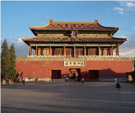
Think and say
What do you know about Beijing?
Which city is the capital of China?
Where is Beijing?
What can we do in Beijing?
What can we see/find in Beijing?
What do tourists like doing there?
What do people in Beijing love eating?

Slide 16
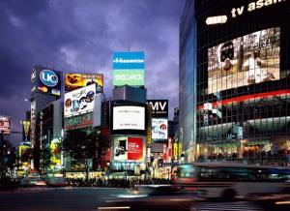
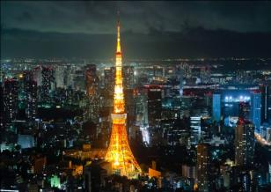
Think and say
Do you know anything about Tokyo?
Where is Tokyo?
What do tourists enjoy doing in Tokyo?
What do people in Tokyo love eating?
Do you want to ask more about Tokyo?
…?

Slide 17
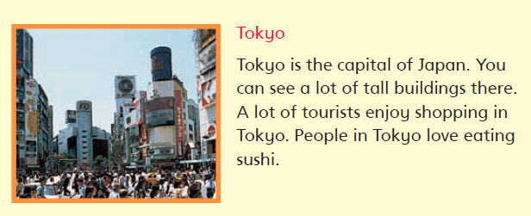
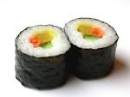
Read and say
buildings
Where is Tokyo?
What do tourists enjoy doing in Tokyo?
What do people in Tokyo love eating?
… ?

Slide 18
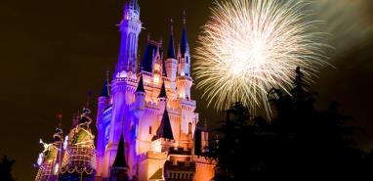
Look and learn
Mount Fuji
Tokyo Disneyland
Tokyo Tower

Slide 19
Think and say
What do you know about Tokyo?
Where is Tokyo?
What do tourists enjoy doing in Tokyo?
What do people in Tokyo love eating?
…?

Slide 20
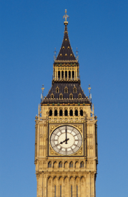
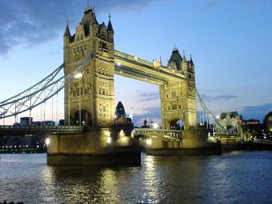
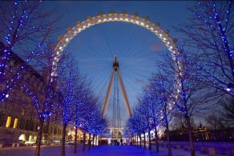
Look and say
London
Do you want to know about London?
Write your questions on the card!

Slide 21
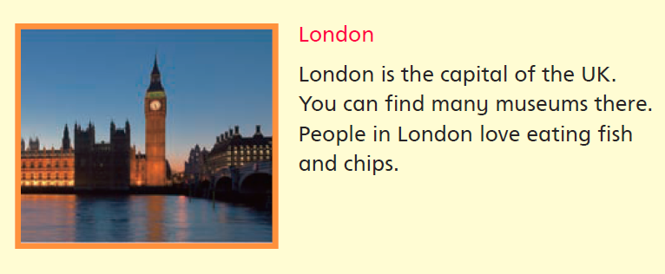
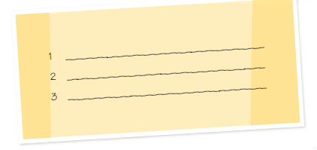
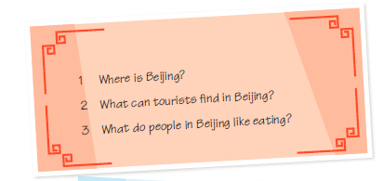
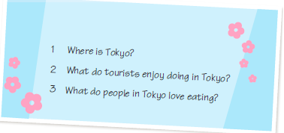
Read and write

Slide 22
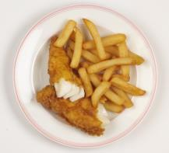
Read and answer
Where is London?
What can you find in London?
What do people in London love eating?
…?

Slide 23
Look and learn
London Eye
Big Ben
Tower Bridge

Slide 24
Think and say
What do you know about London?
Tell with the help of your question card.

Slide 25
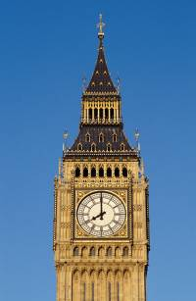
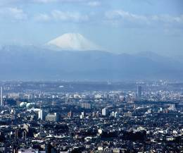
Think and say
Where …?
What …?
What food?
…?

Slide 26
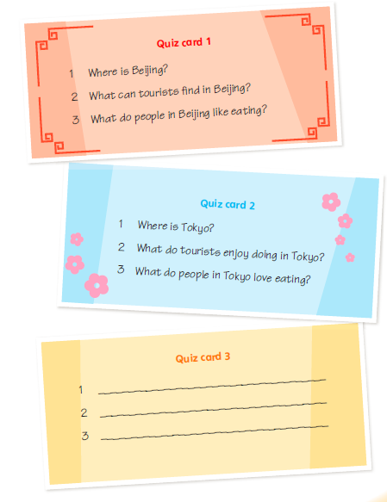
Quiz time
Step 1: Form groups of three.
Step 2: Write quiz cards.
Step 3: Choose and answer.
Step 4: Win the game!

Slide 27
Look and read

Slide 28
Look and read

Slide 29
Look and read

Slide 30
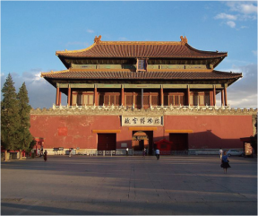
Look and say
…
Beijing
Tokyo
London
Great cities of the world
Paris
Washington D.C.

Slide 31
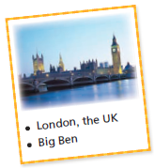
Think and write
The city I want to visit
London is the capital of … It is ... In London, you can … Tourists like … People in London like eating …
I want to visit this great city!
How long does it take to get to this city from your city by plane?

Slide 32
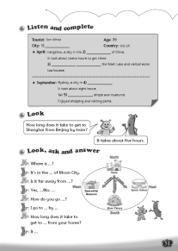
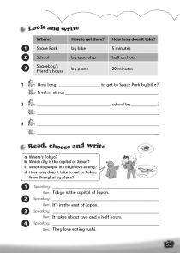
Homework
1. Write about “The city I want to visit”.
2. Read Student’s Book pages 58 to 61.
3. Talk about Beijing, London and Tokyo.
4. Finish Workbook pages 51 and 53.

