Slide 1
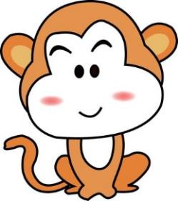
Unit1 My Body
陕旅版
三年级下册
Part A Color the toy
Part B Let’s learn more
Part C Complete and match
Ask and answer
WWW.PPT818.COM

Slide 2
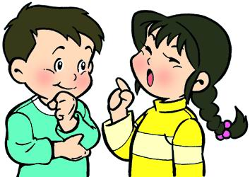
>>Review
Make and say
Make sentences
Does it have feet?
Yes, it does.
It has two feet.

Slide 3
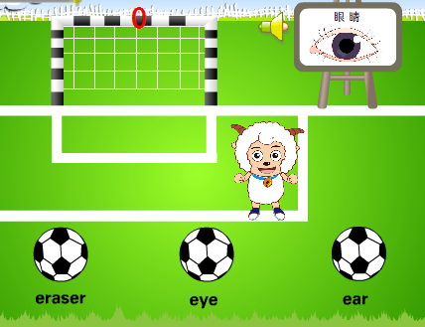
>>Review
Look and say

Slide 4
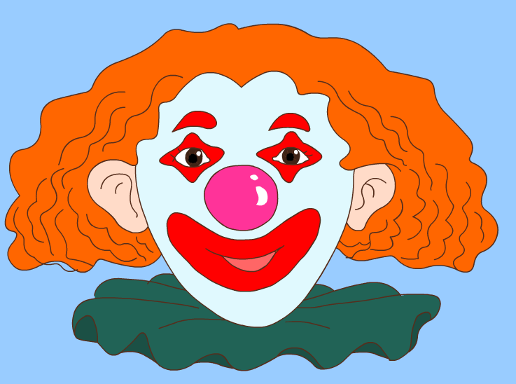
>>Warm-up
Look and say

Slide 5
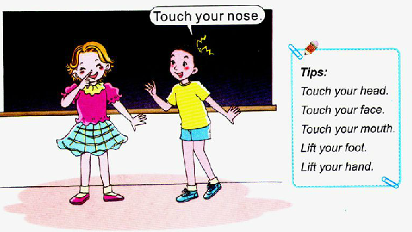
>>Lead-in
Listen and do

Slide 6
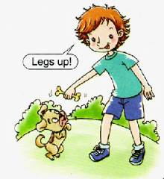
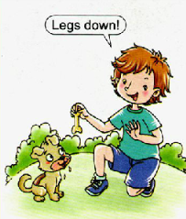
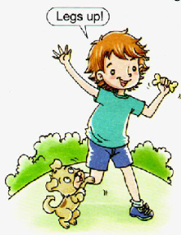
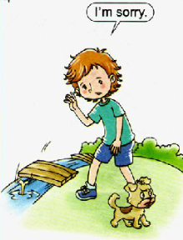
>>Presentation
Look and say

Slide 7
>>Presentation
Listen, then ask and answer
Question 1: Who’s in the story?
The boy is Colin.
Question 2: Does the boy have black hair?
No, he doesn’t. He has yellow hair.
Question 3: Look at Picture 4. Are they happy?
No, they aren’t.

Slide 8
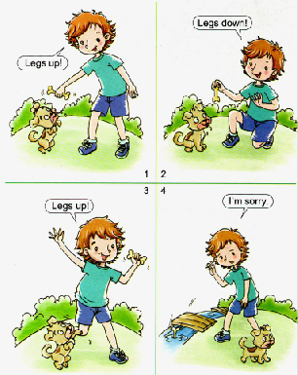
>>Presentation
Read a story
Legs down!
Legs up!
Legs up!
I’m sorry.

Slide 9
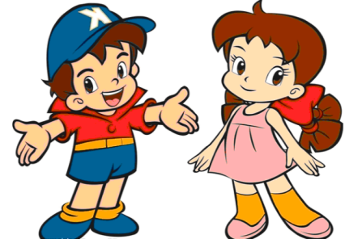
>>Practice
Role play
两人一组，练习对话，随后
表演出来吧！

Slide 10
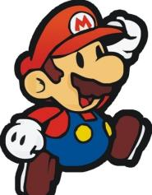
>>Practice
Super Mary:表演/创编我最棒！
小组合作：
1.2-3人一小组。
2.根据Read a story进行表演。
3.根据Read a story进行创编。
Make a new story 创编故事

Slide 11
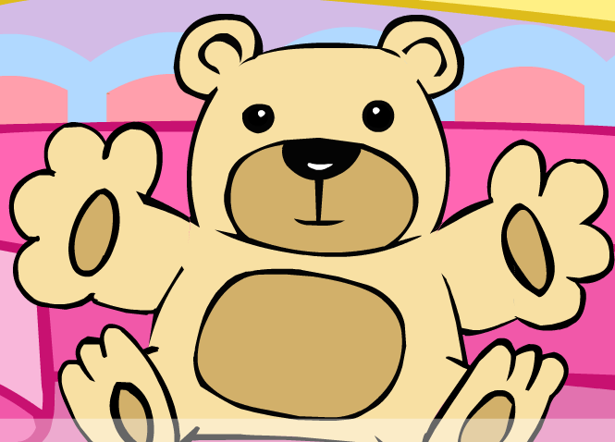
>>Consolidation
Look and say

Slide 12
>>Summary
如何说出身体部位指令并做相应动作？
Legs up/down.
Arms up/down.
Touch your head.
Touch your face.
Lift your foot.
Lift your hand.

Slide 13
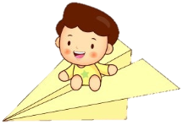
>>Homework
1.听课文录音并跟读，按照正确的语音、语调朗读并表演课文对话。 2.创编对话：同桌2人一组，根据Read a story课文内容，创编对话。
3.预习Unit2 A Let’s learn。
close

