Slide 1
Unit3 Who’s That Man?
陕旅版六年级下册
第二课时
WWW.PPT818.COM

Slide 2
>>Warm-up

Slide 3
>>Review
Magic fingers
pupil reporter singer police officer
actor scientist glasses basketball player

Slide 4
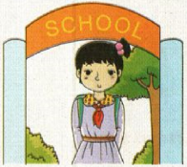
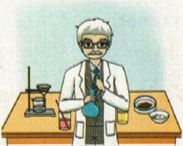
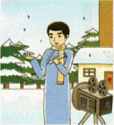
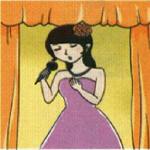
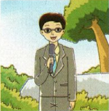
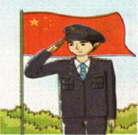
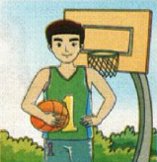
>>Review
Quick response

Slide 5
>>Presentation
Look and say
What does he do?
What does she do?
He is a police officer.
She is a teacher.

Slide 6
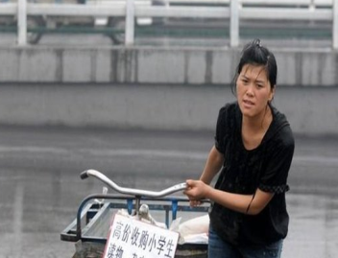
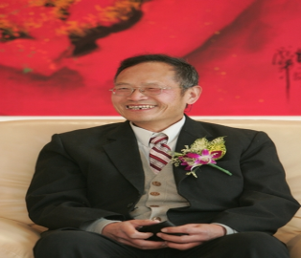
>>Presentation
Look and say
What’s her name?
What’s his name?
Her name is Li Ling.
His name is Wang Wanqing.
What does she do?
What does he do?
She is a teacher.
He is a doctor.

Slide 7
>>Presentation
Listen and answer
Who is the young woman?
Her name is Li Ling.
What does she do?
She is a teacher.
Who’s the thin man with glasses?
He is Wang Wanqing.
What does he do?
He is a doctor.

Slide 8
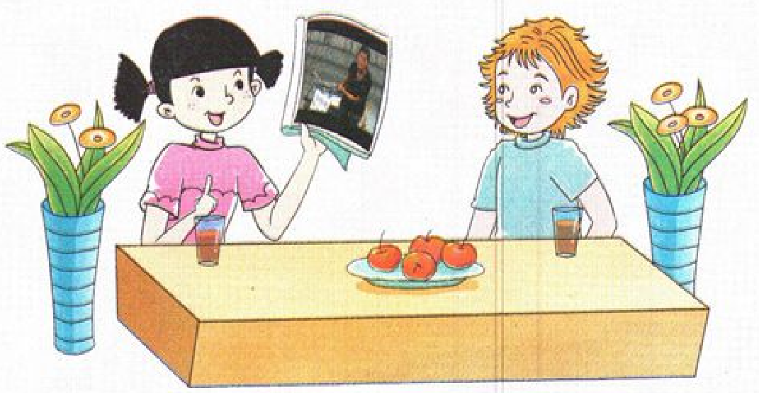
>>Presentation
Let’s talk
Her name is Li Ling. She is a teacher.
Who’s the young woman, Wu Chen?
She set up a hope school for poor children.
What did she do?

Slide 9
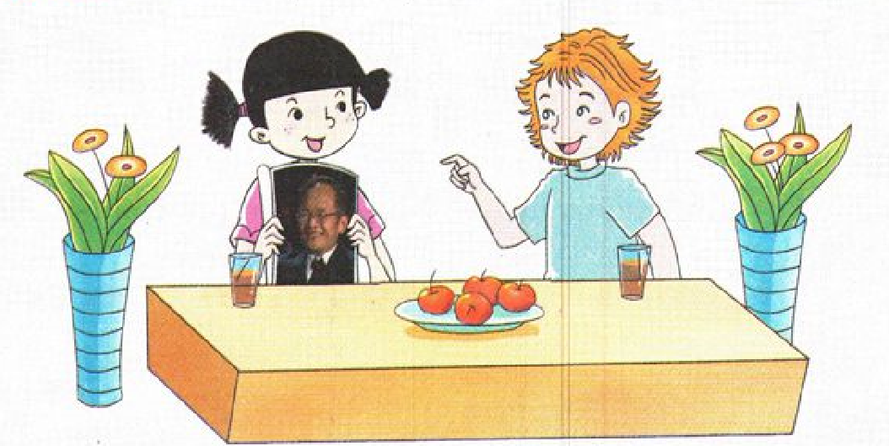
>>Presentation
Let’s talk
Who’s that man?
Which one?
The thin one with glasses.
He is Wang Wanqing.
He is a doctor. He is from Shanghai. But in the past 40 years, he worked on the grassland. He is very helpful to the people there.
What does he do?

Slide 10
>>Practice
Let’s talk
Listen and imitate
Colin: Who’s the young woman, Wu Chen?
Wu Chen: Her name is Li Ling. She is a teacher.
Colin: What did she do?
Wu Chen: She set up a hope school for poor children.
Colin: Who’s that man?
Wu Chen: Which one?
Colin: The thin man with glasses.

Slide 11
>>Presentation
Let’s talk
Wu Chen: He is Wang Wanqing.
Colin: What does he do?
Wu Chen: He is a doctor. He is from Shanghai.
But in the past 40 years,
he worked on the grassland.
He is very helpful to the people there.

Slide 12
>>Practice
2人一组，先朗读再表演课文故事吧。
1
2
3
Read together.
(齐读)
Read in roles.
（分角色读）
Act in roles.
(分角色演）

Slide 13
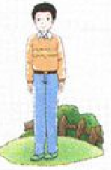
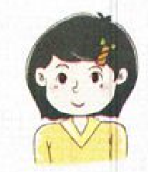
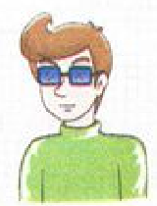
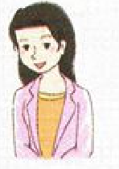
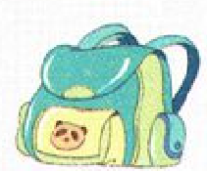
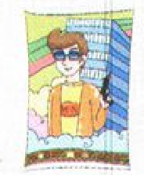
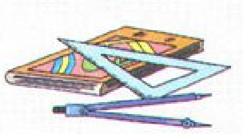
>>Practice
Listen and match
Paul
Gao Hui
Fang Xiang
Liu Ling

Slide 14
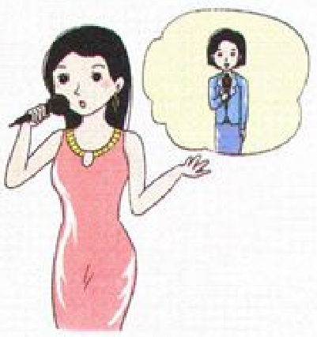
>>Practice
Look and talk
A: Who is the woman with …?
B: Her name is …
A: Is she…?
B: Yes, she is. But three years ago, she was …
A: Did she have long hair then?
B: …
Jenny/singer/reporter

Slide 15
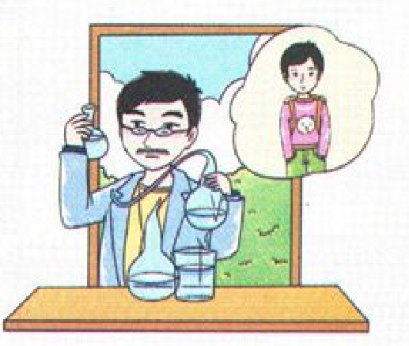
>>Practice
Look and talk
A: Who is the man with …?
B: His name is …
A: What does he do?
B: He is …
A: What did he do thirty years ago?
B: He was …
A: Did he wear glasses then?
B: …

Slide 16
>>Summary
本课所学的重点句子？
-Who’s that man?
-He’s ...
-What does he do?
-He’s a doctor... He is from …
But he worked …

Slide 17
>>Summary
For example
-Who’s that man?
-He’s Wang Wanqing.
-What does he do?
-He’s a doctor. He is from Shanghai.
But in the past 40 years, he worked on
the grassland.

Slide 18
>>Homework
1.听课文录音并跟读，按照正确的语音、语调朗读并表演课文对话。 2.仿照课文Part A Let’s talk写一段话(至少4句)。
3.预习B Let’s learn more。
close

