Slide 1
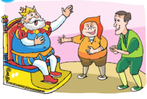
Unit 1
The king’s new clothes
第一课时
WWW.PPT818.COM

Slide 2
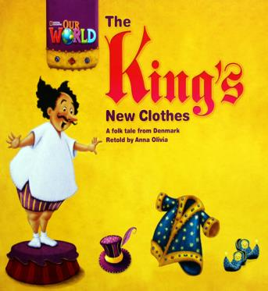
Introduce
Answer questions：
1.I’m very _________.
I like _________ very much.
Who can ________ new clothes for me?
2. Who are they in the story?
3. What did people say?
4. What did the boy say?

Slide 3
Words
magic
/'mædʒɪk/
形容词，表示“有魔法的、神奇的”
动词，表示“用魔术变出”
常用短语：a magic baby 神奇宝贝
eg： Liu Qian has many magic ideas.
刘谦有许多神奇的想法。
agic
小练习： Harry Potter has a m_______ wand(魔杖；棒) .

Slide 4
Words
clever
/'klevə/
形容词，表示“聪明的”；其反义词为：foolish
常用短语：clever fingers 灵巧的手指
eg ：Su Hai is a clever boy.
苏海是一个聪明的男孩。
小练习： （ ）Lily is ___. She knows a lot about animals.
A. foolish B. quiet C. clever
C

Slide 5
Words
foolish
/'fuːlɪʃ/
形容词，表示“傻的、愚蠢的”；其反义词为：clever
常用短语：foolish powder 海洛因
eg ：You are foolish. It’s not a UFO. It’s a plane.
你真笨，那不是UFO，那是一架飞机。
B
小练习：（ ）The king isn’t wearing any clothes in the street. So he is _____.
A. beautiful B. foolish C. clever

Slide 6
Words
through
/θruː/
介词，表示“穿过”；
常用短语：walk through走过 look through浏览
eg ： I am afraid to go through the forest alone.
我不敢一个人穿过森林。
小练习：The sunlight goes _____ the window and makes the room bright.
A. through B. across C. over
A

Slide 7
Words
laugh
/lɑːf/
动词，表示“笑、大笑”；其第三人称单数为：laughs。
现在分词为：laughing，过去式为：laughed，反义词为：cry
常用短语： laugh at 嘲笑
eg：Don’t laugh at the poor. 不要嘲笑穷人。
小练习： 我们不应该嘲笑老年人。
We shouldn’t _________ ________ the elderly.
laugh at

Slide 8
Words
wear
/weə/
动词，表示“穿着、戴着”；
其第三人称单数为：wears，现在分词为：wearing
常用短语： leisure wear 休闲服
eg： Mr. Wang wears a new black coat。
王先生今天穿着一件新的黑色的外套。
小练习： Look! She’s ____________(wear) a new dress.
wearing

Slide 9
Expressions
Long long ago, there was a king.
很久很久以前，有一个国王。
“There be···”句型的一般过去时。
long long ago为过去的时间状语，其谓语动词要用过去时态。
eg : There was much fresh air here many years ago.
多年前，这里空气新鲜。
小练习 : （ ）There ___a tiger in the hill long long ago.
A. is B. was C. were
B

Slide 10
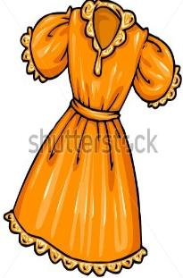
Expressions
We can make new clothes for you.
我们能为你制作新衣服。
Make··· for··· 意为“为······制作······”。
eg : They are making a birthday cake for Su Hai.
他们正在给苏海制作生日蛋糕。
小练习 : Tom, make, beautiful, let’s birthday, card, for, a, (.)
__________________________________________________________
Let’s make a beautiful birthday card for Tom.

Slide 11
Expressions
The two men showed the king his new clothes.
那两个骗子给国王看他的新衣服。
show后通常接双宾语结构，即show sb. sth.,也可以用show sth. to sb.。
eg ： Wang Bing， show me your homework.
王兵，把你的作业给我看看。
小练习 : Show me your robot, please.
Show your robot _________ ________, please.
to me

Slide 12
Expressions
What beautiful clothes!
多么漂亮的衣服呀！
此句是由what引导的感叹句。
“what+adj.+复数名词/不可数名词”
“what+a/an+adj.+可数名词单数”
eg ： What a tall boy! 多么高的男孩呀！
小练习 : 多么酷的玩具车呀！
_________ _________ ________ toy car!
What a cool

Slide 13
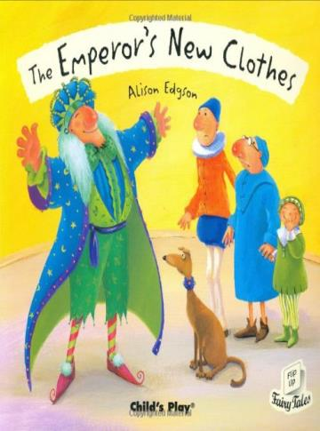
Dialogue
Talk about the stories with cheating you know.

Slide 14
Expand
through/across/over/past的用法区别
1）through是介词，表示从某一范围的一端到另一端
但它表示的动作是在内部空间进行的，往往指穿过沙漠、森林、窗户等。
eg : The river runs through the city. 这条河从这座城市中间流过。

Slide 15
Expand
through/across/over/past的用法区别
2) across是介词，强调从一定范围的一边到另一边，且在物体表面上或沿着某一条线的方向而进行的动作。
eg : Go across the bridge，and you’ll find the park.
越过这座桥，你就会找到公园。

Slide 16
Expand
through/across/over/past的用法区别
3) over是介词，用作“穿过、通过”时，表示到达高的障碍物（如树、墙、篱笆和山脉等）的另一侧。
eg : He jumped over the wall. 他跳过了墙。
4) past也是介词，指从某物旁边经过，意思是“走过某处、经过……”。
eg : He walked past me without saying “Hello”.
他没打招呼就从我身边走过。

Slide 17
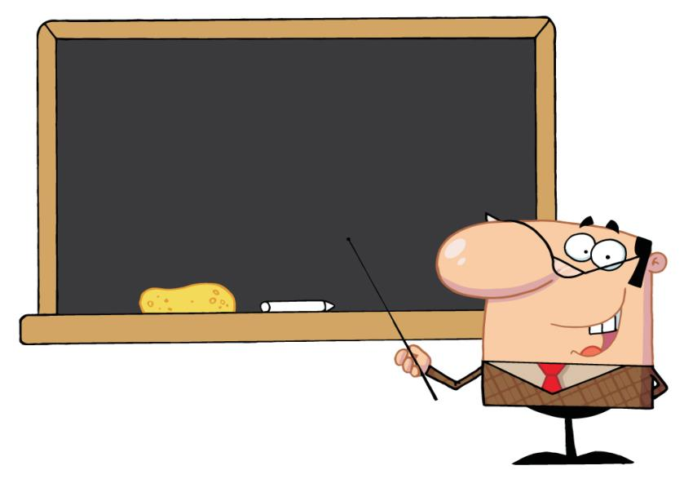
Summary
magic clever foolish
through laugh wear
There was… show sb sth
make… for… what a/an …

Slide 18
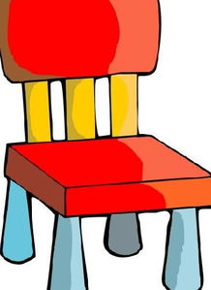
Exercise
1. This is the ______ chair.
A. king’s B. kings’ C. king
2. Let me make a puppet _____ you.
A. with B. to C. for
A
C

Slide 19
Exercise
3. Mr. Smith some beautiful stamps us this morning.
A. showed, for B. showed, to C. shows, to
4. There are a lot of ______ in the classroom.
A. a people B. peoples C. people
B
C

Slide 20
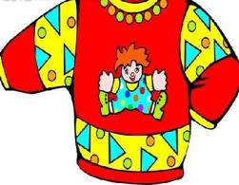
Exercise
5. ______ beautiful clothes!
A. What B. What’s C. How
6.The king a special hobby. He new clothes.
A. had , likes wear B. had, liked wearing C. had, liked wear
A
B

Slide 21
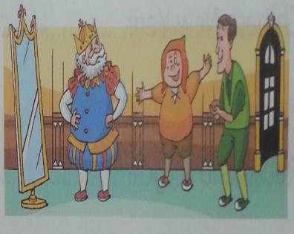
Homework
Complete story framework alone and recite the article.

