Slide 1
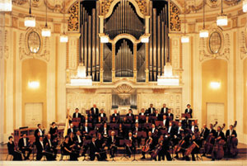
Module 12
Western music
Language in use
WWW.PPT818.COM

Slide 2
Objectives：
1. To practise exclamatory sentences and alternative questions
2. To practise the expression of preference

Slide 3
Observe
Observe the following sentences.
What a beautiful city!
Do you like traditional Western music or pop music?
Is this by Strauss or Mozart?
Listen to those drums!
5. It’s so beautiful!

Slide 4
6. Is it by the father or the son?
7. What nice weather!
8. Shall we go home or stay here?
9. Now I understand!
10. How carefully she is writing!

Slide 5
______ a beautiful city!
Do you like traditional Western music _____ pop music?
Is this by Strauss _____ Mozart?
______ ____ (Listen to) those drums!
5. It’s ______ beautiful!
What
Ready?
go
or
or
Listen to
so

Slide 6
6. Is it by the father ____ the son?
7. _____ nice weather!
8. Shall we go home _____ stay here?
9. Now I __________ (understand)!
10. _____ carefully she is writing!
or
What
or
understand
How

Slide 7
Grammar
选择疑问句
感叹句

Slide 8
选择疑问句
--- Is the yellow ruler short or long ?
--- It’s ______.
long

Slide 9
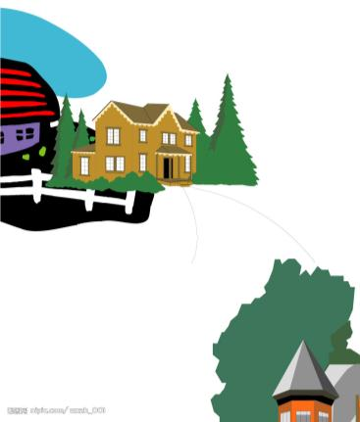
house
school
shop
--- Is your house near the school or the shop?
--- It’s near the ______.
shop

Slide 10
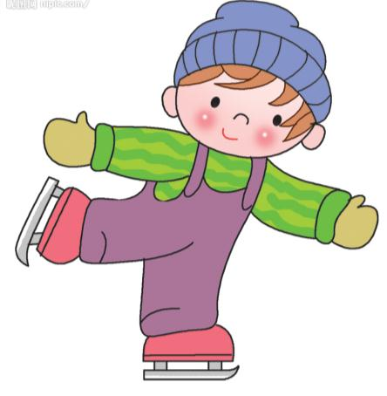
--- Can she skate well or badly ?
--- She can skate ______.
well

Slide 11
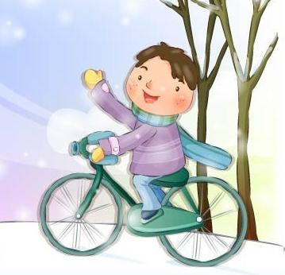
–-- Do you go to school by bike or bus? --- I go to school by ______.
bike

Slide 12
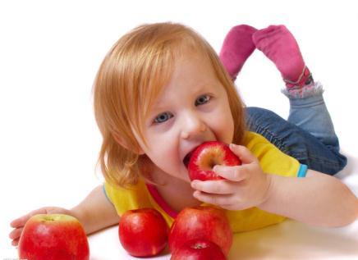
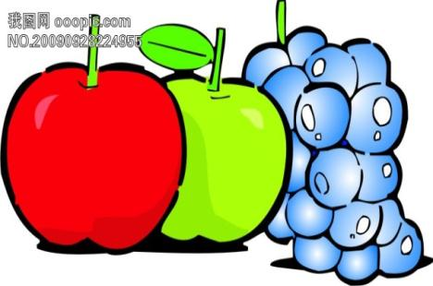
–-- Would you like apples or grapes?
--- I’d like _______.
apples

Slide 13
Let’s join the two sentences together.
Do you like swimming?
Do you like climbing the hill?
Do you like swimming or climbing the hill?

Slide 14
Look at the following sentences.
--- Is this by Strauss or Mozart?
--- It’s by Strauss.
--- Do you like traditional Western music or pop music?
--- Well, I like both.

Slide 15
在问题中提供两个或两个以上可选答案的问句叫 。
选择疑问句
选择疑问句中or所连接的可以是不同的内容，如两个名词(the father or the son)、两个动词 (call or email)、两个介词短语 (by bus or by car)、专有名词 (Mozart or Strauss)等。
注意：or所连接的内容一定是并列的，如果or的前面是名词，其后也应该是名词；如果是动词，则其后也必须是动词，不能前面是名词，后面却接一个动词。

Slide 16
在口语中，选择疑问句的语调应是第一个选择项读升调、第二个选择项读降调。
More examples:
Would you like coffee, tea or soda?
你想喝咖啡、茶还是苏打水？
Should I call or email you?
我应该给你打电话还是发电子邮件？
Did you come here by bus or by car?
你是坐公交车还是开车过来的？

Slide 17
P76
1
Write questions.
例：you / like / pop / traditional music?
Do you like pop or traditional music?
(be) / Strauss / German / Austrian?
Is Strauss German or Austrian?
2. (be) / this / pop / rock?
Is this pop or rock music?

Slide 18
3. they / play / traditional music / modern
music?
Do they play traditional music or
modern music?
4. he / play / piano / violin?
Does he play the piano or the violin?
5. where / (can) we / hear / rock music / in /
New York / London?
Where can we hear rock music, in New
York or in London?

Slide 19
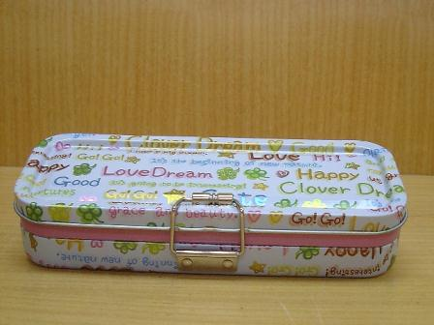
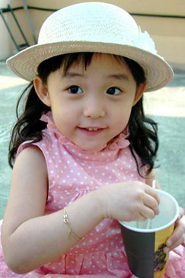
感叹句
What a big pencil box it is!
What a pretty girl she is!

Slide 20
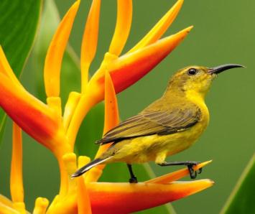
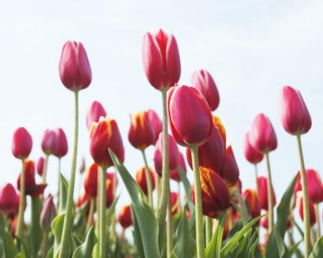
What a beautiful bird it is!
What beautiful flowers they are!

Slide 21
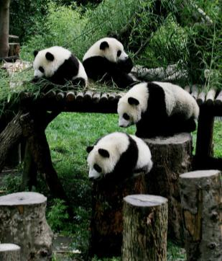
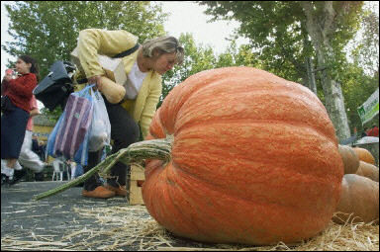
What lovely pandas
(they are)！
Wow, what a big
pumpkin!

Slide 22
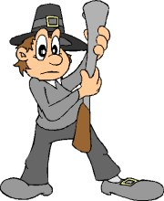
What a tall man (he is)!

Slide 23
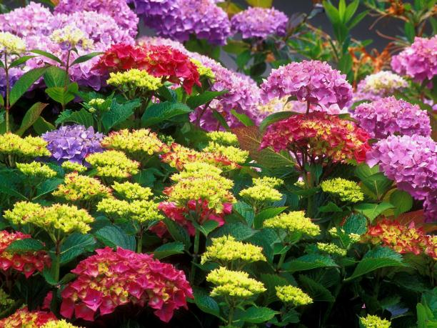
The flowers are beautiful.
What beautiful flowers they are!

Slide 24
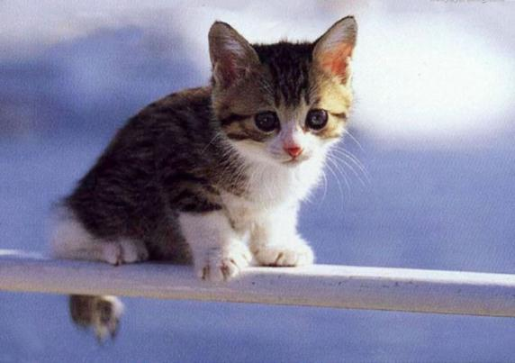
The cat is lovely.
What a lovely cat it is!

Slide 25
感叹句
当我们想表达一种较为强烈的感情，如喜悦、赞叹、惊异、愤怒、厌恶等。读时一般用降调。
仔细观察这三句话：
It’s so beautiful!
I love his music!
What a beautiful city!
我们发现这些句子大致分为两类。

Slide 26
第一类：
It’s so beautiful!
I love his music!
That’s my favourite song!
这类感叹句在句式上与陈述句没有任何区别，只是将句号变成了感叹号，语气变得更强烈而已。
这一类句子在书面语中我们用感叹号表达感叹的语气，在口语中则是通过说话的语气来表达强烈的情感。

Slide 27
More examples:
Happy birthday, Tom!
I am so angry!
Ice cream is the best dessert!
Ouch, that hurts!
I’m so excited!
That’s wonderful!

Slide 28
第二类：两大句型
1. What +(a / an) +形容词+名词+(主语+ 谓语)！
这是以名词为中心词，以what作限定词的感叹句的基本结构。
①中心词为单数可数名词，其前有冠词。如：What a clever boy (he is)!
②中心词为不可数名词，其前无冠词。如：What fine weather (it is)!
③中心词为复数名词，其前无冠词。如：What beautiful flowers (they are)!

Slide 29
2. How +形容词 / 副词+(主语+ 谓语)！
这是以形容词为中心词，以how作形容词或副词修饰语的感叹句的基本结构。如：
How kind you are!
How fast he runs!

Slide 30
P76
2
Write exclamations with What (a)…!
例：This is beautiful music.
What beautiful music this is!
Vienna is a beautiful old city.
What a beautiful old city Vienna is!
2. It is a successful concert.
What a successful concert it is!

Slide 31
3. They are playing noisy drums.
What noisy drums they are playing!
4. It was a wonderful party.
What a wonderful party it was!
5. Mozart is a famous composer.
What a famous composer Mozart is!

Slide 32
3
Put the words into the correct column.
P76
drum fan musician piano
pop rock traditional violin
Types of music | Instruments | People
pop
rock
traditional music
drum
piano
violin
fan
musician

Slide 33
4
Complete the conversation with the correct form of the words from the box.
P77
come give hear learn love write
Lingling: This is beautiful music. Who
wrote it, Betty?
Betty: Beethoven wrote it. He was a
great musician. I ______ his
music.
love

Slide 34
Lingling: Me too. Did he live at the same
time as Mozart?
Betty: Yes, he was born in 1770 and
began to _______ music at an
early age. He ________ his first
piano concert when he was only
eight.
Lingling: When did he start to ________
music?
learn
gave
write

Slide 35
Betty: Very early. His first work _____
out before the age of 12.
Lingling: Was Beethoven famous at that
time?
Betty: Yes. But he began to loose his
hearing. In the last ten years of
Beethoven’s life, he _____ nothing.
Lingling: That’s sad!
Betty: Yes, but he still played the piano.
He died when he was 56.
came
heard

Slide 36
Module task:
Talking about Chinese music

Slide 37
5
Work in pairs. Talk about one or two types of Chinese music.
P77
beautiful fast lively
modern sad slow
Choose one or two types of Chinese
music and describe them. Use the words from the box.
Say which types of music you like. Give your reasons.
Talk about Chinese music in front of the class.

Slide 38
Summary
1. 选择疑问句：由or连接两个或两个以上并列的内容
2.感叹句是表示喜怒哀乐等强烈感情的句子 ，常用句式：
﹡普通陈述句（加强语气）
﹡What + (a / an) + 形容词+ 名词+ (主语+ 谓语)！
﹡How + 形容词 / 副词+ (主语+ 谓语)！

Slide 39
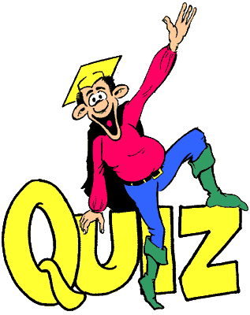

Slide 40
Ⅰ. 用方框中所给单词或短语完成下列句子。
sad at the age of hearing
took place wrote
1. The girl started to play the piano ____________ four.
2. Her father’s words made her feel very _________.
at the age of
sad

Slide 41
hearing
3. —His _________ isn’t good. Please talk to him loudly.
—I see.
4. The old story _________ in a small village many years ago.
5. My father _________ two pieces of music last week.
took place
wrote

Slide 42
Ⅱ. 根据要求改写句子。
1. Betty enjoys fast music. (用slow music改为选择疑问句)
_________ Betty _________ fast music ________ slow music?
2. His sister is a beautiful girl. (改为感叹句)
________ _______ ________ girl his sister is!
Does enjoy
or
What a beautiful

Slide 43
3. The meat is very delicious. (改为感叹句)
________ ________ meat it is!
4. Peter can play the violin. Peter can play the piano. (用both…and…连接两个句子)
____________________________________________________
What delicious
Peter can play both the violin and the piano.

Slide 44
Ⅲ. 从方框中选择恰当的句子完成对话。
A: Good morning, Jack! What did you
do last night?
B: (1)________
A: What music do you like best?
B: Rock music, especially (尤其是)
Chinese rock music.
A: Really? (2)________ You aren’t
Chinese, you are from a Western
country.
C
E

Slide 45
B: Yes, I like Western music, but I like
Chinese rock music more.
A: (3)________
B: Cui Jian. (4)________
A: You’re right! His rock music makes
people excited.
B: Yes. Tomorrow is Sunday. What
about listening to his songs together?
A: (5)________
A
D
B

Slide 46
Who is your favourite Chinese
singer?
B. It sounds like a good idea!
C. I listened to music.
D. He is the first man of rock music
in China.
E. I don’t believe it!

Slide 47
Homework
Write ten sentences using the patterns you learned today.

