Slide 1
Unit 7
Teenagers should be allowed to
choose their own clothes.
Section A (第2课时)
WWW.PPT818.COM

Slide 2
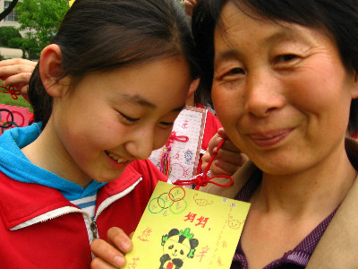
Warming up
1.What do you think of your mom?
2.What's your mom like in your eyes?

Slide 3
3a
Read the poem aloud and discuss what the title means with your partner.
Mom Knows Best
When I was a tiny baby crying all night, my mom sang to me and stayed by my side.
When I was tired and hungry, she gave me food and warm arms to sleep in.
When I was two running through the field, she made sure I was safe and kept me from danger.
When I fell and hurt myself, she gave me a hug and lifted me up.
When I was seven coughing badly, she said no ice-cream for me.
But I talked back loudly, “I should be allowed to eat some! Give it to me now!”

Slide 4
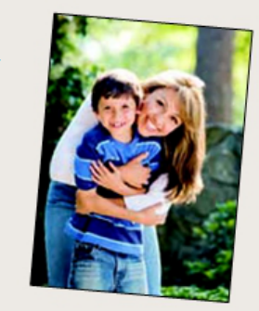
When I was nine watching scary movies, she said it’d give me awful dreams.
But I shouted back angrily, “I should be allowed to watch it! I’m not a baby!”
When I was a teen going out with friends, she said, “Please be
back by ten!”
But I talked back again — “I should not be told what to do!
I’m seventeen now!”
Now I’m an adult, thinking back to those times.
I coughed for days after eating that ice-cream
And had scary dreams after watching that film.
I was late for school from staying out past ten.
I regret talking back, not listening to Mom.
Mom knows best, and for me she wanted only the best!

Slide 5
3b
Read the poem again and answer the questions.
1. What did the mom do when the writer was a baby and a small child?
2. Why do you think the writer talked back to his mom when he was
seven and nine years old?
She sang to him and stayed by his side. She gave him food and warm arms to sleep in. She made sure he was safe and kept him from danger.
Because he thought he was not a baby, and he should be allowed to do those things.

Slide 6
3. How did the writer feel when he was a teenager and his mom
said“Please be back by ten”?
4. After reading the whole poem, how do you think the writer feels about
his mom?
He felt very angry.
His mother is a good mother. She knows best and for him she wanted only the best!

Slide 7
3c
Think about a time you did something even though your mom or dad told you not to do it. Share your story with your partner.

Slide 8
Language Points
1.When I was a tiny baby crying...当我还是小婴儿在哭叫中……（教材第51页）
be sb. /sth. doing ... 在做……
e.g.:It must be a man singing.
2.make sure 的用法
（1）make sure /be sure to do sth.保证做……
（2）make sure of sth.弄清，查明
（3）be /make sure +that 从句

Slide 9
3.keep sb./sth. away from... 让……远离……
e.g.:You must keep away from danger.
【拓展】keep up with 跟上；keep in touch with和……保持联系；keep sb. from doing sth.阻止……做……；keep (on) doing sth.不断做……
4.hurt的用法
(1) vt. 伤害
e.g.:I hurt my hand when I cooked.
(2) vi.疼（不跟宾语）
e.g.:My head hurts.=I have a headache.
(3) adj. 受伤的
一般使用sb./sb.’s part be /get hurt某人/某人的某个部位受伤。
e.g.:My feet are hurt.

Slide 10
5.back的用法
adv. 向后，回复
n.背
e.g.:He hits back.
【拓展】由back组成的短语：turn back转身；think back回想；talk back顶嘴；shout back回叫/对着叫喊。
6.regret 后悔，遗憾
regret doing sth.对做过的事情感到后悔/遗憾。
e.g.:I regret taking my mother’s money.

Slide 11
Exercise
一、根据汉语提示完成下列句子。（词数不限）
1.I often ____________ (回想到) my childhood(童年).
2.He wasn’t allowed ____________ (举起) the baby.
3.____________ (确保) you will be back before 6:00 p.m.
4.It’s impolite ____________ (顶嘴) to your parents.
5.You ____________ (不被允许) to be late for school.
think back to
to lift up
Make sure
to talk back
are not allowed

Slide 12
二、用所给单词的正确形式填空。
1.He regrets ________ (hurt) his mother when he talked back yesterday.
2.The two-year-old child fell and hurt _________ (him).
3.He thinks he shouldn’t ________(tell) what to do.
4.The boy had a dream about ________ (hug) his mother last night.
5.After ________ (eat) ice-cream,he began to cough.
hurting
himself
be told
hugging
eating

Slide 13
Homework
1.Learn and remember the new words and useful phrases by heart.
2.Retell the text according to the key words.

Slide 14
Thank you！

