Slide 1
Unit 10
I’d like some noodles.
R 七年级下册
第1课时
WWW.PPT818.COM

Slide 2
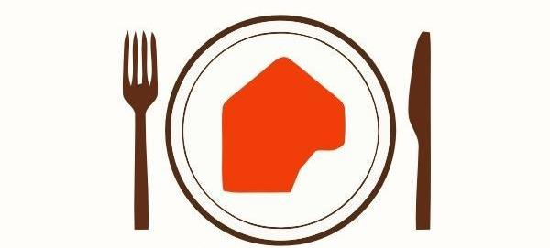
Lead-in
What would you like for lunch?

Slide 3
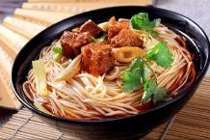
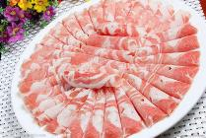
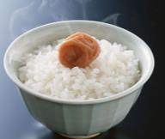
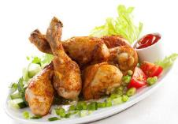
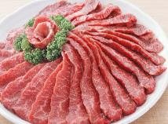

Slide 4
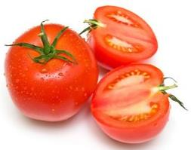
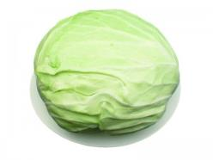
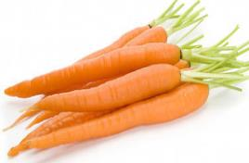
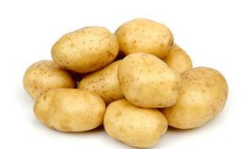

Slide 6
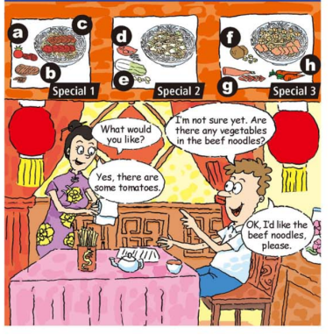
1a
Match the words with the foods.
g
mutton _____
beef _____
noodles _____
chicken _____
cabbage _____
potatoes _____
tomatoes _____
carrots _____
b
c
d
e
f
a
h

Slide 7
Language points
1. What would you like? 您想要点什么？
这是一个由疑问词what引导的特殊疑问句，用来询问对方想要什么。
回答：I’d like… 或直接说想要的东西。
would like （意愿）愿意；喜欢；想要，相当于want, 但比want 语气委婉。

Slide 8
搭配:
sth. 想要某物
to do sth. 想要做某事
sb.to do sth. 想要某人做某事
would like
would like 与 want 的区别:
would like 没有人称、单复数和时态的变化。
want 为实义动词，有人称、单复数和时态的变化。

Slide 9
2. I’m not sure yet. 我还没确定。
yet 为副词，意为“还；仍然；已经”，一般用于否定句或疑问句中，通常置于句末。
（1）肯定句中常用 still 表示“还，仍然”，用 already
表示“已经”。
not yet意为“还没有”，用于省略句中。
（2）yet 用作并列连词时，意为“然而；可是”。

Slide 10
still already yet
It’s time to go home, _________ I haven’t finish the homework. 该回家了，可是我还没完成作业。
yet
He is _________ at home now.
他现在还在家里。
It’s _________ dark.
天已经黑下来了。
still
already

Slide 11
3. Are there any vegetables in the beef noodles？
any 与 some
any 意为“一些；任何”。
①常用于否定句或疑问句中;
②可用于肯定句中，意为“任何，无论如何”。
例：Any color is OK. 任何颜色都可以。

Slide 12
some 意为“一些”。
①常用于肯定句中；
②在表示请求、希望得到对方肯定回答的问句中，表
示“一些”用some；
③可用于表示建议、邀请的疑问句中。

Slide 13
Can I have some rice, please? 我能要些米饭吗？
（表示请求）
Do you want some water? 你想喝点水吗？
（希望得到对方的肯定回答）
Would you like some apple juice? 你想要些苹果汁吗？
（建议）

Slide 14
4. beef noodles 牛肉面
beef noodles ＝ noodles with beef
名词 beef 作定语修饰名词 noodles，noodles为中心词，常用复数形式。
类似的有：tomato and egg noodles 西红柿鸡蛋面
girl student 女学生 apple tree 苹果树

Slide 15
拓展：
由 man 和 woman 修饰名词表明性别时，变复数时将名词及man或 woman都变为复数。
a man driver → men drivers 男司机
a woman teacher → women teachers 女教师

Slide 16
1b
Listen and check (√) the noodles that the
person orders.
____ Special 1 ____ Special 2 ____ Special 3
√

Slide 17
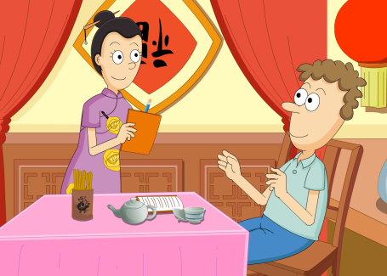
Practice the conversation in 1a with your partner. Then make your own conversations.
1c

Slide 18
I’m not sure yet. Are there any vegetables in the beef noodles?
What would you like?
OK. I’d like the beef noodles.
Yes, there are some tomatoes.

Slide 19
I’m not sure yet. Is there chicken in the noodles?
What would you like?

Slide 20
Yes, there is also cabbage in it.
That sounds good. I’d like it, please.

Slide 21
Listen and check (√) the names of the foods
you hear.
2a
√
√
1. _____ noodles 5. _____ tomatoes
2. _____ beef 6. _____ cabbage
3. _____ mutton 7. _____ potatoes
4. _____ chicken 8. _____ vegetables
√
√
√
√

Slide 22
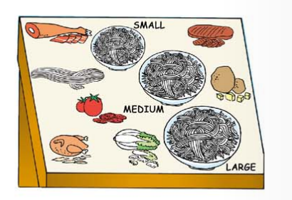

Slide 23
2b
Listen again. Complete the sentences.
Boy: 1. I’d like a ______ bowl of noodles.
2. I’d like ________, _______ and _________ noodles.
large
chicken potato cabbage
Girls: 1. I’d like a _________ bowl.
2. I’d like _______ and ________ noodles, please.
medium
beef tomato

Slide 24
Language points
What kind of noodles would you like?
what kind of 意为“什么样的，哪种”。
kind 可数名词，意为“种，种类”。
其常用短语有：
a kind of 一种 all kinds of 各种各样的
different kinds of 不同种类的

Slide 25
kind的常见搭配：
（1） different kinds of + n. 不同种类的……
作主语时，谓语动词用复数。
There are different kinds of clothes in the shop.
那个店里有不同种类的衣服。
（2） a kind of + n. 一种
作主语时，谓语动词用单数。
a kind of fish 一种鱼 a kind of drink 一种饮料

Slide 26
（3）all kinds of + n. 各种各样的……
作主语时，谓语动词用复数。
（4）kind of 有点儿；稍微
常用于口语中，后接形容词或副词。相当于a little,
a bit, a little bit。
（5）be kind to sb. 对某人友好
相当于be friendly to sb.

Slide 27
Ask and answer questions with your partner. Use the information in 2a.
2c
What kind of
noodles would
you like?
I’d like beef
noodles, please.

Slide 28
What size would you like?
I’d like a medium bowl of noodles.

Slide 29
I’d like chicken, potato and cabbage noodles, please.
What kind of
noodles would
you like?

Slide 30
2d
Role-play the conversation.
Listen and answer the questions.
What size of beef soup would they like?
They’d like a large bowl of beef soup.
What others would they like?
They’d like one gongbao chicken and one mapo tuofu with rice.

Slide 31
Waitress: Good afternoon. May I take your order？
Sally: Yes. Are there any vegetables in the beef soup?
Waitress: Yes. There are some tomatoes.
Sally: OK. We’d like one bowl of beef soup.
Waitress: Sure. What size would you like?
Sally: Large, please.

Slide 32
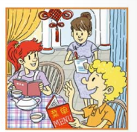
Tom: We’d also like gongbao chicken and some mapo
tofu with rice.
Waitress: OK. One large bowl of beef soup, one gongbao
chicken, and one mapo tofu with rice.
Tom: Yes, that’s right.

Slide 33
Language points
1. May I take your order? 您可以点菜了吗？
本句为餐馆里服务员常用语，用于询问客人现在是否需要点餐。
order 此处作可数名词，意为“点菜，订购”。
order 也可作动词，意为“点菜；预订”。

Slide 34
拓展：
order 作动词时还可意为“命令，嘱咐”。
常用结构为：order sb.to do sth.“命令某人做某事”。
The boss orders the workers to finish the work in one week. 老板命令工人们一周内完成这项工作。

Slide 35
2. We’d like one bowl of beef soup.
bowl 为可数名词，意为“碗”；
a bowl of 意为“一碗……”，其后通常接不可数名词，也可跟可数名词。
bowl 强调的容量而不是数量；表示复数概念时，直接将其变为复数即可。

Slide 36
拓展：
“冠词/数词+量词+of+名词”结构可以表达某物量的多少。 当数词超过“一”时，量词变为相应的复数形式。
There is a cup of water on the desk.
桌子上有一杯水。
I can carry three boxes of apples.
我能搬得动三箱苹果。

Slide 37
3.What size would you like? 你们要多大碗的？
“What size…？”是用来询问物体大小、尺寸、规格的常用句型。
What size of collar is this shirt?
这件衬衫领子的尺寸是多少啊？
例句：

Slide 38
size 是名词，意为“大小；尺码”, 既可表示物体的大小，又可表示服装、鞋帽等的尺码等。
衣服的尺寸：
S = small size 小号
M = medium size 中号
L = large size 大号

Slide 39
4. We’d also like gongbao chicken and some mapo tofu
with rice.
with用作介词，意为“同，跟，和……一起”。
Can you go to the cinema with me?
你能和我一起去看电影吗？
I’d like a hamburger with a cup of coke.
我想要一个汉堡包外加一杯可乐。

Slide 40
拓展：with 的用法
（1）with意为“具有；带有”。
He lives in a room with two beds.
（2）with可作状语,表示伴随等。
Miss Li walks into the classroom with a smile on
her face.
（3）with意为“以（手段、材料），用（工具）”。
We eat with chopsticks.

Slide 41
Exercise
单项选择。
1. —Would you like some beef?
—_______.
A. Yes, I would B. No, I wouldn't
C. Yes, please D. Thanks
C

Slide 42
2. There are _____ hamburgers in our restaurant.
Would you like ______？
A. some; some B. some; any
C. any; any D. any; some
A
3. Meimei is a beautiful girl _____big eyes and dark hair.
A. in B. on
C.at D. with
D

Slide 43
4. — _______ bowl of mutton soup would you like?
—A big bowl, please.
A. What size B. What big
C. How much D. How size
A

Slide 44
按照要求完成句子。
1. She’d like a story book. (改为一般疑问句)
______ she ______ a story book?
2. Kate would like something to eat. (改为同义句)
Kate ______ something to eat.
Would like
wants

