Slide 1
Unit 6
An old man tried to move the mountains.
Section B 第三课时
WWW.PPT818.COM

Slide 2
本单元以“传统经典故事”为话题而展开讨论，谈论了故事的主要内容、精彩片断等。具体到书面表达中，要求同学们会缩写一个经典故事。在写作时，首先要把故事的主要角色写出来，其次简单介绍故事发展的过程，最后写出故事的结局或蕴含的道理。注意描述故事应用一般过去时。
教材中出现的相关句型：
①Once upon a time，there was a very old man.从前，有一个老人。
②Yu Gong found a good way to solve his problem.愚公找到了一个解决问题的好方法。
③Yu Gong kept trying and didn't give up.愚公继续尝试，从不放弃。
④Sun Wukong can make 72 changes to his shape and size，turning himself into different animals and objects.孙悟空能够在形状和大小上72变，把他自己变成不同的动物和物体。
⑤Sometimes he can make the stick so small that he can keep it in his ear.有时他能把金箍棒变得很小，以至于可以放进他的耳朵里。

Slide 3
句型拓展：
①The story is trying to show us that anything is possible if you work hard！这个故事尽全力向我们展示了如果你努力了，什么事情都是有可能的。
②This story reminds us that you can never know what's possible unless you try to make it happen.这个故事提醒我们除非你尽力使它发生，否则你就不会知道什么是可能。
③Western children became interested in reading this story because the clever Monkey King keeps fighting to help the weak and never gives up.西方国家的孩子对读这个故事很感兴趣，是因为猴王为帮助弱者一直战斗着，从不放弃。

Slide 4
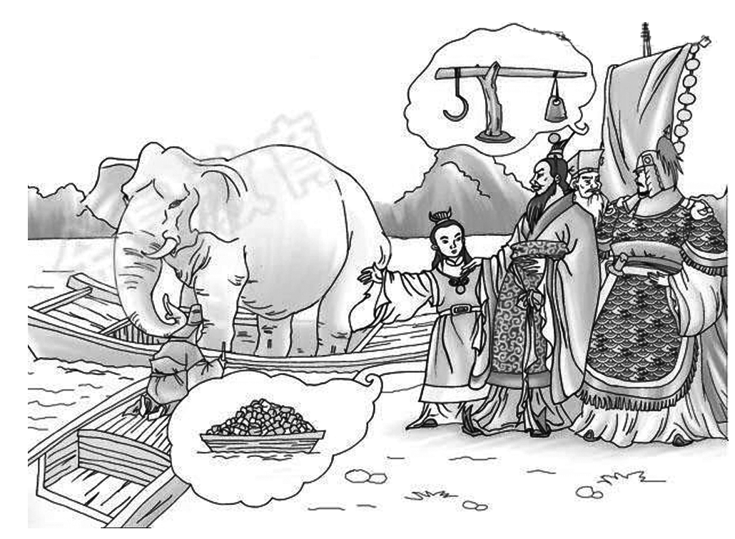
内容要点：1.回信目的；
2．故事简介；
3．故事给你的启示。
注意：1.信中不允许出现与考生本人相关的真实姓名和校名等信息。
2．信的开头已给出，不计入总词数。
3．参考词汇：scale n．称；calculate v．计算

Slide 5
Dear_Lucy，
I_learn_from_your_letter_that you are very interested in the story of Cao Chong weighed the elephant.Let me tell you：
Once somebody sent Cao Chong's father，Cao Cao，an elephant and he wanted to know its weight，but there was nothing big enough to weigh it.Cao Chong told his father he could weigh the elephant if he had a big boat and a lot of heavy stones.Cao Cao was very surprised，but he still ordered his men to get everything ready.When they led elephant down into the boat，the water came up，then Cao Chong marked the water line.Then they drove the elephant onto the bank and put the heavy stones in the boat until the water came up to the same line.At last，Cao Chong told the men to weigh the stones.In this way，he weighed the elephant.
I think Cao Chong is very clever.If we think hard before doing things，we can do them better.
Yours，
Thought

Slide 6
【点评】书信第一段表明写信目的：讲述曹冲称象的故事，开门见山，直奔主题。第二段讲述曹冲称象的故事，用and，but，when，then，at last等引出故事，层次清楚，语言表达准确。第三段说明只要肯动脑，就可以把事情做好，突出并升华了故事主题。

Slide 7
Name | Journey to the West
The writer | Wu Cheng'en
The status (地位) | One of the four greatest classical (古典) Chinese novels
Background (背景) | A true story of a Chinese monk named Xuan Zang who went for some Buddhist scriptures (佛经)
Main characters | Monk Tang (kind)，Monkey King (brave)，Pigsy (funny)，Sandy (serious)
Your opinion | ...

Slide 8
Reading is a good hobby.Today I'll talk about a famous Chinese novel.
Journey to the West is one of the four greatest classical Chinese novels.The writer is Wu Cheng'en.It is about a true story of a Chinese monk，Xuan Zang.He went to the west for some Buddhist scriptures.It shows us some lovely characters：the kind Monk Tang，the brave Monkey King，the funny Pigsy and the serious Sandy.I watched the TV series when I was very young，but now I find the book is much more interesting.No matter how many difficulties we meet，we should find a way and never give up.
I hope everyone can read and enjoy this novel.

