Slide 1
Module 3 Unit 1
The sun is shining.
WWW.PPT818.COM

Slide 2
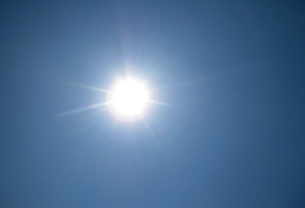
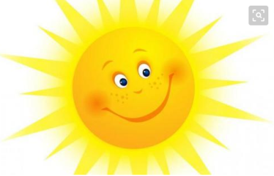
Warm up
It is sunny.
The sun is shining.
shine
（太阳）发光，照耀

Slide 3
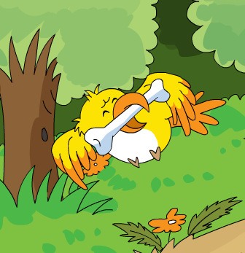
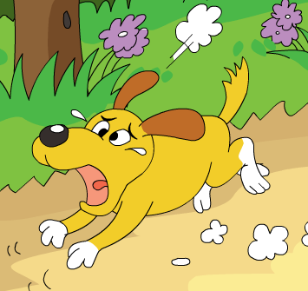
The bird is flying.
The dog is crying.

Slide 4
fly
y
cream
cr

Slide 5
Let's learn.
The sun is shining.
The bird is flying.
The dog is crying.
现在进行时：表示现在或当前正在进行的动作。
构成：主语+ be +动词ing。

Slide 6
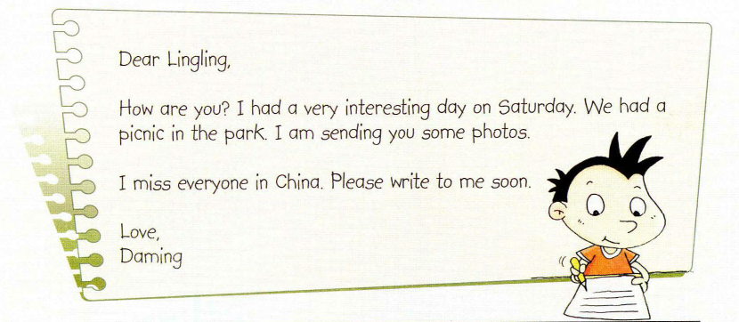
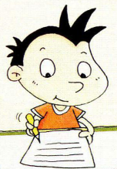
Daming is writing a letter to Lingling.

Slide 7
Presentation
Listen and answer.
1. Did Daming have a interesting day?
2. What is he sending?

Slide 8
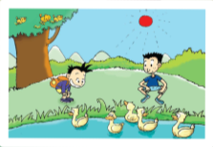
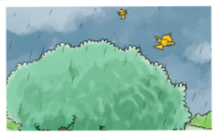
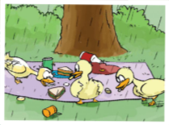
Listen and answer.
1. Did Daming have a interesting day?
Yes, he did.
2. What is he sending?
He is sending some photos.

Slide 9
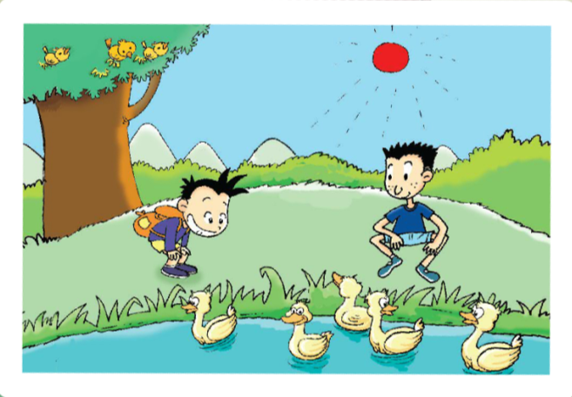
The sun is shining.
In this photo.
The birds are singing in the tree.
We are looking at some ducks.
They look hungry.
The ducks are swimming.

Slide 10
The birds are flying away.
In this photo.
It's starting to rain.

Slide 11
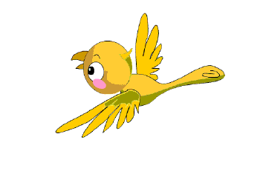
fly
away
飞走

Slide 12
In this photo.
The ducks are eating our sandwiches.

Slide 13
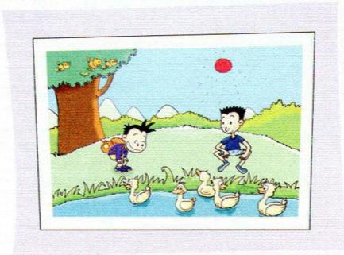
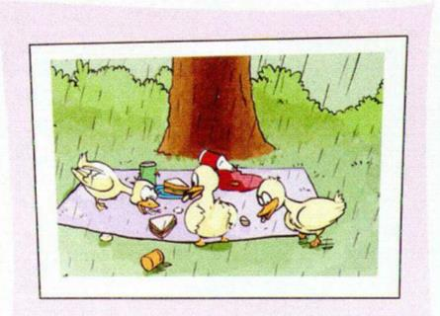
Practice
look and say.

Slide 14
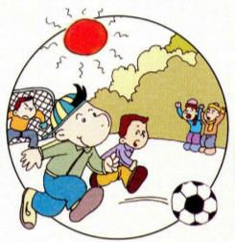
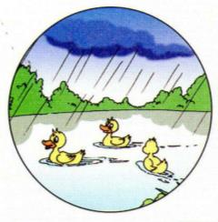
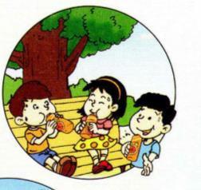
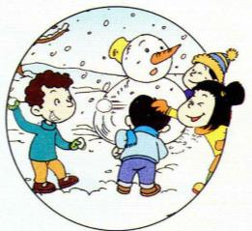
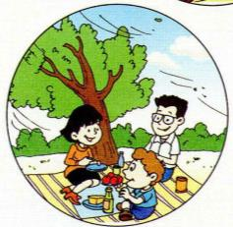
Let's practise.
描述图片。

Slide 15
In this photo,
it's raining.
The ducks are swimming on the pond.

Slide 16
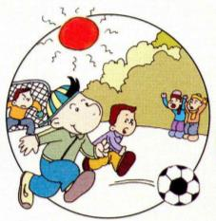
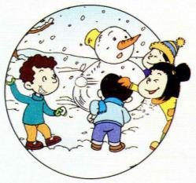
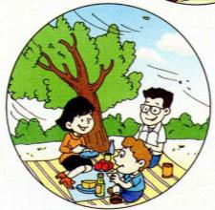
Let's practise.
In this photo, …

Slide 17
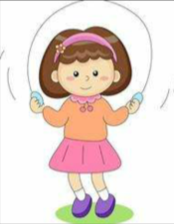
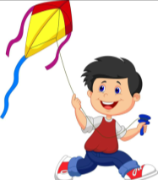
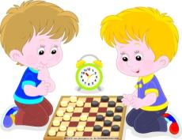
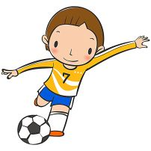
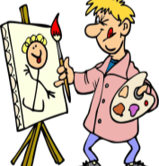
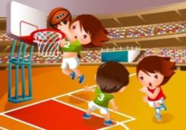
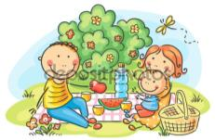
Look and say.
1
2
3
4
5
6
7
8
9

Slide 18
Summary
Summary
What have you learnt?
你学到了什么？

Slide 19
Summary
What have you learnt?
你学到了什么？
现在进行时：
主语 + be +动词ing
单词：
shine, cry, fly away, just, everyone
句型:
I am sending you some photos.
The sun is shining.
The birds are singing in the tree.

Slide 20
Emotional education
World is full of beauty.
Be good at finding beauty.

Slide 21
Homework
Read the text.
Introduce the photos in the book to your friends or parents.
Find some photos, and try to introduce them in English.

