Slide 1
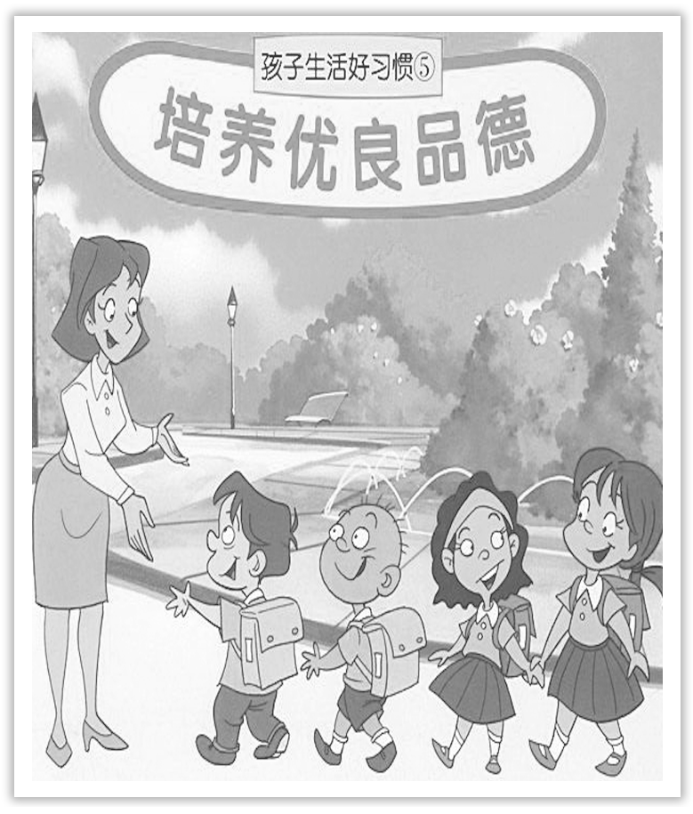
Unit 2 Morals and Virtues
Section Ⅵ The Rest Parts of the Unit(P_{20～24})
WWW.PPT818.COM

Slide 2
Ⅰ.单词语境记忆——根据英汉提示写出单词的适当形式
1.The robbers ____________(装扮) themselves as security guards.
2.There was a fire in our street，but no one was ____________(伤害).
3.We need a foreign policy that is more ____________(灵活的).
4.He was ill，and ____________(因此) could not come.
5.As soon as he entered，he sensed a ____________(紧张) in the air.
disguised
harmed
flexible
therefore
tension

Slide 3
Ⅱ.短语语境填空——根据汉语提示写出适当的短语
1.Mind you，don’t ________________(被……绊倒) these roots; they’re difficult to see under all these leaves.
2.Shocked by the sad news，she broke out ________________(流着泪).
3.It is likely that he will give up ________________(绝望中).
4.Exercising the body does ________________(大量) to improve one’s health.
trip over
in tears
in despair
a great deal

Slide 4
Ⅲ.句式语境仿写
If not，we surely must find the owner，for he will certainly miss it.
如果不是(你)，我们一定要找到失主，因为他一定会发现它遗失的。
[仿写] 只要你在使用电器设备，你便可以把它开着，如果不用就把它关掉！
It is OK to leave an electrical appliance on so long as you are using it—___________，turn it off！
if not

Slide 5
记单词
Ⅰ.语境串记多义词
1.She disguised herself as a man，but she couldn’t disguise her voice.
她假扮成男人，但改不了声音。
2.Take away the complaint，“I have been harmed，” and the harm is taken away.
丢开“我受到了伤害”的抱怨，这伤害也就消失了。

Slide 6
Ⅱ.合成词一族
in＋come→income(n.)
there＋fore→therefore(adv.)
句型公式
if not如果不这样的话，不然，表示否定意义；if so 如果这样的话，表示肯定意义。

Slide 7
1.disguise vt.装扮；假扮；掩盖 n.伪装；化装用具
Early one morning，the king disguised himself and went to a local village.(教材P₂₀)
一天清晨，国王乔装打扮去了当地的一个村庄。
[合作探究] 体会disguise的用法和意义
①The star travelled in disguise.
这个明星____________出游。
②He disguised himself as a girl.
他装扮成一个女孩。
化装

Slide 8
[自主发现]
③____________ disguise 伪装，化装
④disguise oneself ____________ 装扮成
[词块积累]
speak without disguise毫不掩饰地说
see through his disguise 看穿他的伪装
disguise a fact 隐瞒事实
[巩固内化] 单句语法填空
①He went among the drug dealers ____________ disguise.
②He disguises himself ____________ a soldier.
in
as
in
as

Slide 9
2.trip over 被……绊倒
One woman tripped over the stone and her water pot went crashing to the ground.(教材P₂₀)一位妇女被石头绊倒，她的水壶哗啦一声掉在地上。
①He started running to catch the bus but tripped over a stone and fell down.
他开始跑着赶公交车，但被一块石头绊倒了。
[短语记牢] 记牢下列短语
trip up 绊倒；跌倒；(使)犯错误
②Jim was running well until he tripped up and fell，losing the race.
比赛中吉姆一直跑得很好，可后来跌倒在地，输了比赛。

Slide 10
[词块积累]
trip over these roots被那些树根绊倒
trip and fall 绊倒
[巩固内化] 副词填空
①The hard math problem tripped __________ most of the students.
②I was so unlucky today.I tripped ____________ a stone.
up
over

Slide 11
3.harm n.& vt.损害；伤害 harmful adj.有害的 harmless adj.无害的
Is there no one in this village who feels any responsibility to keep their neighbours from harm? (教材P₂₀)这个村子里难道没有人觉得有责任不让邻居受到伤害吗？
[合作探究] 体会harm的用法和意义
①Keep away from such things as you think will do you harm.
远离你认为____________的这样的事情。
②There is no harm in saying sorry to her first.＝It does no harm to say sorry to her first.对她先说对不起也无害。
对你有伤害

Slide 12
[自主发现]
③do harm ____________ sb/sth＝do sb/sth harm 对……造成伤害
④There is no harm ____________ (one’s) doing sth＝It does no harm (for sb) ____________ sth(某人)做某事并无害处。
to
in
to do

Slide 13
[巩固内化]
单句语法填空/同义句转换
①What should be done to punish people who do harm ____________ the animals?
②They killed the ____________(harm) old man in cold blood.
③Drinking too much ________________________ our health.
→Drinking too much ________________________ our health.
喝酒太多对我们的身体有害。
to
harmless
does harm to
is harmful to

Slide 14
4.a great deal (of)许多；大量
After a great deal of effort，she finally succeeded in moving it to the side of the street.(教材P₂₀)经过很大的努力，她终于成功地把它搬到了街道的一边。
[合作探究] 体会a great deal (of)的用法和意义
①I think he sang a great deal better than I.
我认为他唱得比我好多了。
②A great deal has been studied and this is the best way.
经过____________研究后，这(被认为)是最好的办法。
③A great deal of their work is unfinished.
他们的大部分工作还没有完成。
大量

Slide 15
[自主发现]
④a great/good deal，用作副词短语时，可用于修饰形容词、副词比较级来加强程度，也可以用来修饰动词作____________。
⑤a great deal用作名词短语时，意为“大量，许多”作主语或者____________。
⑥a great/good deal of 许多的，大量的，只能修饰____________。
状语
宾语
不可数名词

Slide 16
[词块积累]
laugh a great deal 笑了很久
convey a great deal 传达许多信息
write a great deal of poetry 创作大量的诗歌
[巩固内化] 补全句子
①I also had friends who gave me ____________________________.
我还有些朋友给了我很多鼓励。
②She is ______________________ today than she was yesterday.
她今天身体比昨天好多了。
a great deal of encouragement
a great deal better

Slide 17
5.If not，we surely must find the owner，for he will certainly miss it.(教材P₂₀)
如果不是(你的)，我们一定要找到失主，因为他一定会发现它遗失的。
【句式解读】 句中if not 是if this gold doesn’t belong to you 的省略形式，表示否定意义。
【用法总结】
if not如果不这样的话，不然，表示否定意义
if so 如果这样的话，表示肯定意义
if any 如果有的话
if ever 如果有过或发生过的话
if necessary/possible 如果有必要/可能

Slide 18
①Are you ready？If so，let’s set off at once.
你准备好了吗？如果准备好了，我们立刻出发。
②She wants to go with us，if possible.
可能的话，她想跟我们一起去。
③My mother seldom，if ever，goes to the cinema.
我母亲难得看场电影。

Slide 19
[巩固内化] 补全句子
①I think there’s a bullet train at midday.________________，you will have to wait till 2 o’clock in the afternoon.
我想正午会有一辆动车。要是没有，你只好等到下午2点了。
②Wash it in water，pick out the small particles，___________.
用清水冲洗它，如果有的话，把小颗粒拣出来。
③They think she may try to phone.________________，someone must stay here.
他们认为她可能来电话，要是这样的话，就得有人守在这儿。
If not
if any
If so

Slide 20
6.therefore adv.因此；所以；因而
...and therefore the public would continue to receive good health services.(教材P₂₂)……因此，公众将继续得到良好的卫生服务。
[合作探究] 体会therefore的用法和意义
①Therefore，it is our wish that these people could be happy and enjoy high welfare standards.因此，我们希望这些人会幸福，享受高标准的福利待遇。
②Everything works out well，and therefore we are sure that the experiment will be completed on time.
一切进行得很顺利。____________，我们确信实验能按时完成。
因此

Slide 21
[自主发现]
③therefore是____________词，当therefore在整句中时，它一般不放句末，放在句首后要有逗号。
④当therefore用在分句中时，即一个句子一部分表示原因一部分表示结果。若第二个分句前是逗号或无符号，则要注意therefore是副词，和so不一样，要保持句子完整，应用____________。
副
and therefore

Slide 22
[巩固内化] 补全句子
①She was caught cheating in the exam，________________ she was punished by her teacher.
她考试作弊受到了老师的惩罚。
②He ____________ gives millions of yuan to equip others for their research in agriculture.
于是他拿出几百万元帮助其他人进行农业科学研究。
and therefore
therefore

