Slide 1
Unit 3 Writing Home
Lesson 18 Little Zeke Sends an Email
WWW.PPT818.COM

Slide 2
Warming up
Greeting
Would you like to write an email to your friend?
What do you want to write?

Slide 3
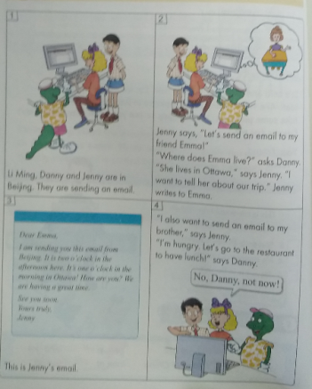
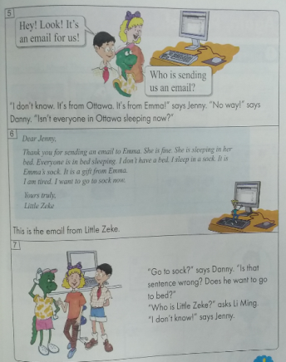
Warming up
Little Zeke Sends an Email

Slide 4
Leading in
Do you like writing emails?
What do you often write?
Who do you write emails to?

Slide 5
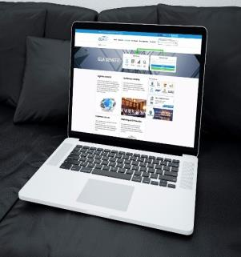
Presentation
1
我们用什么写电子邮件？
We can use the computer.
2
我们必须填写地址吗？
No, we needn’t.
3
邮件的正文需要写很长吗？
No, it isn’t.

Slide 6
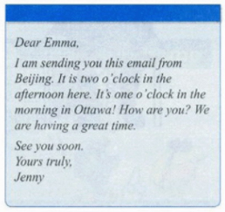
Presentation
What does Jenny write in her email?
She writes…

Slide 7
Consolidation and extension
Talk and complete the chart
Who to write to | What to write | What to hope
friend
my life
happy

Slide 8
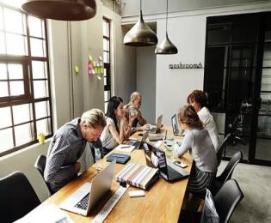
Consolidation and extension
You can use the following sentences:
Who do you often write an email to?
To…
What do you often write in your email?
I often write…

Slide 9
Summing up
重点句型：
send…to
Can you send this letter to your teacher?
have a great time
They had a great time in London.
have lunch
They usually have lunch at twelve.
thank…for
Thank you for your help.

Slide 10
Evaluation
内容 | 学生A | 学生B | 学生C | 学生D
积极发言
乐于合作
完成情况

Slide 11
Homework
用英语给自己的家人写一封电子邮件
总结常用句式

