Slide 1
人教精通版五年级上册
unit3 My father is a writer.
WWW.PPT818.COM

Slide 2
>>Warm-up
Let’s sing

Slide 3
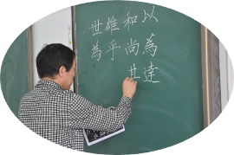
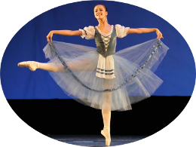
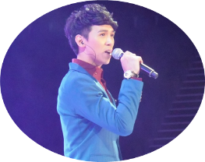
>>Review
Look and say
This is my ... He / She’s a …

Slide 4
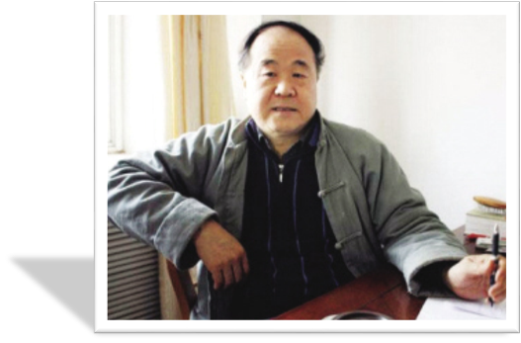
>>Lead-in
Look and say
Who is he? What does he do?
He is Mo Yan.
He is a writer.

Slide 5
>>Lead-in
Free talk
Is your father a writer?
Do you want to be a writer?
What do you want to be?

Slide 6
>>Presentation
Look and say
worker
My father is a factory worker.

Slide 7
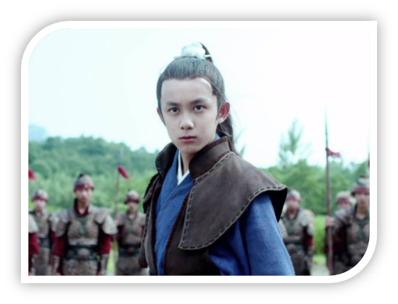
>>Presentation
Look and say
What does he do?
He is .
an
actor

Slide 8
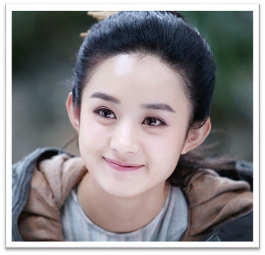
>>Presentation
Look and say
What does she do?
an
She is .
actress
I want to be an actress, too. What about you?

Slide 9
>>Presentation
Look and say
This is Wei Min. What do you want to know about him?

Slide 10
>>Presentation
1. How old is he?
2. What class is he in?
Read and answer
He’s eleven.
He’s in Class Three, Grade Five.

Slide 11
>>Presentation
Read and answer
3. What does his father do?
4. Is his mother an actress?
5. What does Wei Min want to be in the future?
He’s an actor.
No. She’s a factory worker.
He wants to be an actor.

Slide 12
>>Presentation
Think and say
What do you want to be in the future?

Slide 13
>>Presentation
Just talk
Listen and imitate
Wei Min: Hello, everyone! My name is Wei Min. I’m
eleven. I’m a student in Class Three,
Grade Five. Let me introduce my parents
to you. This is my father and this is my
mother.
Hostess: What does your father do?
Wei Min: He’s an actor.

Slide 14
>>Presentation
Just talk
Listen and imitate
Hostess: Is your mother an actress?
Wei Min: No. She’s a factory worker.
Hostess: What do you want to be in the future?
Wei Min: I want to be an actor.
Hostess: That’s a good idea.

Slide 15
>>Practice
Show time
小组合作，练习对话并表演，其他同学评价。
Pronunciation (语音) |  | Fluency (流利) | Cooperation (合作)
OK!
Great!
Super!

Slide 16
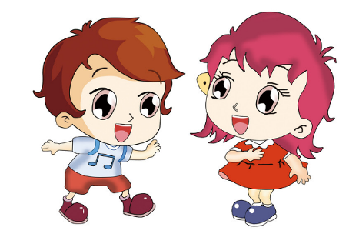
>>Practice
Pair work
说一说父母的职业吧
A: What does your father/mother do?
B: He/She is a/an ….

Slide 17
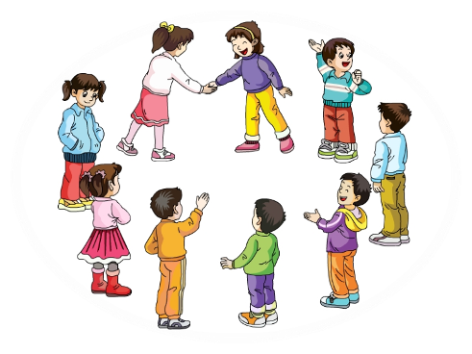
>>Practice
Group work
句子接龙
I want to be a singer. What about you?
I want to be a teacher. What do you want to be?
I want to be …

Slide 18
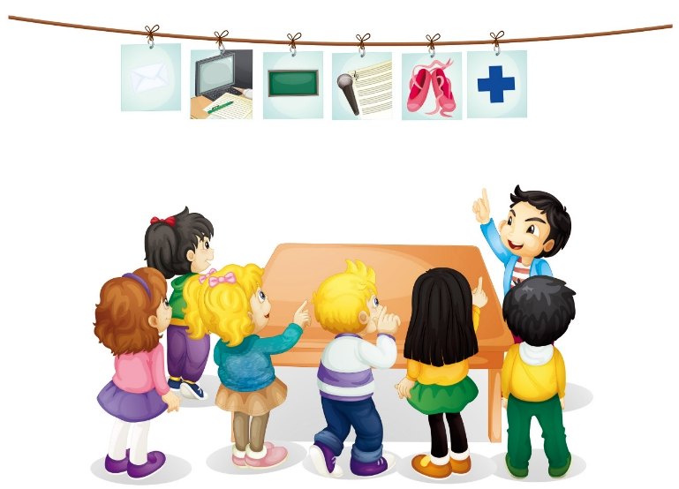
>>Practice
Let’s play
1
2
What does your mother do?
Look at this.
4
No!
3
6
Is she a nurse?
Yes!
5
Is she a doctor?

Slide 19
>>Practice
Let’s chant

Slide 20
>>Summary
本课学习的职业类单词有：
work actor actress
如何询问和介绍他人的职业，并表达自己的职业梦想呢？
—What does …(your father) do?
—(My father)… is a / an …
—I want to be a / an …

Slide 21
>>Homework
1.观看课文动画，按照正确的语音、语调朗读课文对话。 2.运用本课所学句型，询问你的爸爸妈妈或亲戚朋友他们的职业，并制成一张调查表。
3.预习 Lesson17。

