Slide 1
Section Ⅲ Developing ideas
WWW.PPT818.COM

Slide 7
教材原句
Only metres away from me was a bear.
离我只有几米远的地方有只熊。
句式解构
本句是一个倒装句，“only ＋状语”位于句首引起部分倒装。
佳句背诵
Only in this way, can we realize our dreams.
只有通过这种方式，我们才能实现梦想。

Slide 8
教材原句
With water falling off its thick, brown hair, the bear stared back at me.这只熊回头看着我，水从它厚厚的棕色的毛上落下来。
句式解构
with 复合结构：with＋宾语＋宾补(现在分词)。
佳句背诵
He fell asleep with the lamp burning.
他没关灯就睡着了。
教材原句
It is after all we who are the visitors to their world.毕竟我们才是它们世界的访客。
句式解构
强调句型：It is＋被强调部分＋that/who＋其他部分。
佳句背诵
It is Mary and Tom who often do good deeds.
是玛丽和汤姆经常做好事。

Slide 19
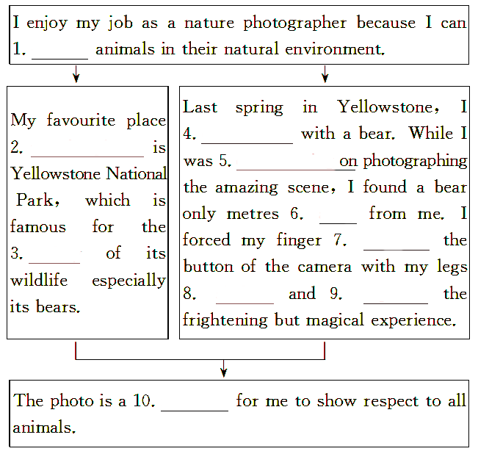

Slide 44
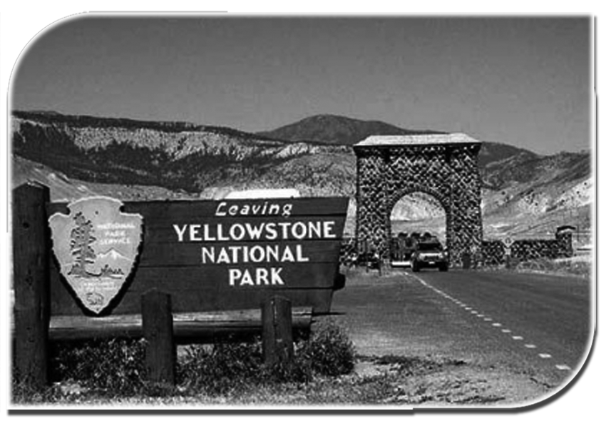

Slide 47
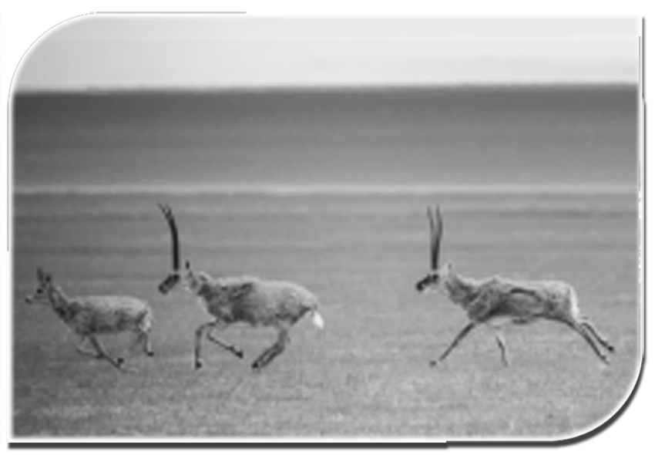

Slide 50
谢 谢 观 看

