Slide 1
您好, 我是甄美丽
HELLO WORLD
感谢您在百忙中浏览我的作品集

Slide 2
单张作品
MY WORKS
The young always have a lot of things we can not retain, such as far away time, such as the withered emotions; there is always a lot of things hard to forget, such as chasing dreams, such as the heart of love; facing the unknown factors on the road ahead, not when the walk, don't love the scenery, do not look back to travel simple; do it yourself, there is always a door open for dream.

Slide 3
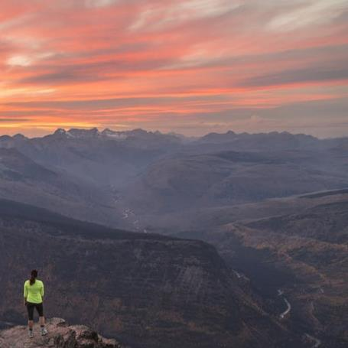
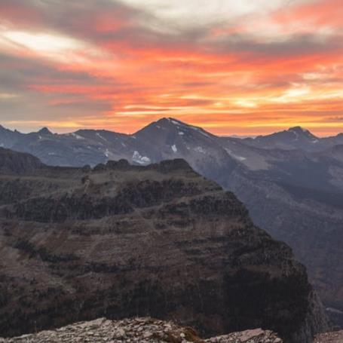
两张作品
The young always have a lot of things we can not retain, such as far away time, such as the withered emotions; there is always a lot of things hard to forget, such as chasing dreams, such as the heart of love; facing the unknown factors on the road ahead, not when the walk, don't love the scenery, do not look back to travel simple; do it yourself, there is always a door open for dream.

Slide 4
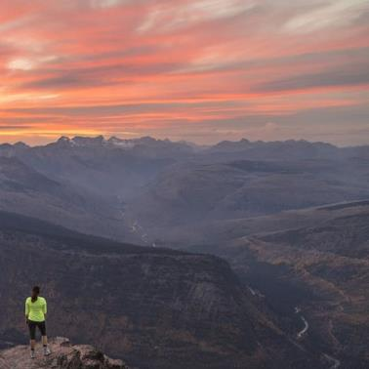
三张作品
The young always have a lot of things we can not retain, such as far away time, such as the withered emotions; there is always a lot of things hard to forget, such as chasing dreams, such as the heart of love; facing the unknown factors on the road ahead, not when the walk, don't love the scenery, do not look back to travel simple; do it yourself, there is always a door open for dream.

Slide 5
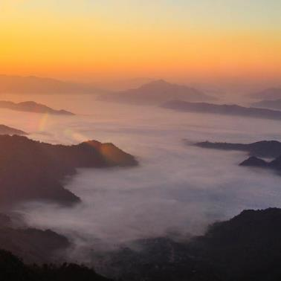
四张作品
The young always have a lot of things we can not retain, such as far away time, such as the withered emotions; there is always a lot of things hard to forget, such as chasing dreams, such as the heart of love; facing the unknown factors on the road ahead, not when the walk, don't love the scenery, do not look back to travel simple; do it yourself, there is always a door open for dream.

Slide 6
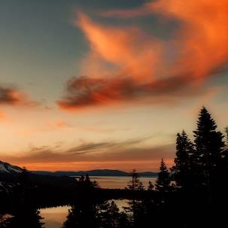
五张作品
The young always have a lot of things we can not retain, such as far away time, such as the withered emotions; there is always a lot of things hard to forget, such as chasing dreams, such as the heart of love; facing the unknown factors on the road ahead, not when the walk, don't love the scenery, do not look back to travel simple; do it yourself, there is always a door open for dream.

Slide 7
我是甄美丽
· 身高：173cm · 最高学历：硕士
· 民族：汉族 · 现居城市：江苏-南京市
· 手机号码：186 025 88888
· 电子邮箱：jobs@docer.com
· 首次工作：2001-5或应届
· 婚姻情况：已婚已育或未婚
The young always have a lot of things we can not retain, such as far away time, such as the withered emotions; there is always a lot of things hard to forget, such as chasing dreams, such as the heart of love; facing the unknown factors on the road ahead, not when the walk, don't love the scenery, do not look back to travel simple; do it yourself, there is always a door open for dream.

Slide 8
谢谢
感谢您在百忙中浏览我的作品集

