Slide 1
Unit 2 Feelings
He's excited
WWW.PPT818.COM

Slide 2
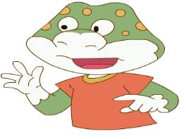
Danny looks happy, too.
cook
book
took

Slide 3
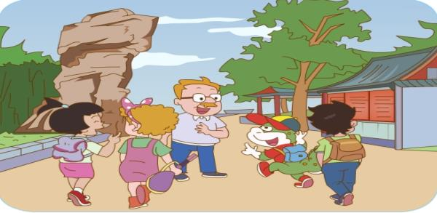
cook
took
book
Danny looks so happy. Why?

Slide 4
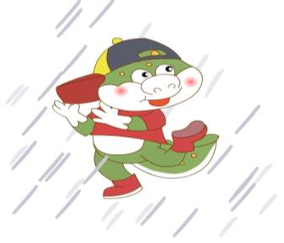
Listen and answer.
Oh, It’s raining. What’s Danny doing there?

Slide 5
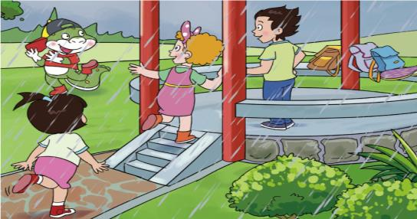
Ask and answer.
He’s dancing in
the rain.
He’s excited.
What’s Danny
doing there?
PPT模板：www.1ppt.com/moban/ PPT素材：www.1ppt.com/sucai/
PPT背景：www.1ppt.com/beijing/ PPT图表：www.1ppt.com/tubiao/
PPT下载：www.1ppt.com/xiazai/ PPT教程： www.1ppt.com/powerpoint/
资料下载：www.1ppt.com/ziliao/ 个人简历：www.1ppt.com/jianli/
试卷下载：www.1ppt.com/shiti/ 教案下载：www.1ppt.com/jiaoan/
手抄报：www.1ppt.com/shouchaobao/ PPT课件：www.1ppt.com/kejian/
语文课件：www.1ppt.com/kejian/yuwen/ 数学课件：www.1ppt.com/kejian/shuxue/
英语课件：www.1ppt.com/kejian/yingyu/ 美术课件：www.1ppt.com/kejian/meishu/
科学课件：www.1ppt.com/kejian/kexue/ 物理课件：www.1ppt.com/kejian/wuli/
化学课件：www.1ppt.com/kejian/huaxue/ 生物课件：www.1ppt.com/kejian/shengwu/
地理课件：www.1ppt.com/kejian/dili/ 历史课件：www.1ppt.com/kejian/lishi/

Slide 6
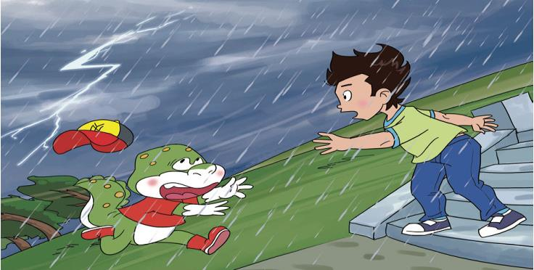
Danny, come
back!
Help. The sky
is angry.

Slide 7
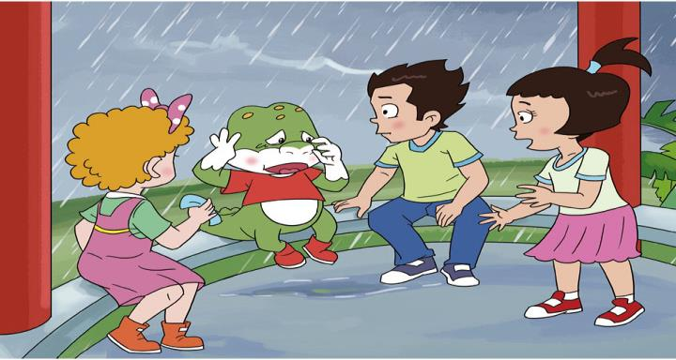
Why is Danny sad?
mad
had
bad

Slide 8
Read and answer.

Slide 9
Why is Danny sad?
Don’t be sad. We can help you.
Oh, no! I’ve
lost my cap.

Slide 10
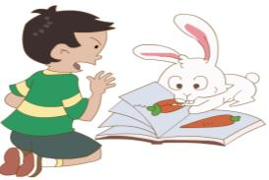
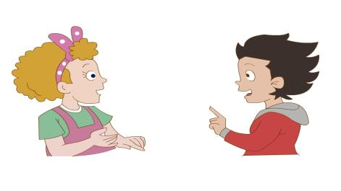
Let’s talk.
What’s he doing?
He’s looking at the
rabbit. He’s angry.

Slide 11
