Slide 1
Unit 4 Topic 2
How can we protect ourselves from the earthquake?
Section A
WWW.PPT818.COM

Slide 2
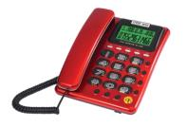
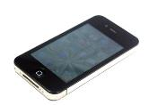
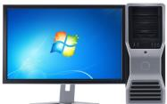
Let's talk
The telephone is useful.
telephone
The mobile phone is ___________ than the telephone.
more useful
mobile phone
The computer is _______________ of the three.
the most useful
computer

Slide 3
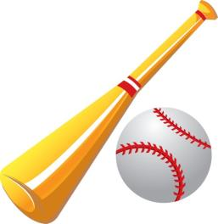
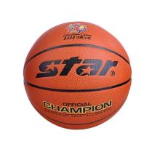
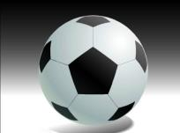
Ask and answer with your partner according to 2b.
dangerous
football
basketball
baseball
A：The __________ is dangerous.
B: I think the ________ is more dangerous than the ________.
C: Yes, but the _________ is the most dangerous of the three.

Slide 4
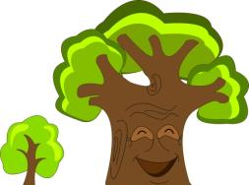
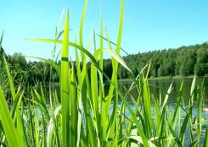
Ask and answer with your partner according to 2b.
beautiful
trees
grass
flowers

Slide 5
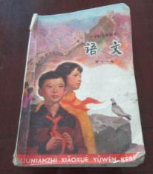
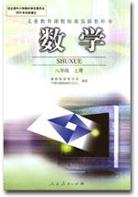
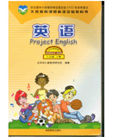
Ask and answer with your partner according to 2b.
important
Chinese
math
English

Slide 6
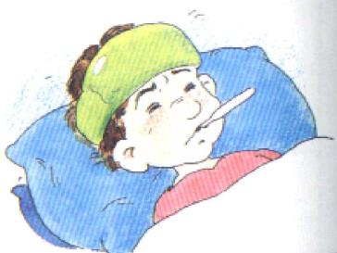
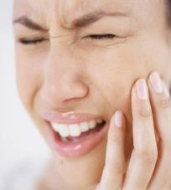
Ask and answer with your partner according to 2b.
terrible
cold
toothache
fever

Slide 7
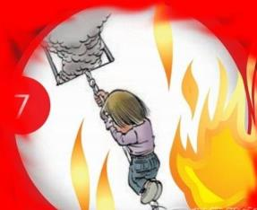
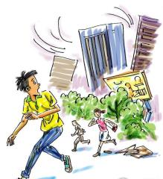
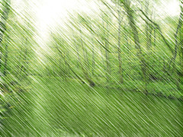
Ask and answer with your partner according to 2b.
serious
fire
earthquake
rainstorm

Slide 8
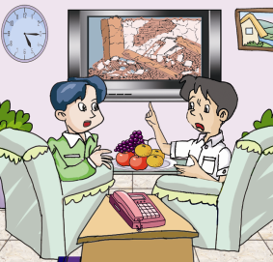
Let's know more about earthquakes.
1b
Look the flash of 1a and choose the correct answer.
Kangkang and Li Ming are talking
about _______.
ways to protect us from earthquakes
the earthquakes in China
the number of buildings falling down
the missing people in earthquake

Slide 9
1c
Listen and complete the table.
Earthquake | Year | Degree | Fact
 | 2010 |  | buildings _____________ some people __________ many people ___________
Wenchuan earthquake |  | more serious
 |  |  | 240 000 people __________________
fell down
Yushu earthquake
serious
died
were missing
2008
Tangshan earthquake
the most serious
1976
lost their lives

Slide 10
Pair work
Act out the dialog in pairs.

Slide 11
Key points
lose one’s life 失去生命
protect sb. from 保护……免受……
Eg: 戴太阳镜可以保护眼睛不受伤害。
Wearing sunglasses can ____________________
the sunshine.
3. ask sb. for help 向某人求助
Eg: 当我们处于危险时，可以向警察求助。
We can _____________________ when we are in
danger.
protect our eyes from
ask the police for help

Slide 12
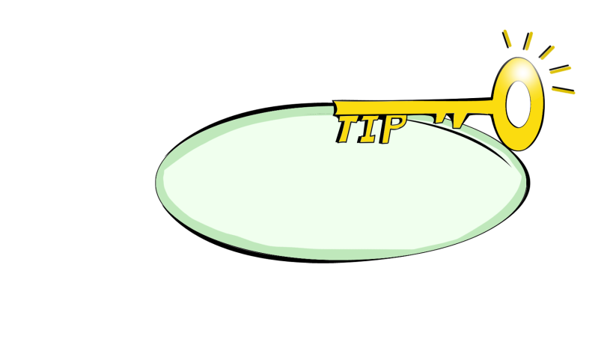
Find out the comparative and superlative degrees in 1a.
more serious the most serious
Work out your own grammar rules and check them with your teacher and classmates.

Slide 13
sum up
多音节词和部分双音节词：
在词前加more/the most。
delicious—
interesting—
carefully—
popular—
careful—
more delicious— the most delicious
more interesting—the most interesting
more carefully—the most carefully
more popular—the most popular
more careful—the most careful

Slide 14
2a
Study the rules and complete the table.
Adjective | useful | serious | dangerous | beautiful | important | terrible
Comparative | more useful
Superlative | most useful

Slide 15
Listen to the passage and complete the table.
3
Bad News
What | The T16 ______ from Guangzhou to Beijing will be ＿＿＿.
Why | a ＿＿＿＿ snowstorm
Passenger | stay for about ＿＿＿ hours
Station | prepare ＿＿＿ and ＿＿＿＿
train
late
terrible
eight
food
drinks

Slide 16
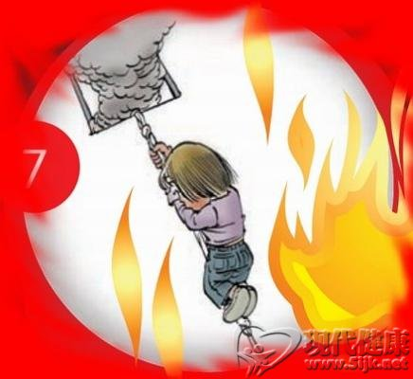
Exercises
翻译句子。
１.我的学校比你的学校更漂亮。
２.我认为英语比数学更有趣。
３.鲨鱼是最危险的动物。
４.他的病更严重了。
My school is more beautiful than yours.
I think English is more interesting than math.
Sharks are the most dangerous animals.
His illness is more serious.

Slide 17
Choose the best answers.
The building is ____ than that one.
A. more taller B. very taller C. taller D. so taller
2. Everything is getting ________.
A. good and better B. better and better
C. best and better D. best and best
3. Which is ______ , the moon or the earth ?
A. big B. very bigger C. the bigger D. bigger

Slide 18
summary
The phrases of the dialog :
lose one’s life 失去生命
protect sb. from 保护……免受……
ask sb. for help 向某人求助
The comparative and superlative of adjectives:
more + adj. the most + adj.

Slide 19
Homework
收集有关地震如何逃生的资料，准备下一
个section 的学习。

