Slide 1
Reading signs
第二课时
WWW.PPT818.COM

Slide 2
Revision
Do you know these signs?

Slide 3
Great!

Slide 4
A story
The path of stones

Slide 5
Pre-reading
Do you know them?
Hi, I’m father.
Hi, I’m Jack.
Hello, I’m Jane.

Slide 6
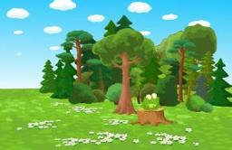
Let’s read!
Jack and Jane lived by the forest.
forest
Never go into the forest. You may get lost.
Their father often said to them,

Slide 7
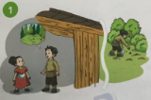
Let’s read!
One day, Jack said to Jane,
Let’s go into the forest and have a look.

Slide 8
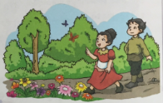
insects
flowers
Jack and Jane went into the forest. They saw beautiful flowers and interesting insects. They were happy. After some time, they felt hungry and tired.
flowers
insects

Slide 9
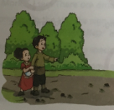
Jane looked around, she could not find her way. She said to Jack,
Don’t worry. Look at the stones on the ground. I dropped them on the way. We can follow them back home.
Jack, we’re lost!

Slide 10
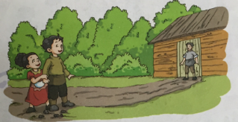
They followed the stones back home. Their father was very happy to see them.

Slide 11
Let’s play a game!
Let’s go into the forest.
Jack
Never go into the forest.
Jane
I dropped them on the way We can follow them back home.
Jack and Jane’s father
Jack, we’re lost.

Slide 13
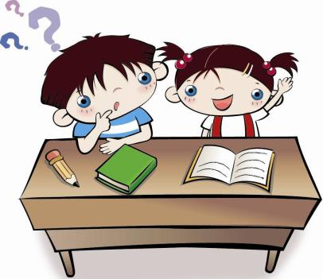
Work in pairs
1.Talk with your partner:
Who is cleverer? Jane or Jack?

Slide 14
WORK IN PAIRS
2. What should we do or not do in library?
In the library
We should _________________
keep quiet.
We shouldn’t smoke.
We shouldn’t eat.

Slide 15
Learn
apple teacher lesson mother
today about guitar machine
beautiful elephant together exciting
before Monday father animal magazine tomorrow

Slide 16
Summary
本课我们一起阅读了《The path of stones 》的故事。认识了stone, forest, flower insect, look at, on the way等词和词组。

Slide 17
Homework
1. 和爸爸妈妈一起分享你认识的标志吧！
2. 给爸爸妈妈讲讲《The path of stones》的故事。

Slide 18
The End

