Slide 1
Unit 2 Lesson 2
She likes dancing.
WWW.PPT818.COM

Slide 2
Review(复习)-- Let’s chant!
sing, sing, singing I like singing.
draw, draw, drawing I like drawing.
run, run, running I like running.
skip, skip, skipping I like skipping.

Slide 3
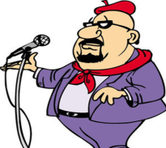
Let’s learn!
like: 用于第一、二人称或第三人称复数
如：I/ you/ they等。
I like singing.

Slide 4
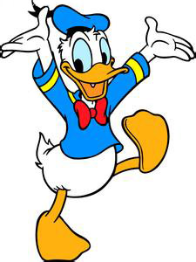
Let’s learn!
当主语是第三人称单数时，要在动词后面加上s。
like:
He likes dancing.

Slide 5
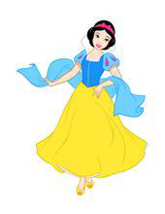
我喜欢跳舞。
I like dancing.
她喜欢跳舞。
She likes dancing.

Slide 6
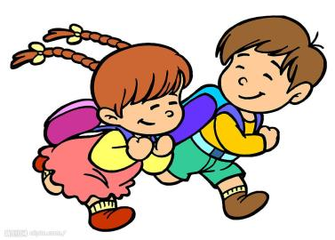
run - running
I like running.
Do you like running?
Yes, I do./No, I don’t.

Slide 7
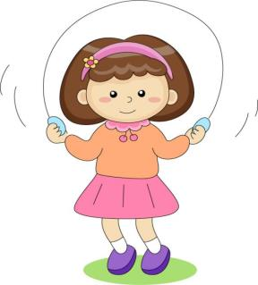
Skip - skipping
I like skipping.
Do you like skipping？
Yes, I do. / No, I don’t.
Hi！Come and skip！

Slide 8
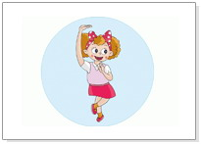
dance - dancing
I like dancing.
Do you like dancing?
Oh, she likes dancing.
Oh, he likes dancing, too.

Slide 9
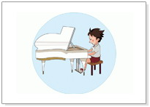
Playing the piano.
This is Guo Yang.
He likes playing the piano.
Do you like playing the piano?
Yes, I do.
No, I don’t.

Slide 10
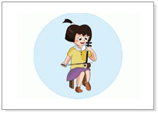
Playing the erhu.
This is Wang Hong.
She likes playing the erhu.
Do you like playing the erhu?

Slide 11
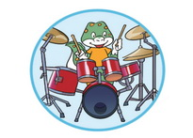
Palying the drums
I like playing the drums.
Do you like playing the drums?
Oh, She likes playing the drums.
Oh, He likes playing the drums, too.

Slide 12
Practice and talk
Do you like…?
你喜欢……?
This is …
这是……?
She likes…
她喜欢 ……
He likes…
他喜欢……
I like…
我喜欢 ……

Slide 13
Let’s chant!
Dance, dance, dancing
I like dancing.
Dance, dance, dancing
You like dancing.
Dance, dance, dancing
He likes dancing.
Dance, dance, dancing
She likes dancing.

Slide 14
Practice
1)She _______ dancing.
2)I ______ dancing, too.
3)He likes _______ the piano.
4)Daming _______ singing.
likes
like
playing
likes

Slide 15
Love sports
Love life.

