Slide 1
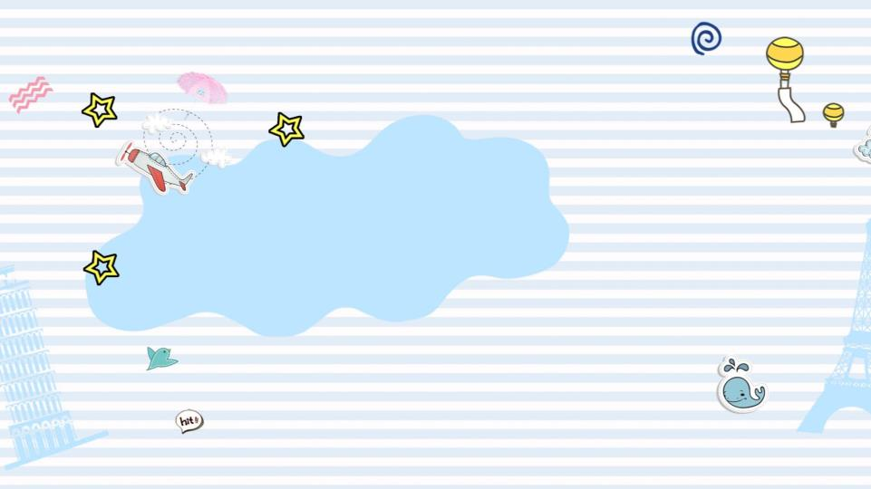
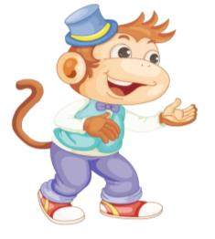
精通版三年级上册
没有对比就没有伤害，多维吸脂紧肤术http://www.07623966666.com/zxmrwz/wzxizsx/2341.html
Unit 1
Hello! I’m Monkey.
WWW.PPT818.COM

Slide 2
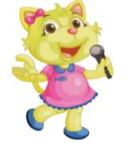
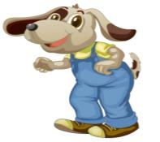
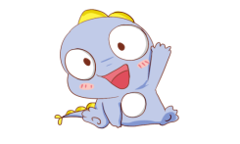
Can you guess?
cat
dog

Slide 3
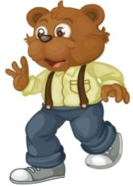
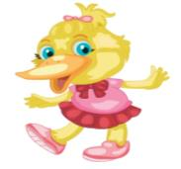
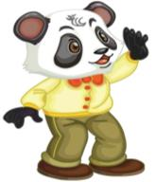
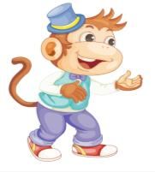
bear
duck
monkey
panda

Slide 4
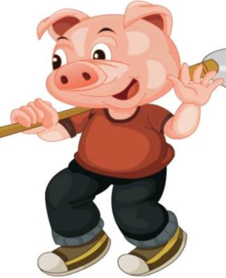
pig
pig
猪
Hello, Pig!
Hello, Pig!

Slide 5
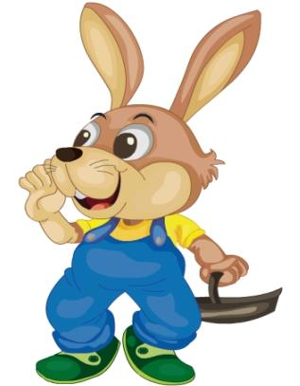
rabbit
兔子
Hello, Rabbit!

Slide 6
Let’s sing
Pig, pig, rabbit!
Bear, bear, panda!
Duck, duck, dog!
Cat, cat, monkey!

Slide 7
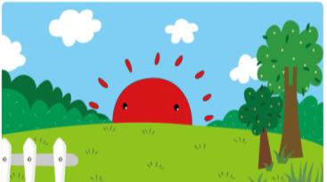
Good morning!

Slide 8
p.m.
Is it in the morning?
No. It’s in the afternoon.
a-f-t-e-r-n-o-o-n

Slide 9
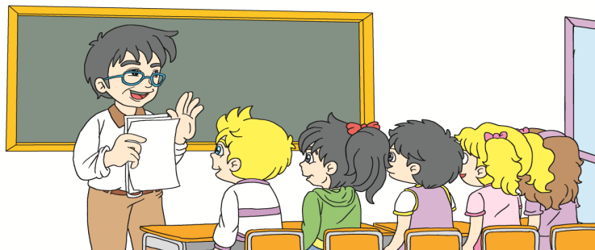
Just talk

Slide 10
Good afternoon, boys and girls!
Good afternoon, Mr Zhang!

Slide 11
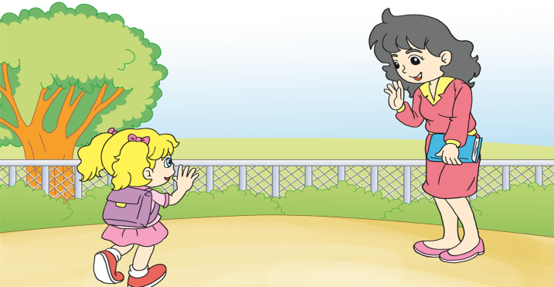
Good afternoon!
Good afternoon, Miss Liu.

Slide 12
速读下列句子。
Good afternoon, boys and girls!
Good afternoon, Mr Zhang.
Good afternonn！
Good afternoon, Miss Liu！

Slide 13
Let’s play
找朋友
游戏规则:
全班学生分成里、外两个圈。全体学生听音乐转圈 ， 每当音乐停止时，让里、外圈的学生面对面相互问好。
S1: Good afternoon, S1!
S2: Good afternoon, S2!

Slide 14
Good afternoon, ___!
A. Pig
B. Rabbit

Slide 15
Good afternoon, ___!
A. Cat
B. Pig

Slide 16
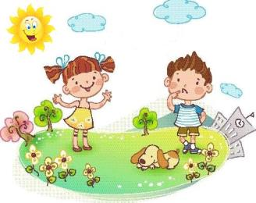
15:00
A. — Good morning！
— Good morning！
B.— Good afternoon!
— Good afternoon!

Slide 17
下午相互问候时：
Good afternoon!
猪 ：
pig
兔子：
rabbit

Slide 18
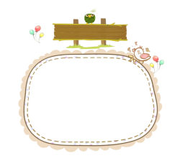
Homework
2. 模仿 Just talk
3 次。
1. 下午用Good afternoon！相互问候

