Slide 1
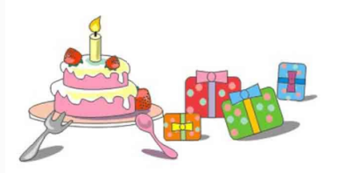
陕旅版
四年级下册
Unit6 Today Is Her Birthday
第三课时
WWW.PPT818.COM

Slide 2
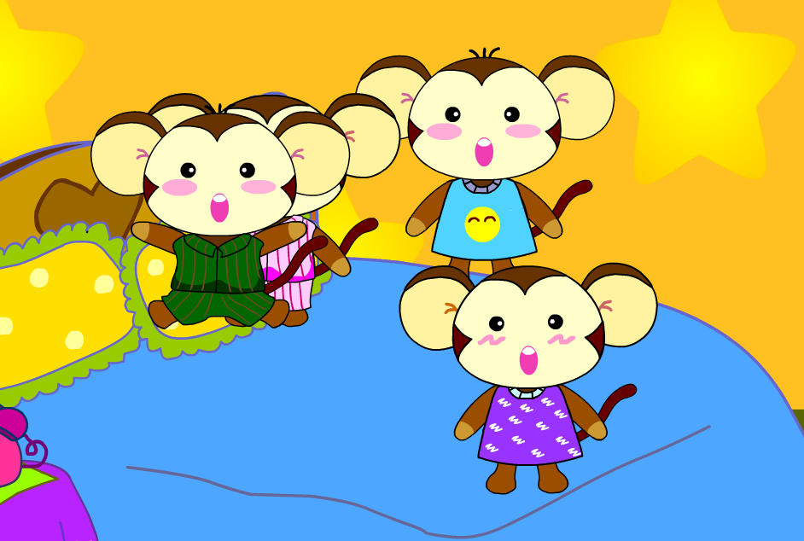
>>Warm-up

Slide 3
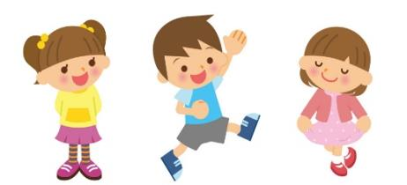
>>Lead-in
Say the numbers
three
five
one
two
four
…

Slide 4
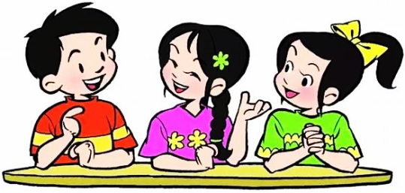
>>Presentation
Free talk
How old are you?

Slide 5
>>Presentation
Let’s learn more
thirty

Slide 6
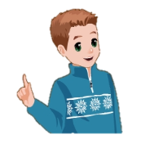
>>Presentation
Let’s learn more
How old is Mr. Brown?
thirty-two
Mr. Brown
He is thirty-two.

Slide 7
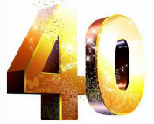
>>Presentation
Let’s learn more
30+10=?
What’s thirty and ten?
forty

Slide 8
>>Presentation
Let’s learn more
What’s forty and ten?
(40)
(10)
fifty

Slide 9
>>Presentation
Let’s learn more
What’s thirty and thirty?
(30)
(30)
sixty

Slide 10
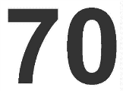
>>Presentation
Let’s learn more
What’s thirty and forty?
(30)
(40)
seventy

Slide 11
>>Presentation
Let’s learn more
What’s fifty and thirty?
(50)
(30)
eighty

Slide 12
>>Presentation
Let’s learn more
What’s eighty and ten?
(50)
(30)
ninety

Slide 13
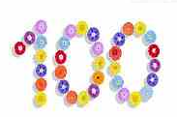
>>Presentation
Let’s learn more
What’s ninety and ten?
(90)
(10)
hundred

Slide 14
>>Presentation
Look and learn
two
twenty
thirty
three
forty
four
five
fifty
eight
eighty
表示几十的数词结尾都有ty.

Slide 15
>>Presentation
Look and learn
twenty
thirty
forty
fifty
eight eighty
表示几十的数词结尾都有ty.

Slide 16
>>Practice
Magic fingers

Slide 17
>>Presentation
Listen, then ask and answer
Q1:How old is Wu Chen’s grandma?
She is sixty.
Q2:How old is Wu Chen’s mother?
She is thirty-seven.
Q3:How old is Wu Chen’s father?
He is forty-one.
Q4:How old is Wu Chen?
He is ten years old.
答案

Slide 18
>>Presentation
Let’s talk
Toby: How old is your grandma? Do you know?
Wu Chen: She is sixty.
Toby: And your mother?
Wu Chen: My mother is thirty-seven.
Toby: Is your father thirty-seven, too?
Wu Chen: No. He is forty-one.
Toby: How old are you, then?
Wu Chen: I’m ten years old.
Toby: A nice girl!

Slide 19
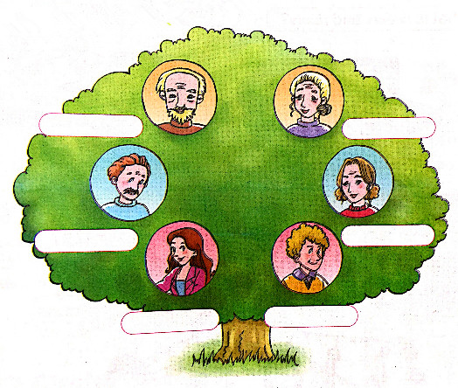
>>Practice
Listen and write
How old are they?
84
80
51
49
27
20

Slide 20
>>Practice
Read, ask and answer
A: How old are you?
B: I’m …
A: How old is …?
B: He /She is …
I
Music
Miss Gao
32
Science
Miss Wang
45
Chinese
Miss Yang
36
Math
Mr. Zhang
59
English
Miss White
27
Art
Mr. Zhao
24
PE
Mr. Lin
28

Slide 21
>> Summary
本课所学的表示数十的表达方式：
thirty forty fifty sixty
seventy eighty ninety hundred
本课所学的重点句型：
-How old are you/is …?
-I’m …/He / She is …

Slide 22
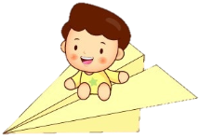
>> Homework
1.听课文录音并跟读，按照正确的语音、语调朗读并表演课文对话。 2.用英语向家长表述今天所学的整十类数字。
3.预习 Unit6 B Read a story。
close

