Slide 1
Unit 8 Save Our World!
Connected to Nature
WWW.PPT818.COM

Slide 2
Learning Targets
1. Be able to use the words and phrases: bee, ant, dove, die, dead, species, respect, be filled with, start out, depend on, live off, die off
2. Learn that all the living things on the planet depend on one another and learn to protect our world
3. Learn some key sentences:
· The natural world is filled with living things.
· Living things start out weak and small and slowly
grow strong and big.

Slide 3
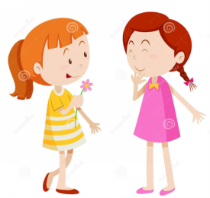
· If we pollute the rivers and oceans, fish may
get sick or even die.
· Some birds live off fish.
· If the birds eat the sick or dead fish, they may die off.
· We should respect the earth and all the living
things on it.

Slide 4
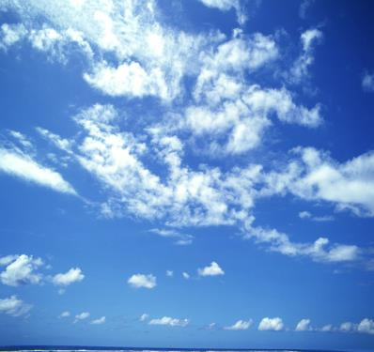
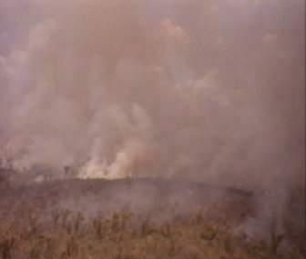
Lead in
Observe the pictures and contents below and how you feel.

Slide 5
human
drive more cars
pour dirty water
into the rivers
and oceans
throw waste
away
noise pollution
waste
pollution
water pollution
air pollution
environment
worse and worse

Slide 6
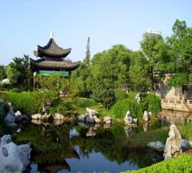
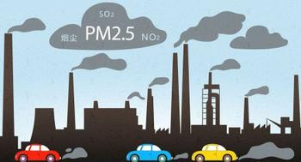
traffic jam
cars and buses
waste gas
air pollution
make noise
noise pollution
serious(严重的)

Slide 7
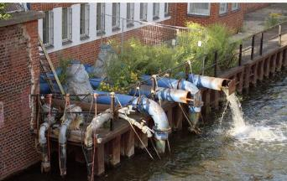
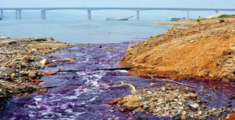
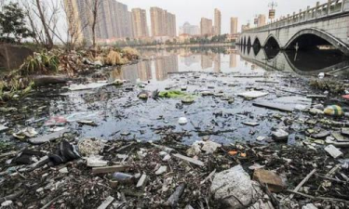
river
fish die
people sick
factories
pour
dirty water
lake
sea
water
pollution
serious
ocean

Slide 8
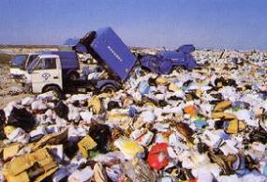
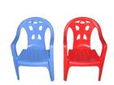
metal
glass
People
throw away
paper
plastic
clothes
waste pollution
food
serious

Slide 9
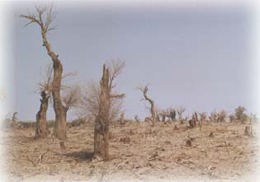
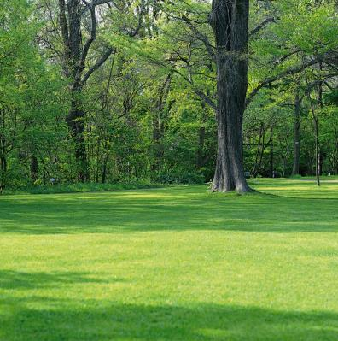
Wood cutting

Slide 10
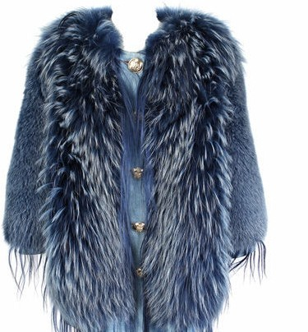
fur coat

Slide 11
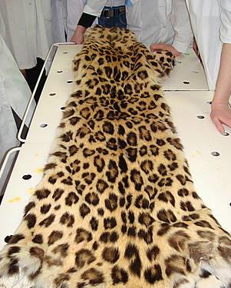
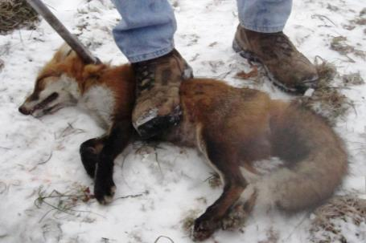
They are killing the animals for skins.

Slide 12
Words and expressions
bee
ant
dove
die
dead
species
respect
n. 蜜蜂
n. 蚂蚁
n. 鸽子
v. 死
adj. 死的
n. 物种；种类
v. 尊敬；敬重

Slide 13
be filled with start out
depend on
live off
die off
充满……
启程，出发；开始做
依赖
以……为食；以……为生
相继死去；灭绝

Slide 14
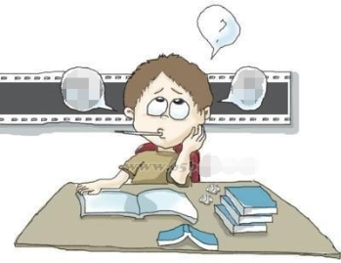
THINK ABOUT IT
Do all the living things on the planet depend on one another？
What can we do for nature？

Slide 15
Presentation
Listen and read the passage.
The natural world is filled with living things. Living things start out weak and small and slowly grow strong and big. You are a living thing. Each of your classmates is a living thing. Flowers, grass and trees are living things, too. Bees, ants, doves, dogs and cats—these are all living things.
All living things need food and water to grow.

Slide 16
Think about yourself. When you are hungry, you need to eat. You eat fruit, vegetables, meat and fish. They can help you grow big and strong. You drink water when you are thirsty. Now think about a tree. When a tree is hungry, it gets food from the soil. Trees drink water, too.
We are different in some ways, but all living things are connected. We all live on the same planet, and we depend on each other. If we pollute the rivers

Slide 17
and oceans, fish may get sick or even die. Some birds live off fish. If the birds eat the sick or dead fish, they may die off. Nature is a balance between all the living things on the planet. If one species dies off, then another species may die off, followed by another, and another…
We should respect the earth and all the living things on it.

Slide 18
Let’s Do It!
Read the lesson and put these sentences
in the correct order.
1
All living things are connected.
We should protect the environment.
Living things live in the world.
All living things need water and food to grow.
3
4
1
2

Slide 19
Fill in the blanks with the correct forms of the words in the box.
2
respect connect die dead follow
His mother has been ____ for ten years.
People should _______ and understand each other.
3. Don’t always _____ others. You should have your own ideas.
4. We are _________ by the Internet.
5. The trees _____ out, and this place became desert.
dead
respect
follow
connected
died

Slide 20
3
Read the passage and fill in the blanks with the sentences below.
Many years ago, there were more animal species than there are now. There were many forests. The rivers were clean. The sky was blue. Birds sang from morning until night. ______
But later, people cut down the trees in the forests, killed the animals and built factories
B

Slide 21
and buildings. ______ People's houses were buried by soil in floods. Some animals lost their homes, and they attacked people. Some factories polluted the air, water and people's food. The earth is getting warmer. Some scientists say the sea level will rise by at least 1 metre in the next 100 years. ______
D
A

Slide 22
People are now living in a worse and worse environment. ______ We need to reduce pollution and protect our environment.
C
A. Some houses beside the sea will disappear.
B. People lived together with many kinds of animals.
C. We should do something to save our world.
D. They changed the earth.

Slide 23
Language points
1.The natural world is filled with living things.
be filled with 充满…… 它相当于be full of。
例：My father's study is filled with/full of books.
我爸爸的书房里满是书。

Slide 24
2. Living things start out weak and small and slowly grow strong and big.
start out意为“启程，出发，开始或着手做”。
例: We started out by preparing for the sports meeting.
我们通过为运动会做准备开始的。

Slide 25
3. If we pollute the rivers and oceans, fish may get sick or even die.
(1)【辨析】sick 与 ill
①sick 生病的，不舒服的。其为形容词，在句中既可作表语，也可作定语。
例：The sick girl asked for a day's leave.
那个生病的女孩请了一天的假。

Slide 26
②ill 生病的。作此义讲时，在句中只能作表语。
例：He is seriously ill and unlikely to recover.
他病得非常厉害，不大可能康复了。
(2)die v．死。为非延续性动词，用于完成时时不能
与时间段连用。其过去式为died，现在分词为
dying。常用短语：die of死于(疾病、饥饿等原因)；die from死于(寒冷、事故等外部原因)。die off 相继死去，灭绝；die out灭绝。
例：In the past，many people died of starvation during the famine.过去发生饥荒时，许多人都会饿死。

Slide 27
4. Some birds live off fish.
live off 意思是“以……为食；以……为生；依赖……生活” 。
例：We should not live off our parents all our life.
我们不能一辈子都依靠父母生活。
Most of the Asians live off rice.
多数亚洲人以大米为主食。

Slide 28
5. If the birds eat the sick or dead fish, they may die off.
die off意思是“相继死去；灭绝”
例：As he grew older, his relatives all died off.
随着他年龄的增长，亲人相继死去了。
The chickens are all dying off from the disease.
小鸡一个个地病死了。
The leaves of this plant are dying off.
这株植物的叶子正在凋落。

Slide 29
die 还有很多固定搭配，在使用时要注意它们的区别：
die of “死于……；因……而死”，主要指疾病、衰老等自身的原因。
例：He died of a heart attack.
他死于心脏病发作。
die from “死于……；因……而死”，主要指事故等方面的外部原因。
例：Many villagers die every year from snake bites. 每年都有许多村民被蛇咬死。

Slide 30
6.We should respect the earth and all the living things on it.
respect v．尊敬；尊重。其形容词为respectable(值得尊敬的；受人尊敬的)。
例：We should respect the old and love the young.
我们应该尊老爱幼。

Slide 31
Exercises
根据句意和首字母及汉语提示完成句子。
If the snowstorm does not stop, the cattle will_______ (相继死掉).
2. A tiger _______ (以……为生) some small animals.
3. The expedition(探险队) __________ (出发) before sunrise.
4. All students should r______ their teachers.
die off
lives off
started out
espect

Slide 32
5. Her grandfather has been d_____ (死) for 20 years now.
6. Many people d____ (死) in the accident.
7. Lucy loves to watch ____(蚂蚁) moving house.
8. She was stung(蛰) by a b ____ (蜜蜂).
9. Over a hundred s_______ of insect are found in this area.
ead
ied
ants
ee
pecies

Slide 33
Summary
1. Learn some new words and expressions.
2. Be able to understand the passage .
3. Know the importance of the nature and the connection between human and nature.

Slide 34
Homework
1. Finish the exercises of Lesson 47.
2. Preview next lesson.
3. Tell your relatives and friends about the importance of protecting nature.

