Slide 1
Unit3 What subject do you like best?
人教精通版四年级下册
WWW.PPT818.COM

Slide 2
Review
Game
看谁反应快
Show me your art book.

Slide 3
Presentation
What subject do you like best?
Chinese
art
PE
subjects
maths
music
English

Slide 4
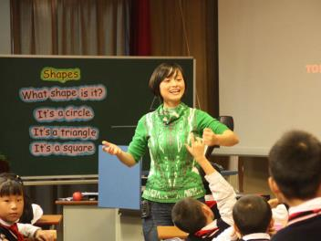
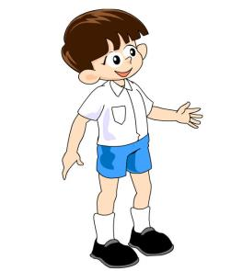
Presentation
What subject do you like best?
I like English best.

Slide 5
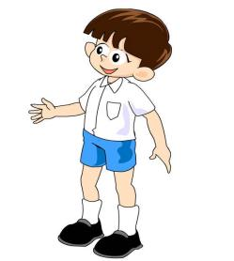
Presentation
Do you like English?
Yes, I do. It’s very useful.

Slide 6
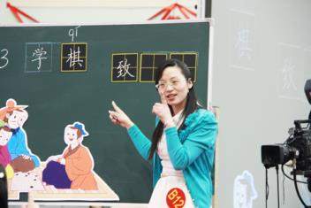
Presentation
What subject do you like best?
I like Chinese best.

Slide 7
Presentation
Do you like Chinese?
No, I don’t. It’s boring.

Slide 8
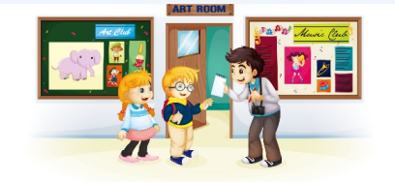
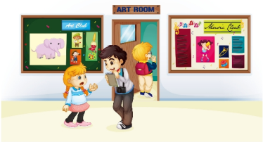
Presentation
Listen and say
What subject does the girl like best?
She likes art best.
2. Does the girl like music?
No, she doesn’t.

Slide 9
Presentation
Let’s watch

Slide 10
Presentation
Look and read
What subject do you like best?
I like art best.
Do you like music?
No, I don’t.

Slide 11
Presentation
Listen and read
 | What subject do you like best?
 | I like art best.
 | Do you like music?
 | No, I don’t.

Slide 12
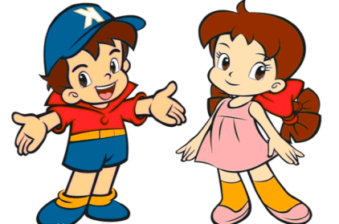
Practice
Role play
两人一组练习Just talk部分对话，随后表演出来吧！

Slide 13
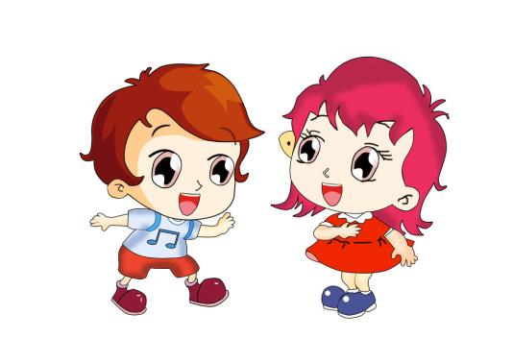
Practice
>> Practise
活动1
猜猜看
What subject
do you like best?

Slide 14
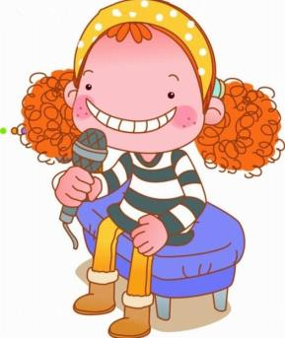
>> Consolidation
Practice
活动2
我是小记者
A: What’s your name ?
B: My name is …
A: What subject do you like
best?
B: I like …
A: Do you like …?
B: ….

Slide 15
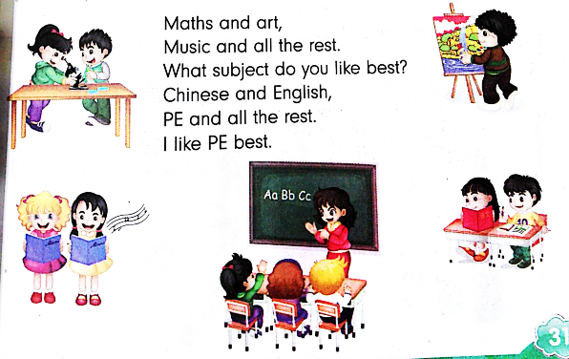
Practice
Let’s chant

Slide 16
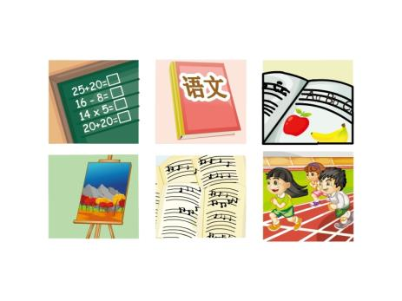
Summary
c
怎样询问别人最喜欢的科目？
—What subject do you like best?
—I like ... best.

Slide 17
Homework
1. 跟读课文Just talk部分的录音，注意语音、语调。
2.和朋友一起运用“What subject do you like best? I like … best.”相互询问彼此喜欢什么科目并写出你们之间的对话，不少于4句话。
3. 预习Lesson 16。
Close

