Slide 1

Lesson 55
Look into the Future
WWW.PPT818.COM

Slide 2

Think about it
●What do you want to be when you
grow up?
●What should you do now if you want to
make your dream come true?

Slide 3

New words
1. boss n. 老板
e.g. Our boss was very glad to see the
good result.
我们老板看到这个好的结果非常
高兴。
2. manage v. 管理；负责
e.g. We need people who are good at
managing.
我们需要擅长管理的人。

Slide 4
3. doubt v. 怀疑
e.g. I doubt whether Tom will come.
我怀疑汤姆是否会来。
4. wealth n. 钱财；财富
e.g. Health is more important than
fame and wealth.
健康比名誉和财富更重要。
5. astronaut n. 宇航员

Slide 5
Task-based reading
boss
manage
1. Brian wants to be a _______ and _________ a big company.
2. What are students doing in Ms. Cox’s class?
_____________________________________.
3. What does Jenny want to be?
_____________________________________.
4. Where does Danny want to play basketball?
_____________________________________.
5. 翻译：I don’t think wealth is the most important thing in life.
____________________________________.
They are working on a group project.
She wants to be a pilot.
In the spaceship.
我认为财富不是生活中最重要的事情。

Slide 6
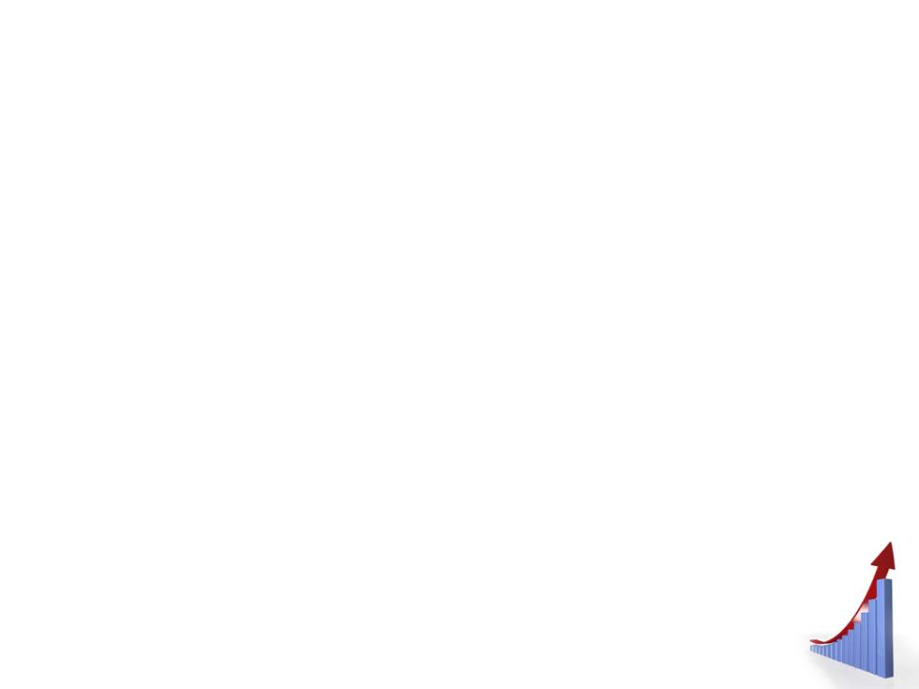

Read the lesson and fill in the
blanks.
Some students are having a discussion about their future. Jenny wants to be a pilot. She loves to ______. Brian wants to be a ____, but Jenny thinks Brian should do something that he enjoys.
travel
boss

Slide 7
Steven wants to be an _________. He wants to invent something that won’t harm the environment. Kate likes ________ meals and enjoys trying different kinds of food. As for Danny, he is going to choose the most fun and ________ job in the world. He is going to be an astronaut.
engineer
cooking
exciting

Slide 8
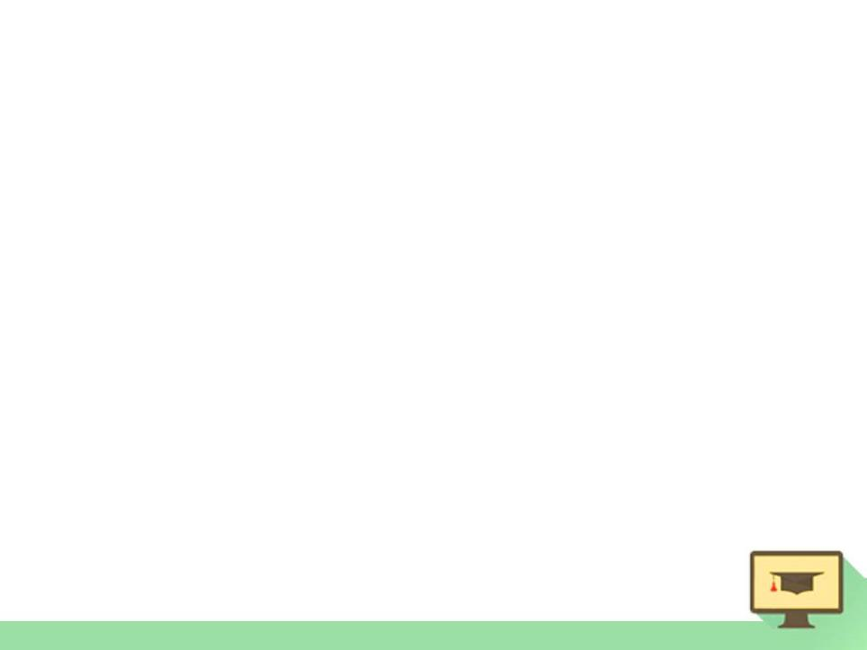

1. Look into the Future 展望未来
look into 此处是“观察”。
还有“朝里看；调查；浏览（书籍、资料等）” 的意思。
e.g. I noticed Tom looking into a shop
window.
我注意到汤姆正往商店橱窗里看。

Slide 9
The police are looking into the accident.
警方正在调查那起事故。
You’d better look into the novel, and get its main idea.
你最好翻阅一下这部小说，了解其主题思想。

Slide 10
2. What do you want to be when you
grow up, Jenny?
詹妮，长大后想干什么？
grow up长大
grow into 长成

Slide 11
e.g. The little girl has grown up.
The little boy has grown into a handsome young man.

Slide 12
3. I love to travel, and it would be fun to
fly an airplane.
我喜欢旅行，开飞机旅行会很有趣。
I want to be a boss and manage a big
company, I could make a lot of money.
我想当老板管理一家大公司了。我会
赚很多钱。

Slide 13
I’d like to be a transportation engineer. I would invent things that help improve the environment. Maybe I could invent a solar-powered plane.
我想要当运输工程师。或许我会发明太阳能飞机。

Slide 14
could, would都是表推测的情态动词。其所指时间几乎总是“现在”，说话人的主观看法总是以现在时间为基点的。

Slide 15
可能性大小，一般 might最低，must最高，由低到高的顺序：might (可能) → may (可能) → could (可能) → can (可能) → should (应该会) → ought to (必然) → would (会) → will (会) → must (一定)。

Slide 16
说话人推测的事件所发生的时间，要根据不定式所采取的形式而定，可以是现在时间和过去时间，也可以是将来时间。一般，情态动词之后的不定式若不是完成式，则表示现在时间或将来时间。

Slide 17
e.g. He must be there. (= I’m sure (that)
he is there.)
他一定在那里。
Our team might win the race. (= It
is possible that our team will win
the race.)
我们队可能在赛跑比赛中获胜。

Slide 18
He must be working at the office. ( = I’m sure that he is working in the office.)
他一定正在办公室里工作。

Slide 19
4. I want to be a boss and manage a big company.
boss老板 bosses(复数)
manage v. 管理；负责 manager经理
manage to do 设法做成某事
He manages to pass the exam.

Slide 20
5. Well, I don’t doubt you would be a
good boss, but I don’t think wealth is
the most important thing in life.
我肯定你会是一位好老板，但我认为
钱不是生活中最重要的。

Slide 21
doubt后接宾语从句时，如主句为肯定句，用whether或if连接；如主句为否定句或疑问句，用that连接。在这样的结构中，doubt的意思是“怀疑，不相信，不信任；不能肯定，对……没准儿”。

Slide 22
e.g. I doubt whether / if he is clever.
我怀疑他是否聪明。
I don’t doubt that he will be
successful.
我肯定他会成功。
Do you doubt that I love you?
我爱你，对此你有怀疑吗？

Slide 23
doubt在肯定句中也可接that引导的宾语从句，意思是 “认为……未必可能”。
e.g. I doubt that Danny will be a good
boss.
我看丹尼未必会当个好老板。

Slide 24
6. As for me, I’m going to choose the
most fun and exciting job in the
world.
至于我，我打算选择世界上最有趣、
最激动人心的工作。
as for 至于；关于

Slide 25
e.g. As for the thief, he was caught by
the police.
至于那个小偷，他被警察抓住了。
As for my achievement, I have
much to say.
关于我的成就，我有很多要说的。

Slide 26
7. Astronauts need to know a lot about
science, Danny.
丹尼，宇航员需要懂得很多（知识）。
①astronaut n. 宇航员 an astronaut
② lot n. ，a lot “大量；许多”。表示 “大量（许多……）” 时，后接of短语，of后的名词既可以是可数名词，也可以是不 可数名词。

Slide 27
e.g. He has a lot (of things) to do today.
今天他有很多事要做。
She has a lot of money.
她有很多钱。
These boys get lots in common.
这些男孩子有许多共同之处。

Slide 28
There’s lots of juice left.
还剩下很多果汁。
There are lots of bottles on the table.
桌子上放着许多瓶子。

Slide 29
a lot还可以用作副词，可以修饰形容词和副词的比较级以及动词。
e.g. Thanks a lot. 多谢。
He waited a lot when he saw the
doctor.
他看病时等了很久。

Slide 30
The patient felt a lot better.
病人觉得好多了。
I am a lot taller than your brother.
我比你弟弟高多了。

Slide 31

Imagine what your life will be like in 10 years and write about it. What do you hope to be doing and why? Where do you hope to be?

