Slide 1
Can you come to my party?
WWW.PPT818.COM

Slide 2
Make a list of the kinds of parties people have.
2a
birthday party, __________________________
________________________________________

Slide 3
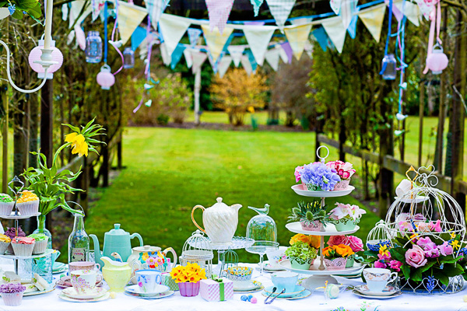
Garden Party

Slide 4
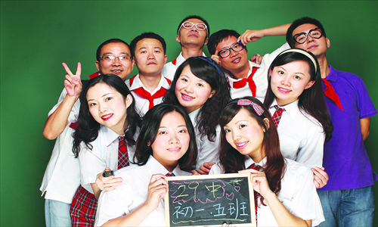
Classmates’ Party

Slide 5
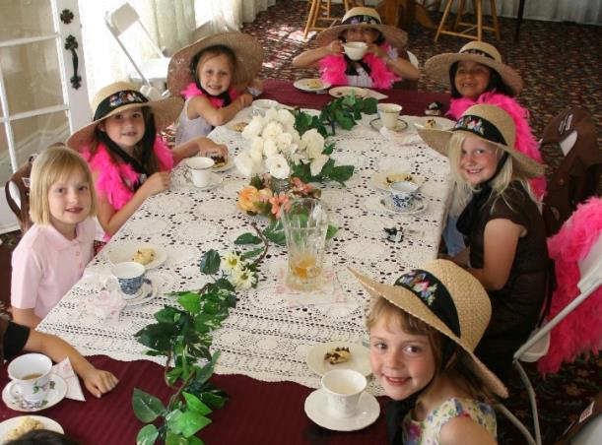
Tea Party

Slide 6
Farewell Party (欢送会)

Slide 7
Surprise Party (惊喜聚会)

Slide 8
Housewarming Party (乔迁聚会)

Slide 9
New words
1. invitation n. 邀请；请柬
preparation n. 准备；准备工作
动词+ ion (后缀)→invitation
动词+ ion (后缀)→ preparation
e.g. She didn’t accept my invitation.
她没有接受我的邀请。
He didn’t do any preparation for this exam, so he failed.
他考试前没做任何准备，所以不及格。

Slide 10
2. reply v. 回答；答复
e.g. They replied my letter three days ago. 三天前他们回复了我的信。
3. print v. 打印；印刷
e.g. Can you print this for me?
你能给我打印一下这个吗？

Slide 11
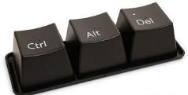
4. delete v. 删除
e.g. Please delete my name from your list. 请把我的名字从你的名单中删除。
5. turn down 拒绝
e.g. Why did she turn down your
invitation?
她为什么拒绝你的邀请？

Slide 12
6. forward v. 转寄；发送
adv. 向前；前进
e.g.
You can forward e-mail to someone else. 你可以将电子邮件转发给别人。
She walked forward in order to see clearly.
她向前走了一步以便能看得更清楚。

Slide 13
7. sad adj. (令人)悲哀的； (令人)难过的
e.g. She was very sad when her cat died.
她的猫死后, 她很悲伤。
8. glad adj. 高兴；愿意
e.g. I am glad that you can come.
你能来我很高兴。

Slide 14
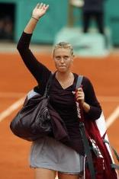
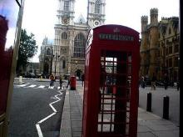
9. goodbye interj. & n. 再见
e.g. She said goodbye and walked away. 她说了再见就走了。
10. take a trip 去旅行
e.g. I’d like to take a trip to England.
我想去英国旅行。

Slide 15
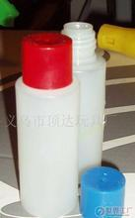
11. glue n. 胶水
e.g. The glue doesn’t work well.
这胶水不粘了。
12. without prep. 没有; 不（做某事）
e.g. A life without a friend is a life without
a sun.
人生没有朋友, 犹如生活中没有太阳。

Slide 16
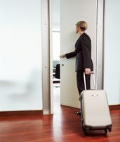
13. surprised adj. 惊奇的；感觉意外的
动词surprise + ed → surprised 惊奇的
e.g. He was surprised to find
nobody was at home.
他很吃惊地发现没人在家。

Slide 17
14. look forward to 盼望；期待
look forward to + v.–ing 形式
e.g. We look forward to seeing you again.
我们盼望再次见到你。
15. hear from 接到（某人的信，电话等）
e.g. I hear from my cousin every two
months.
我每两个月就会收到我表姐的来信。

Slide 18
Read the message quickly. Why did the people write them? Match the reason with each message.
2b
1. accept an invitation 2. make an invitation
3. turn down an invitation
Top message: 1
Middle message: 3
Bottom message: 2

Slide 19
Message
New Reply Forward Delete Print Move to
新信息 回复 发送 删除 打印 移动到
Hi David,
What a great idea! I really like Ms. Steen
a lot(非常). She helped me to improve(提高) my English so much. I’m sad(伤心) to see her go, and this party is the best way to say “Thank you and goodbye.” I can help to buy some of the food and drinks(饮料). I can help to bring MS. Steen to the party. I already(已经) have a great idea about how to do that.
He Wei
1
bring…to…
把…带来…

Slide 20
Hi David,
Thanks so much for planning(计划) this. I’d love to come to the party, but I’m not available. My family is taking a trip(去旅游) to Wuhan at the end of this month to visit my aunt and uncle. However, I’d still be glad(依然) to help out with any of the party preparations(准备工作), like planning the games. Let me know if you need my help.
Jake
3
在…的末尾
分担工作，解决难题

Slide 21
Dear classmates,
As I’m sure you know by now, our favorite teacher, Ms. Steen, is leaving soon(很快) to go back to(回到) the US. We’re very sad that she’s leaving because she is a fun teacher. To show how much we’re going to miss her, let’s have a surprise party for her next Friday the 28th! Can you come to the party? If so, can you help with any of these things? Please tell me by this Friday.
2

Slide 22
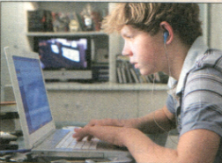
Buy food and drinks.
Think of (思考)games to play.
Prepare things we need for the games (glue,
paper, pen,…).
4) Bring Ms. Steen to the play without telling so
that she can be surprised.
I look forward to hearing from you all.
David
without doing sth.
不做某事

Slide 23
2c
Read the message and answer the questions.
1. What kind of party is it?
_______________________________________
2. Who is the party for?
_______________________________________
It is a surprise party.
Ms. Steen.

Slide 24
3. When is the party?
________________________________________
4. Who did David invite to the party?
________________________________________
5. What can people do at the party?
________________________________________
Next Friday the 28th.
His classmates.
They can eat, drink and play games at the party.

Slide 25
3. surprised adj. 惊奇的；感觉意外的
Are you surprised to see him alive?
你看到他还活着很惊奇吗？
与surprised 有关的用法：
①I’m surprised at the surprising news.
我对这个令人惊讶的消息感到很吃惊。
②To my surprise, he left without leaving a word.
令我惊奇的是，他一声不响地离开了。
③He looked at me in surprise.
他惊奇地看着我。

Slide 26
①I’m surprised at the surprising news.
我对这个令人惊讶的消息感到很吃惊。
②To my surprise, he left without leaving a word.
令我惊奇的是，他一声不响地离开了。
③He looked at me in surprise.
他惊奇地看着我。
surprised 与surprising形容词，
surprised修饰人，surprising修饰物，
be surprised at sth.“对…感到惊讶’’
surprise是名词,
to one’s surprise“令某人惊奇的是”
in surprise 意为“惊奇地”。

Slide 27
I’m surprised _______ what you said.
A. to B. of
C. for D. at

Slide 28
Complete the invitation with words and phrases from the messages on Page 69.
2d
party
We are planning a housewarming _______ at our new house this Saturday. Can you ______? Our house is at 2 London Road. We are serving _______ and _______ from 7:30 p.m. Please ________ your friends and family. A party is more ________ with more people! Please let us ________ by Wednesday _________ you can come to the party. Hope you can make it!
come
food drinks
bring
surprising
know
if

Slide 29
1) bring … to …把…带来
2) take a trip去旅行
3) think of 认为
4) without doing sth. 没有做某事
5) so that 以便于；目的是
6) look forward to doing sth.期待做某事
7)be surprised at sth. 对…感到惊奇
8) hear from 收到某人的来信

