Slide 1
Unit 3 Topic 1
Does he speak Chinese?
Section A
WWW.PPT818.COM

Slide 2
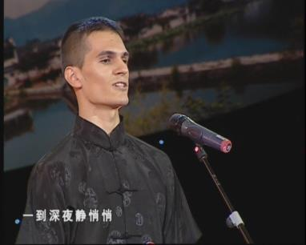
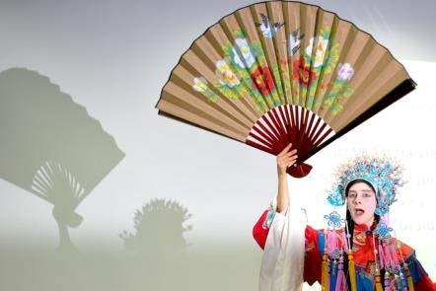
Speak in Chinese

Slide 3
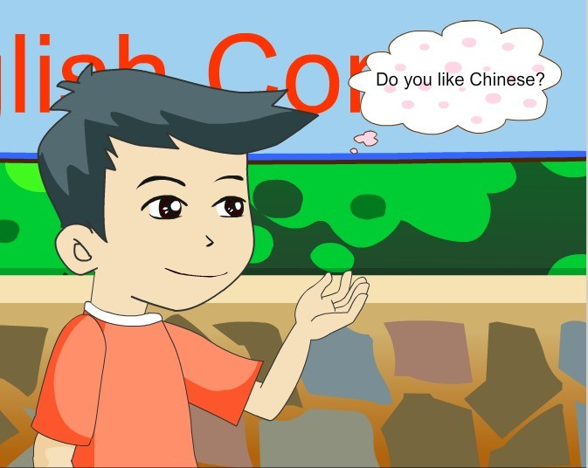
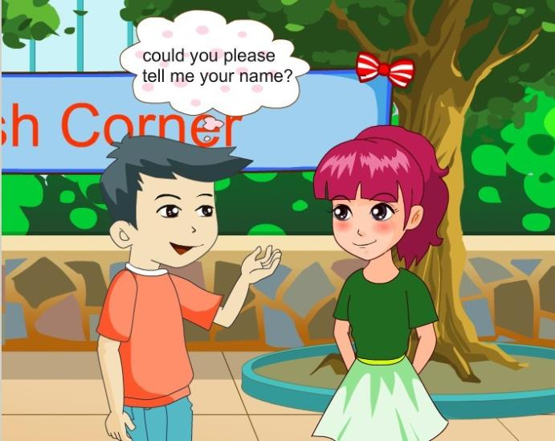
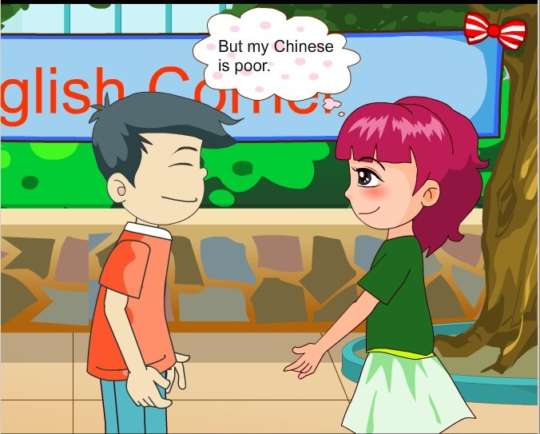
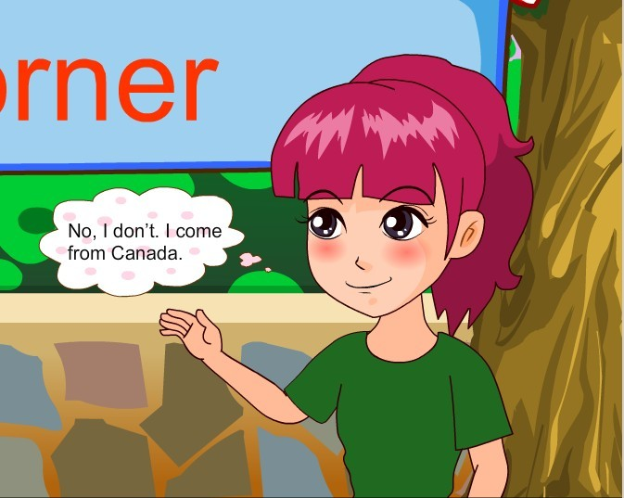
1a
Look, listen and say
Is Jane's Chinese good or poor?

Slide 4
Useful expressions:
Could you please tell me your name?
— Could you please+动词原形？你能......吗？
— Sure./Of course./
No problem./Sorry.

Slide 5
Useful expressions:
come from
Do you come from the U.S.A.?
=Are you from the U.S.A.?
be from
Jane

Slide 6
Useful expressions:
speak 讲、说（某种语言）
He can speak English .
speak

Slide 7
Useful expressions:
help sb. with sth.
help sb.(to) do sth.
帮助某人做某事
E g: Please help us to find him.

Slide 8
Listen to 1a and write T (True) or F (False).
( ) 1.Jane likes Chinese.
( ) 2. Li Xiang’s pen pal is from America, too.
( ) 3.Li Xiang’s pen pal can speak Chinese very well.
( ) 4.Li Xiang will help Jane with her Chinese.
T
F
F
T

Slide 9
1c
Pair work: Act out the conversation above with your partner.
Li: Excuse me, could you please tell...?
Jane: Sure. ...
Li: ...come from...?
Jane: No,.... ... Canada.
Li: Oh, ...pen pal....
...can...Chinese. ...like...?
Jane: Yes,... But ...poor. ...help...with...?
Li: No problem.

Slide 10
Listen to the passage and fill in the blanks.
2
Chinese
I’m Li Wei. My is very good.
I often my friends Chinese.
I like very much. But my English is not very good. I want to a pen pal. Could you help me with it?
help
with
English
have
?

Slide 12
Project
调查表
Group | one | two | three | four | five | ...
like English
speak English after class
have an English name
have a pen pal

Slide 13
Report like this
In Group One, we all like English.
We each have an English name.
We often speak English after class.
But Li Hong's English is poor. She needs some help.
We can help her with it. And she wants to have a pen pal.

Slide 14
Exercise:
— Excuse me, c_____ you please tell me
your name?
—Sure, my name is Li Hong.
2. —Can you s________ Chinese?
—Sorry, I can't. I come from Canada.
3. —Could you help me with my English?
—No problem.
4.My English is p_____. Could you help me with it?
5. — Do you often speak English a ____ class?
—Yes, I do.
ould
peak
oor
fter

Slide 15
Exercise:
（ ）1. We are from England. We _______ English.
A. tell B. say C.speak
（ ）2. —Do you have any friends here? --- ________
A. Yes , I am. B. Yes, I do. C. Yes, I have.
（ ）3. —______ you like English? —Yes, I do.
A. Does B. do C. Do
（ ）4. Mary's Chinese is poor. We can help her ______ it.
A. with B.and C.to
C
B
C
A

Slide 16
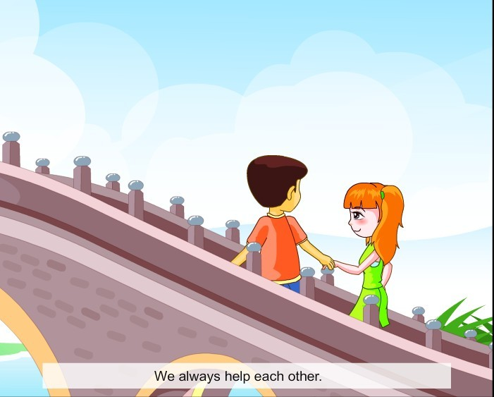
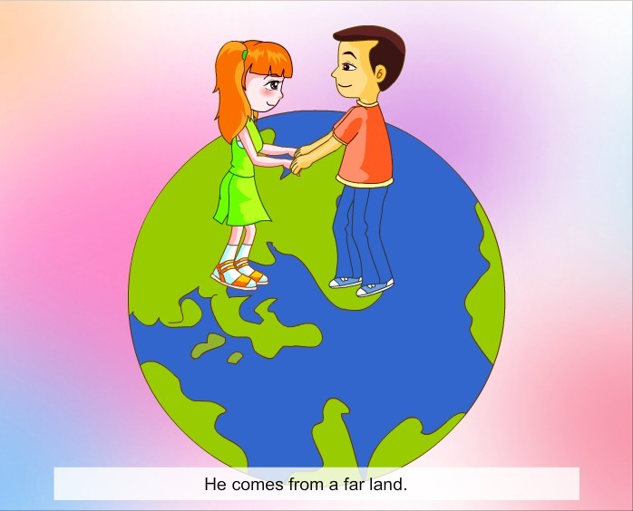
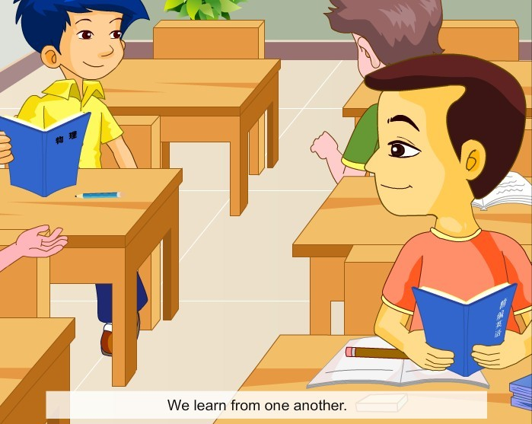
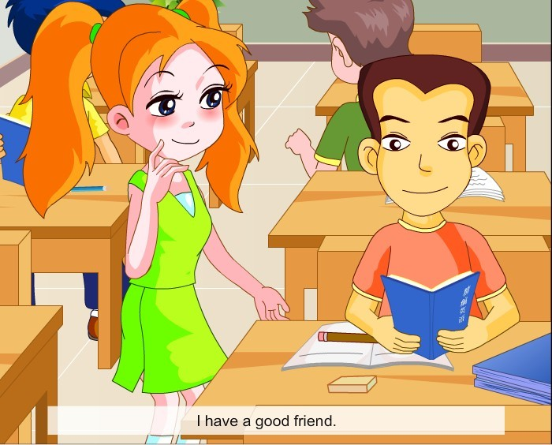
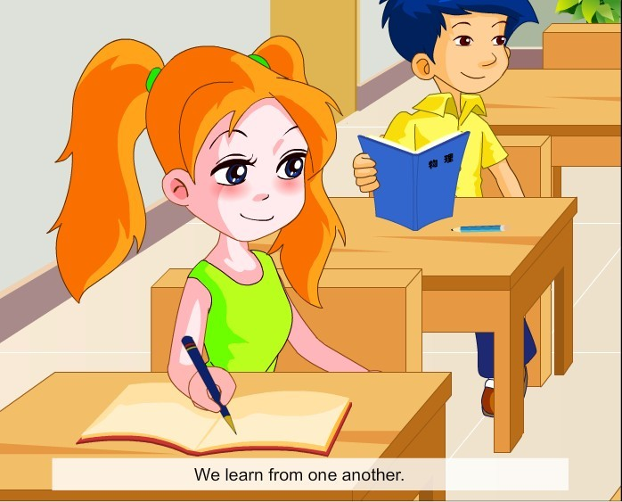
4
Let’s chant

Slide 17
Sum up:
— Could you please+动词原形 你能……吗？
— Sure./Of course./No problem./Sorry.
2. tell sb. sth.告诉某人某事
3. come from=be from
4. help sb. with sth./help sb.(to) do sth.
帮助某人做某事
5. speak +某种语言
6. No problem. = Sure.

Slide 18
Homework:
Do you have a pen pal?
If you have one,
write to him\her after school.
If you don’t have a pen pal,
make one, please.

