Slide 1
Unit 2
We have celebrated the festival since the first pioneers arrived in America.
WWW.PPT818.COM

Slide 2
Words and
Expressions
among
speech
pioneer
grow
corn
following
lay
prep. 在……之中
n. 演说；讲演
n. 开拓者；先驱者
v. 种植，栽培（植物）
n. 谷物；玉米
adj. 接着的；接下来的
v. 摆放（餐桌）

Slide 3
Words and
Expressions
lay the table
over
dish
parade
ourselves
摆放餐桌
adj. 完了的；结束的
n. 盘；碟
n.（庆祝）游行
pron. 我们自己

Slide 4
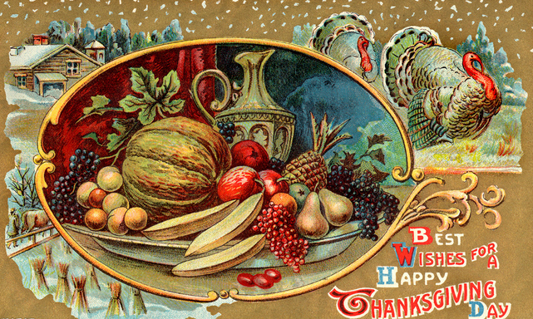
Lead-in
Let’s enjoy a video.
Thanksgiving Day

Slide 5
objectives
1. To understand how people in America celebrate the Thanksgiving Day.
2. To learn some new words and expressions.
3. To have a further understanding of Adverbial Clause of Time.

Slide 6
Words:
among, speech, pioneer, grow, corn, following, lay, over, dish, parade, ourselves
Phrases:
lay the table
Patterns:
while they were crossing…
give thanks (to sb.) for (doing) sth.
We were celebrated the festival since…

Slide 7
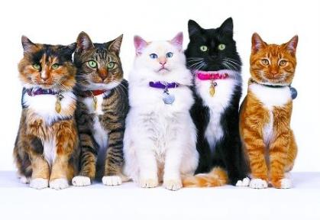
Look and say
among
prep.
在……之中（一般为三者或三者以上）
In the middle of
It is a time for a special dinner among family and friends.
这个时候，朋友或家人会一起吃上一顿特别的晚餐。

Slide 8
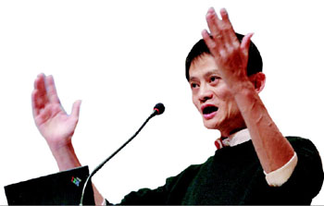
Look and say
speech
n.
演说；演讲
A talk, especially a formal one about a particular subject, given to a group of people.
People make short speeches and give thanks for their food.
人们作简短的致辞，为食物而感恩。

Slide 9
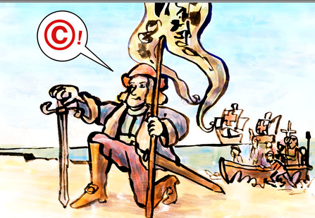
Look and say
pioneer
n.
开拓者
One of the first people to do something that other people will later develop or continue to do.
We have celebrated the festival since the first pioneers from England arrived in America.
自17世纪首批英格兰的拓荒者抵达美洲大陆后，我们就一直庆祝这个节日。

Slide 10
Look and say
grow
v.
种植；栽培（植物）
to make plants or crops grow by taking care of them.
The local people, the Native Americans, taught the pioneers how to grow corn.
当地人，也就是美洲印第安人，教这些拓荒者如何种植玉米。

Slide 11
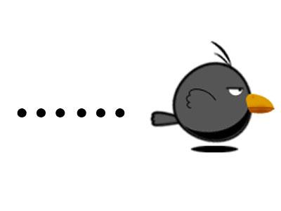
Look and say
following
adj.
接着的；接下来的
The next afternoon, month and so on.
The following year they celebrated together by eating a dinner of the new food.
第二年他们一起享用新收获的食物，欢庆(丰收)。

Slide 12
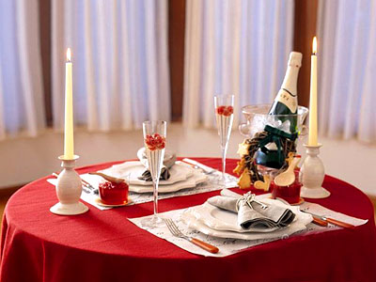
Look and say
Lay the table
摆好餐桌（准备开饭）
To put the cloth, plates, knives, forks etc on a table, ready for a meal.
When the supper was ready, mother told her to lay the table.

Slide 13
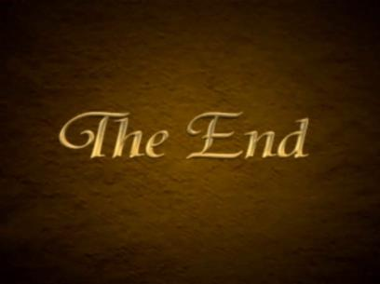
Look and say
over
adj.
结束的
If an event or period of time is over, it has finished.
When it is all over, everyone helps wash the dishes.
吃完饭后，每个人都来帮忙洗餐具。

Slide 14
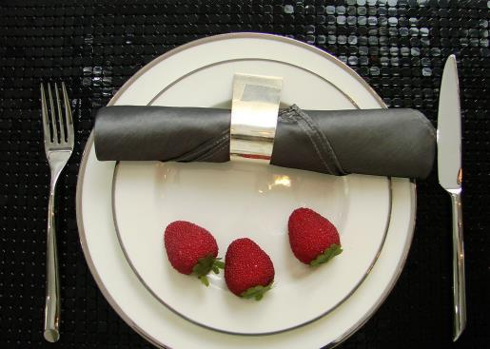
Look and say
dish
n.
盘子；碟子
I’ll just do the dishes before we go.
我们走之前我会把餐具洗好的。

Slide 15
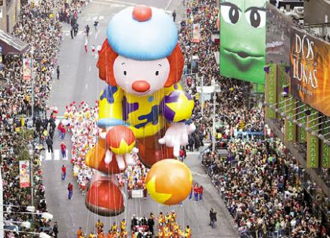
Look and say
parade
n.
游行
A parade is a procession of people or vehicles moving through a public place in order to celebrate an important day or event.
We live in New York City, and we go to watch the Macy’s Thanksgiving Day Parade.
我们住在纽约，我们会去看梅西感恩节大游行。

Slide 16
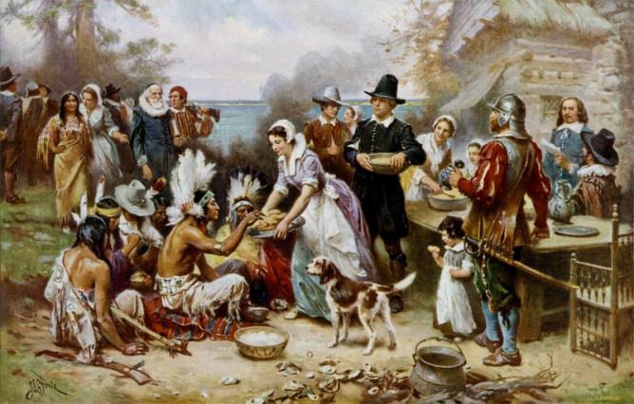
Talking
What do your know about Thanksgiving? What is it?

Slide 17
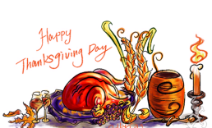
感恩节（Thanksgiving Day）是美国和加拿大共有的节日，由美国人民独创，原意是为了感谢上天赐予的好收成、感谢印第安人的帮助。在美国，自1941年起，感恩节是在每年11月的第四个星期四，并从这一天起将休假两天。
1620年，英国一批主张改革的清教徒，因理想和抱负不能实现而退出国教，自立新教，此举激起了英国当政者的仇恨。他们不得不乘船远渡重洋，流亡美国。

Slide 18
船在大海中漂泊了65天，终于到达了美国东海岸，在罗得岛州的普罗维斯敦港登陆。当时，此处还是一片荒凉未开垦的处女地，火鸡和其他野生动物随处可见。时值寒冬，来到陌生的地方，缺衣少食，恶劣的环境正在威胁着他们的生命。
在这生死攸关的时刻，当地的印第安人为他们送去了食物、生活用品和生产工具，帮助他们建立了新家园。为感谢在危难之时帮助、支援过他们的印第安人，同时也感谢上帝对他们的“恩赐”，他们将猎获的火鸡制成美味佳肴，盛情款待印第安人。感恩节吃火鸡的习俗便流传下来了。

Slide 19
2
Read the passage and match the headings with the paragraphs.
A special dinner.
3
An American festival.
1
2
The history of the festival.
4
Things to do during the festival.

Slide 20
3
Read the passage and complete the table.
Fact about Thanksgiving
Date | _______________________
Meaning | _____________________for their food
History | 1. Have celebrated since ______from England arrived in America 2. Learnt from the Native Americans how to ___and celebrated together by ____ of the new food.
celebration | 1. Celebrate with _______ 2. _________ before dinner 3. Celebrate by watching ________in New York City and ________on television

Slide 21
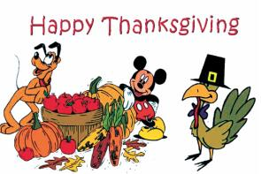
4
Complete the passage with the correct form of the words in the box.
among corn dish
lay pioneer plenty
The first _________crossed the Atlantic and arrived in America in the seventeenth century. At the beginning, they did not have enough food. The Native Americans taught them how to grow______. They soon had ________ to eat.

Slide 22
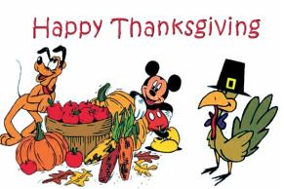
4
among corn dish
lay pioneer plenty
Today, people living in the US remember the Native Americans and the pioneers at Thanksgiving. This festival is celebrated with a meal _____ family and friends. Everyone helps prepare the food and _____ the table. After the meal ,they help wash the______.

Slide 23
What do you think the true meaning of Thanksgiving is?
Turkey?
Shopping?
Holiday?
Having fun?
To be grateful/ thankful for what we have.
To express our appreciation/ gratitude to those around us.
To appreciate ourselves.

Slide 24
Language points
People make short speeches and give thanks for their food.
人们作简短的致辞，为食物而感恩。
give thanks (to sb.) for (doing) sth.
对某人做了某事表示感谢
She expressed her thanks to her friends for coming to the party.
她对朋友们来参加聚会表示感谢。
Thanks for (doing) sth
Thanks for your support.
对某人做了某事表示感谢

Slide 25
We have celebrated the festival since the first pioneers from England arrived in America by ship in the seventeenth century.
自17世纪首批英格兰的拓荒者乘船抵达美洲大陆后，我们就一直庆祝这个节目。
“自从……”可引导时间状语从句，常与完成时连用。
We have been friends since childhood.
我们从小就是朋友。

Slide 26
While they were crossing the Atlantic, many people died…
当他们穿越大西洋的时候，很多人死了……
while
当……的时候
While 引导的从句，其谓语动词只能是延续性动词，强调主从句的两个动作同时发生；while也可作并列连词，表示两个动作的对比，译为“而”、“然而”。
He is strong while his brother is weak.
他长得很结实，而他弟弟却很瘦弱。

Slide 27
The following year they celebrated together by eating a dinner of the new food.
第二年，他们一起享用新收获的食物，共庆丰收。
by eating a dinner of the new food
在句中作方式状语。
by doing sth.
常用来表示“以某种方式进行……”
The little girl earns her living by selling newspapers.
They learnt English by listening to the radio.

Slide 28
Writing
Think about the most unforgettable festival you have enjoyed. Talk it with your partner.
What was it?
Write a passage about your most unforgettable festival!
When was it?
Who did you spend it with?
How did you spend it?
Will you remember it for long? Why?

Slide 29
范文欣赏
An unforgettable festival for me was Chinese New Year last year. It usually comes in January or February. It is the most important festival for us Chinese. Before the Chinese New Year, we were busy shopping and cleaning our houses. My parents bought me some new clothes. On Chinese New Year's Eve, we had a big family dinner. We ate some traditional Chinese food. It tasted delicious.

Slide 30
After dinner, we watched New Year TV programmes till midnight. And we also set off beautiful fireworks. I got some red pockets with money in them from my parents, grandparents, uncles and aunts. I can buy what I want with the money. We always have a good time at Chinese New Year.

Slide 31
本课时重点回顾
give thanks (to sb.) for (doing) sth.
The following year they celebrated together by eating a dinner of the new food.
We have celebrated the festival since the first pioneers from England arrived in America by ship in the seventeenth century.

Slide 32
Spelling Bee
Now 2 mins to test your spelling.
English-Chinese
corn lay the table speech
Chinese-English
在……之中 开拓者 种植 结束的
庆祝游行 接着的 摆放 我们自己
When finished, exchange your papers to see who does the best.

Slide 33
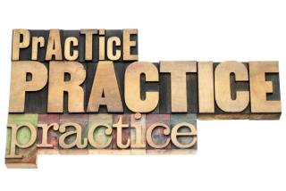
1.He will spend six hours at his desk ____ he finishes his composition.
A. before B. until C. after D. when
2.I knocked at the door for more than five
minutes ____ Mrs. White answered it.
A. until B. when C. after D. before

Slide 34
He was about to go to bed ________ the
doorbell rang.
A. while B. as C. before D. when
_____ John was watching TV, his wife was cooking.
A. As B. As soon as C. While D. Till

Slide 35
–What was the party like?
– Wonderful. It’s years _____ I enjoyed
myself so much.
A. after B. before C. when D. since

Slide 36
Homework
1. Write a passage about your unforgettable festival.
2. Preview the new words we will use in the next lesson.

