Slide 1
Unit1 We have new friends.
人教精通版五年级上册
Lesson 3
WWW.PPT818.COM

Slide 2
>>Review
Let’s sing

Slide 3
>>Lead-in
Quick answer
Where are you from?

Slide 4
>>Presentation
Look, listen and say
Who are they? What are they doing?
Pat
Zhou Pei
Perry
They’re having a TV Music Talk.

Slide 5
>>Presentation
Listen and check
Where do they come from?
= Where are they from?
China
France
Germany
Zhou Pei
√
Pat
√
Perry
√

Slide 6
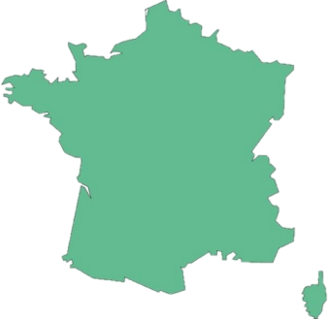
>>Presentation
Look and say
France
is from
Pat comes from France.

Slide 7
>>Presentation
Look and say
Germany
is from
Perry comes from Germany.

Slide 8
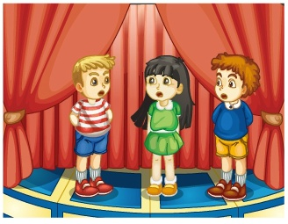
>>Presentation
Listen and answer
1. What do they like?
They all like singing.
2. What does Pat say?
I like both singing and
dancing.

Slide 9
>>Presentation
Just talk
Listen and imitate
Zhou Pei: Hello! My name is Zhou
Pei. I’m from China.
Where are you from?
Pat: I’m from France. This is
my new friend, Perry.
Zhou Pei: Hi, Perry. Where do you come from?
Pat: I come from Germany.

Slide 10
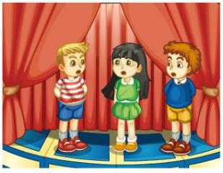
>>Presentation
Just talk
Listen and imitate
Zhou Pei: Do you like singing?
Perry: Yes, I do.
Zhou Pei: I like singing, too. How
about you, Pat?
Pat: I like both singing and
dancing.
Zhou Pei: Great! Let’s sing a song
together.
Pat: OK. Let’s sing!

Slide 11
>>Practice
Read it by groups for one minute .
小组读对话一分钟。
一分钟倒计时
60
Learning tip :
10
10
50
四人一组，比赛读句子，看谁能在一分钟内读完，并且读得准确、流利！
20
20
40
30
30
开始

Slide 12
>>Practice
Show time
小组合作，练习对话并表演，其他同学评价。
Pronunciation (语音) |  | Fluency (流利) | Cooperation (合作)
OK!
Great!
Super!

Slide 13
>>Practice
Pair work
What’s your name?
My name is … / I’m ...
Where do you come from?
I come from ...
What do you like?
I like …

Slide 14
>>Practice
Group work
活动1
Do a survey
Name
Country
Age
Hobby

Slide 15
>>Practice
活动2
名人采访秀
What’s you name?
My name is …
Where do you come from?
I come form…
…?
…

Slide 16
>>Consolidation
Let’s say
Name
Country
Hobby
My name is…
I’m…
I come from…
I’m from…
I like…
Zhou Pei
Pat
Perry

Slide 17
>>Summary
如何询问和回答某人来自哪个国家？
1. —Where do you come from?
—I come from …
2. —Where are you from?
—I’m from …

Slide 18
>>Homework
1.观看课文动画，按照正确的语音、语调朗读课文对话。 2.制作一张调查表，询问同学或家人的国籍、年龄、爱好等信息，并用英文在班级汇报，要求调查对象不少于4人。
3.预习 Lesson 4。

