Slide 1
Unit 4 Growing up
WWW.PPT818.COM

Slide 2
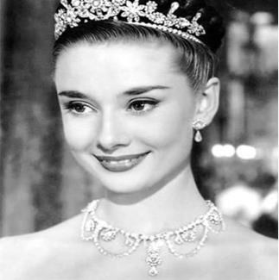
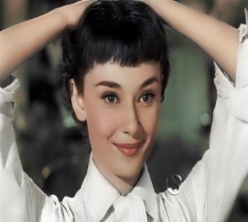
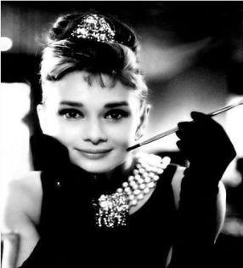
You will not learn more about her until you do some research.
n.调查，研究

Slide 3
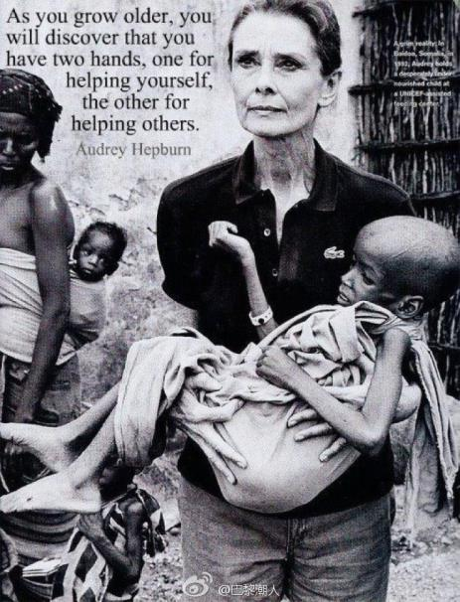
kind and helpful
She devoted much of her lifetime to doing charity work.
Whenever she had some time left , she was always willing to help children in poor areas.

Slide 4
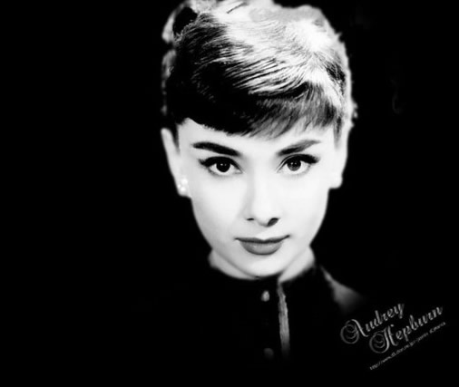
To her surprise,
She discovered that she had cancer in 1991.
after her death
has a heart full of love

Slide 5
Let’s read an article on Page 60.

Slide 6
Read the article and answer the following questions.
Who has influenced the writer most?
How old is he?
What is special about him?
What has he done since 1990?
What does the writer think of him?

Slide 7
Who has influenced the writer most?
How old is he?
What is special about him?
Her father.
between 50 and 59 years old
He is in his fifties.
He has always been kind and helpful.
He is kind and helpful.

Slide 8
4. What has he done since 1990?
He has donated blood many times since 1990.
献血
He has also donated blood cells to people with blood cancer.
n.细胞
To my surprise, he has decided to donate his body for medical research after his death.
医学研究
5.What does the writer think of him?
He has a heart full of love.

Slide 9
How to write about a person who has influenced you most?

Slide 10
Who has influenced you most in your life?
A pop star/film star/sports star
Your family member
Your friend/classmate
Your teacher
…

Slide 11
Useful expressions
…is the person who has influenced me most.
…is in his /her twenties/thirties/forties/…
You will not find anything unusual about him/her until…
…has always been kind/helpful/…
Whenever…
To my surprise,…
When I was a little girl/boy, I could not understand…
Now I realize that…

Slide 12
Pay attention to
Tenses
Expressions
Spelling
Handwriting
Number of words

Slide 13
史蒂夫.乔布斯（Steve Jobs）是苹果公司的前任行政总裁兼创办人之一，是iPad, iPhone等知名数字产品的缔造者。假如你校英文版的编辑，乔布斯的成就对你有较深的影响，请你写一篇短文纪念这位名人。
姓名 | Steve Jobs | 出生年月 | 1955年2月24日
出生地 | California, The USA | 外貌 | 身材瘦高，喜欢穿牛仔裤、羊毛衫和运动鞋
性格 | 聪明善思，喜欢尝试新想法，不轻易放弃。
主要经历 | 1.1976年和朋友共同成立苹果电脑公司。 2.他所涉及和创造的产品极大影响了人们的工作和生活方式。 3.2011年死于癌症，终年56岁。

Slide 14
Possible version:
The person who has influenced me most is Steve Jobs.
He was born in California, the USA, on 24 February 1955. He was tall and thin. He liked wearing a black sweater, jeans and trainers, In 1976, he and his friends set up Apple Computer Company. Steve Job was smart and food at thinking. He kept trying out new ideas and never gave up easily, What he designed and created has greatly changed the way people work and live, Unluckily, he died of cancer at the age of 56.
I think people will remember him for his great achievements.

Slide 15
Evaluating your composition
（评议作文）

Slide 16
Underline the mistakes if necessary.
同伴交换作文，根据表格内的检查项目，帮你的同伴批改作文。
Items 评价项目 | Details 具体检查内容 | Standard scores 标准分值 | Scores 得分
 |  |  | 组评 | 师评
Content 内容 | 文章要点齐全（首段、尾段各1分，品质2分，具体事例2分） | 6
Expressions 表达 | 句子时态正确(错一处扣1分，通篇时态错误不得分) | 2
 | 语言表达准确 | 2
 | 单词拼写正确 | 1
Structure 结构 | 分段合理 | 1
 | 层次清晰、连贯性好 | 1
Others 其他 | 书写整洁美观 | 1
 | 字数合格 大小写和标点使用是否正确 | 1

Slide 17
Life is like a journey. There are people who can help you learn and grow.
Never give up and a hero lies in you.

Slide 18
1. Revise and improve your article.
2. Finish Period 7 on exercise books.

