Slide 1
Unit 11
Sad movies make me cry.
Section B Period 3 1a-2e
WWW.PPT818.COM
Notes:
1
1

Slide 2
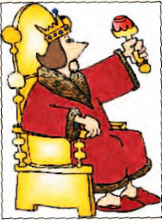
Free talk
What’s the ending of the story about the unhappy king?

Slide 3
Guess
Look at the possible endings to the story about the unhappy king. Do you think any of these is the
right one? If so, which one?
1a

Slide 4
a. The general cannot find a happy person and the king remains unhappy forever.
b. The general finds a happy person with power and money.
c. The general realizes he is a happy person and gives his shirt to the king to wear.
d. The king suddenly becomes happy without the shirt of a happy person.

Slide 5
What are some other possible endings to the story? Discuss your ideas with your partner.
1b
The general found a poor man. The man was very happy.
The poor man gave his shirt to the general.

Slide 6
Listening
Listen to The Shirt of a Happy Man (Part II) and check (✔) the things that happened in the rest of the story.
1c

Slide 7
_____ The general searched for three days and found a happy person.
_____ The general could not find a happy person.
_____ The general saw a poor man on the street.
_____ The poor man was a happy man.
_____ The poor man gave the general his shirt.
✔
✔

Slide 8
Listen again. Answer the questions.
1d
1. How long did it take the general to find the happy man?
2. What was the poor man doing on the street?
Two days.
He was eating some food with his hands and singing happily to himself.

Slide 9
3. What made the poor man so happy even though he had no power, money or fame?
4. Do you think the general will return to the king with the poor man’s shirt? Why or why not?
He had everything he wanted and didn’t want what he couldn’t have.
No, because the poor man did not have a shirt.

Slide 10
Role-play
Do you agree with the poor man’s thoughts about happiness? Discuss your ideas with your group. Then role-play the rest of the story.

Slide 11
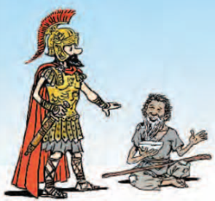
I heard you singing just now, and you sound very happy.
That’s because I am happy.

Slide 12
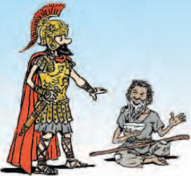
I have everything I want, and I don’t want what I can’t have. So I’m happy, and my song comes from the happiness in my heart.
But I don’t understand. What makes you so happy? You have no power, money or fame.

Slide 13
Then I need to give your shirt to the king. Is it there in your bag? How much do you want for it?
Shirt? What shirt? I don’t own any shirts!

Slide 14
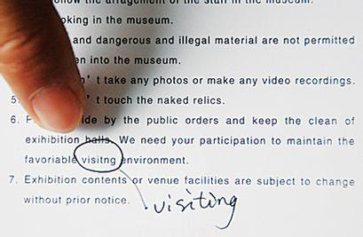
Free talk
Have you ever made a mistake? How did it make you feel? Talk to your partner about what happened.
2a
In the English exam last week, I was too nervous that I made a spelling mistake. It made me feel very angry about myself.

Slide 15
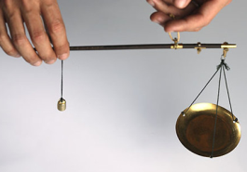
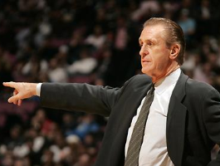
Presentation
shoulder
n. 肩; 肩膀
weight n. 重量; 分量
coach
n. 教练;
私人教师
nod v. 点头

Slide 16
Read the story and number the events in the correct order.
2b
2
____ Peter got home and went into his room.
____ Peter talked to his teammates.
____ Peter missed a goal.
____ Peter’s father gave him advice.
____ Peter realized that he was worried for no reason.
4
n.同队队员;
队友
1
n. 球门;射门; 目标
3
5

Slide 17
Read the story again and answer the questions.
2c
Why did Peter feel angry and worried?
He was angry with himself for missing an important goal and letting his team down. His was worried that his coach may kick him off the team.

Slide 18
2. What kind of advice did Peter’s father offer him?
Peter’s father advised him not to be too hard on himself but to learn how to communicate with his teammates and learn from his mistake.

Slide 19
3. Do you agree with Peter’s father? Why or why not?
Yes. It is more meaningful to learn from one’s mistakes and do better in the future.

Slide 20
4. What happened after Peter told his teammates that he was sorry?
His teammates asked him not to worry about what had happened as it wasn’t just one person’s fault. They agreed that they should work together to think about how they could do better in the future.

Slide 21
5. Why did Peter think that he was on a winning team even though they lost the last game?
He was on a team with good team spirit that would help them achieve success in the future.

Slide 22
The general finds a happy person with power, money and fame.
with 表伴随, “带着……, 与…… 一起, 随着, 有”; 反义词: without “没有”。后面均可接名词或动名词。
e.g. He left without saying a word.
他一句话都没有说就走了。

Slide 23
2. How could he have missed scoring that goal?
could have done表示“过去本能够做某事但未做”, 包含“责备”意义。
e.g. How could he have been such a fool? 他怎么这么糊涂？
How could she have forgotten what kind of man he was?
她怎么能忘记他是哪种人呢？

Slide 24
3. He was really worried that his coach might kick him off the team.
kick v. 踢; 踹
kick sb. off 开除某人
e.g. Tim made a huge mistake, and the manager kicked him off the company. 蒂姆犯了一个很大的错误, 经理把他开除了。

Slide 25
4. Ten minutes later, Peter heard his father knocking on his bedroom door.
knocking在这里做hear的宾补。
相同用法的词还有：
see/watch/find/hear/notice sb. doing sth.
e.g. When Lisa was alone at home, she
heard something making noise
outside.
当丽莎独自在家时, 她听到外面有
响声。

Slide 26
5. But whatever it was, don’t be too hard on yourself.
be hard on sb.
过于严格地要求某人; 对某人过于严厉; 以刻薄的方式批评、对待某人
e.g. Some teachers today are too hard on
their students.
如今一些老师对学生的要求过于严厉。
Perhaps I’m too hard on my
daughter.
或许我对我女儿要求过头了。

Slide 27
6. Besides, wining or losing is only half the game.
besides “除……以外还有”, 表示包括后面提到的人或物在内。
except “除去”, 表示不包括后面所提到的人或物在内。
e.g. All the students went to the park
except Jim. (Jim没去)
Lucy went to the cinema besides Lily.
(Lily也去了)

Slide 28
7. The next day, Peter went to soccer practice with courage rather than fear in his heart.
courage n. 勇气; 勇敢
rather than 并非; 而不是
e.g. I, rather than you, should do the work. 该做这工作的是我, 而不是你。
The most valuable thing is time, rather than money. 最珍贵的是时间, 而不是金钱。

Slide 29
8. But I think if we continue to pull together, we’re going to win the next one.
pull together 齐心协力; 通力合作
e.g. If all of us pull together, there must
be something we can do to improve
the environment.
如果我们都能齐心协力, 我们一定能
做点什么来改善环境。

Slide 30
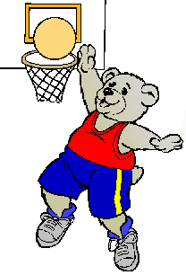
What is the bear
doing?
It might /could be
_______________.
playing basketball

Slide 31
Find idioms or phrases from the story to replace the underlined parts of these sentences.
2d
He could not believe that he did not get the ball into the basket.
2. She was worried because she had disappointed her parents.
missed scoring that goal
v. 使失望
let … down
使失望

Slide 32
3. Tony was sad that he was asked to leave the team.
4. You should learn to relax and not put so much pressure on yourself.
5. The teacher told the students to work hard together and not give up.
kicked off
be too hard on yourself
pull together

Slide 33
Role-play
Role-play a conversation between Peter and his father.
2e
Father: What’s wrong, Peter? You look
sad.
Peter: I missed scoring a goal. I made
my team lose the game.
…

Slide 34
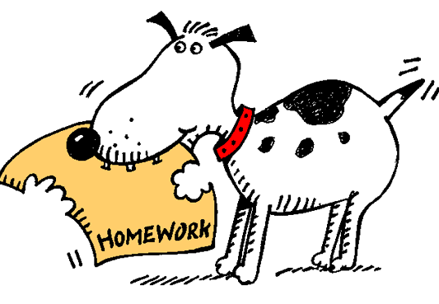
Homework
1.Recite the text on Page86.
2. 用make的相关用法描述自己的情感，写一篇短文。

