Slide 1
Unit 4 Growing up
Welcome to the unit
WWW.PPT818.COM

Slide 2
课前自主预习
单词闯关 | 1.时期，时代________ 2．无论何时________ 3.以，凭借________
time
whenever
through

Slide 3
短语互译 | 1.挂在心上；惦念______________ 2．把某人叫醒______________ 3．大量，许多______________ 4．一……就______________ 5.in different times and places ___________________ 6．for oneself______________ 7．grow up______________ 8．learn about______________
on one's mind
wake sb up
a great deal (of)
as soon as
在不同的时代和地方
亲自
长大
了解，得知

Slide 4
句型在线 | 1.埃迪，在想什么呢？ What's ______________________， Eddie? 2．直到你建好它再叫醒我。 Don't ________________________ you finish building it. 3．我喜欢通过网络了解世界。 I like to ____________ the world________________. 4．你一点击鼠标，就会有大量的信息。 ________ you click the mouse, there's __________information.
on your mind
wake me up until
learn about
through the Internet
As soon as
a great deal of

Slide 5
课堂互动探究
词汇点睛
●1 time n．时期，时代
[观察] This saves plenty of time.这节省很多时间。
Books allow me to learn about people in different times and places.
书让我了解不同时代和地方的人。
I have been to Beijing three times.我去过北京三次。
This sitting room is 3 times as large as the kitchen.
客厅的面积是厨房的三倍。

Slide 6
意为“时期，时代；次数”，用作可数名词。表示倍数时，要用复数。
[探究] time的用法：
意为“时间”，为____________名词，前面可用much, little, a lot of, plenty of等修饰。
不可数

Slide 7
[拓展] time构成的短语：
at a time一次，每次 at times/from time to time有时，偶尔
every time每次 for the first/last time第一次/最后一次
all the time 总是，一直 in time及时，迟早
on time准时 (at) any time随时
at all times总是 at the same time 同时

Slide 8
活学活用
1．—How many books can I borrow from the library ________？
—Two or three.
A．at times B．at a time
C．all the time D．on time
B

Slide 9
●2 through prep. 以，凭借
[观察] You can learn English through the Internet.
你可以通过网络学习英语。
[探究] through 作介词，意为“穿过；通过；从头至尾；遍及”；
through还可作副词，意为“穿过；自始至终；完全”。

Slide 10
[辨析] across, through, over, past与cross
across | 介词 | “从……表面穿过”，从某个范围的一边到另一边
through | 介词 | “从……中间穿过”，往往指穿过沙漠、森林，光线透过窗户

Slide 11
over | 介词 | “翻越”，表示到达高的障碍(如树、墙、篱笆和山脉等)的另一侧
past | 介词 | “走过，经过”，从某物或某人旁边经过
cross | 动词 | “穿过”，相当于go across

Slide 12
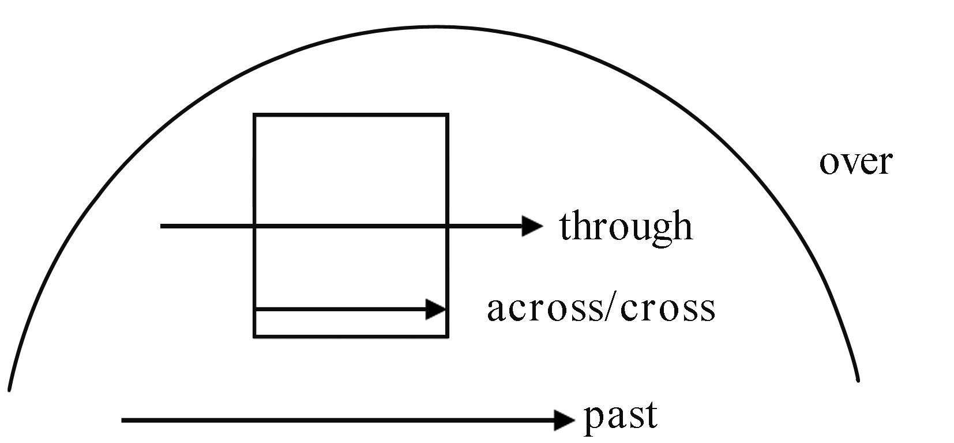
He can swim across the river.他能游过这条河。
He jumped over the wall.他跳过了墙。
He walked past me without saying hello.
他没打招呼就从我身边走过了。
The old man is crossing the road.
这位老人正在过马路。

Slide 13
2．(1)Ma Yun, the Chairperson of Alibaba Group, has made much
money ________ the Internet.
A．through B．along
C．across D．towards
A

Slide 14
(2)2017·安顺 —Why would you like to walk ______ the
forest? —Because I want to try ________.
A．across; exciting something B．through; exciting something
C．across; something exciting D．through; something exciting
D
【解析】考查介词与不定代词的用法。句意：“你为什么想穿过森呢？”“因为我想尝试一些令人激动的事。”前者考查“穿过森林”，表示空间上的“穿过”应用through；后者考查形容词修饰不定代词应该后置的用法，表示“一些令人激动的事情”应用something exciting。故选D。

Slide 15
句型透视
●As soon as you click the mouse, there's a great deal of information.
你一点击鼠标，就会有大量的信息。
[探究] as soon as 意为“一……就”，引导时间状语从句；
a great/good deal of 意为“大量，许多”，其后通常接
______________。
She spends a good deal of money on clothes every year.
她每年在衣服上花不少钱。
不可数名词

Slide 16
[拓展] 英语中有很多短语表示“大量，许多”，根据性质可分
为以下三类：
(1)修饰可数名词复数：a large/great number of，其作主语时，
谓语动词用复数形式。
A large number of students play soccer in our school.
在我们学校许多学生踢足球。

Slide 17
(2)修饰不可数名词：a great/good deal of，其作主语时，谓语动
词用单数形式。
He has spent a great deal of money on his new house.
他在新房子上花了许多钱。

Slide 18
(3)既能修饰可数名词复数，又能修饰不可数名词：a lot of, lots
of, plenty of等，其作主语时，谓语动词根据被修饰的名词的数
来决定单复数形式。
There are a lot of/lots of people in the supermarket.
超市里有许多人。

Slide 19
活学活用
(1)—Did you catch the early bus this morning?
—Yes. The bus started to move ________ I got on it.
A．as soon as B．as if
C．though D．before
A
【解析】考查连词。根据答语中的“Yes.”可知，“我”赶上了早班车。
句意：我一上车，车就开了。故选A。

Slide 20
(2)They spent ________ money on the new hospital.
A．a great deal
B．a good deal of
C．a great many
D．a large number of
B

