Slide 1
Unit 8 Let’s have both
WWW.PPT818.COM

Slide 2
Teaching Objectives：
1.了解中西方饮食方式和习惯的差异。
2.训练阅读理解能力。

Slide 3
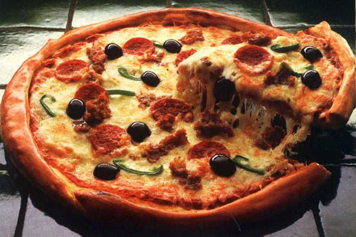
pizza

Slide 4
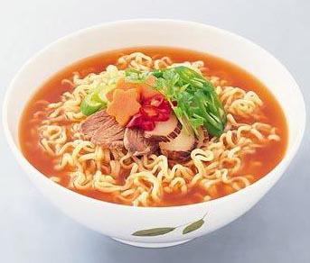
noodles

Slide 5
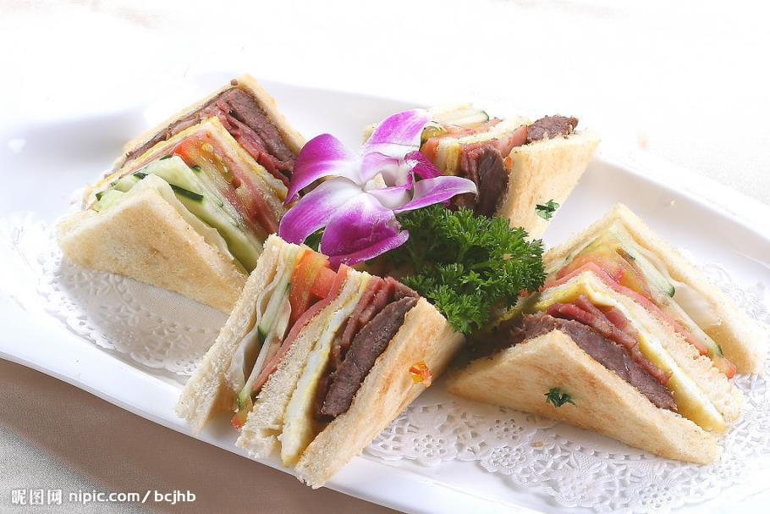
Sandwiches

Slide 6
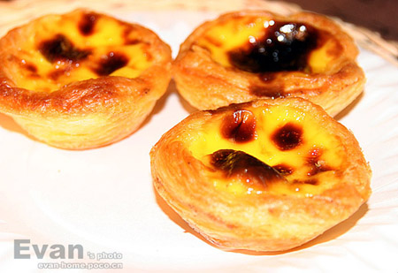
Egg tarts

Slide 7
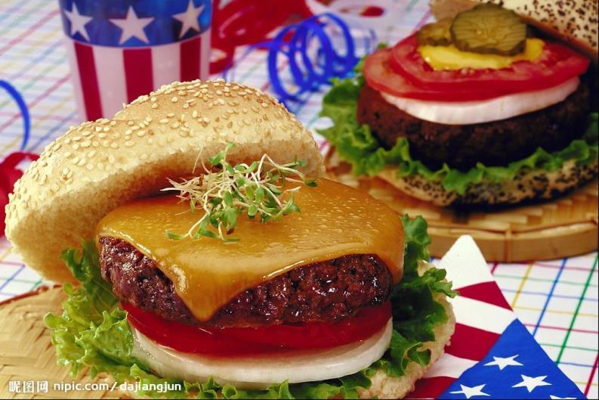
hamburger

Slide 8
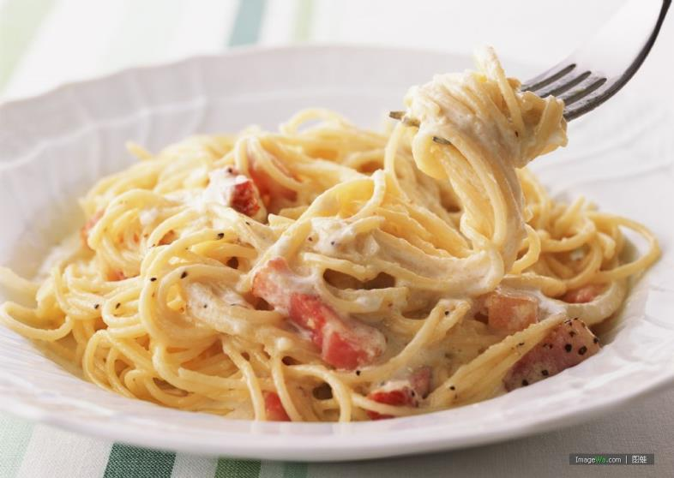
pasta

Slide 9
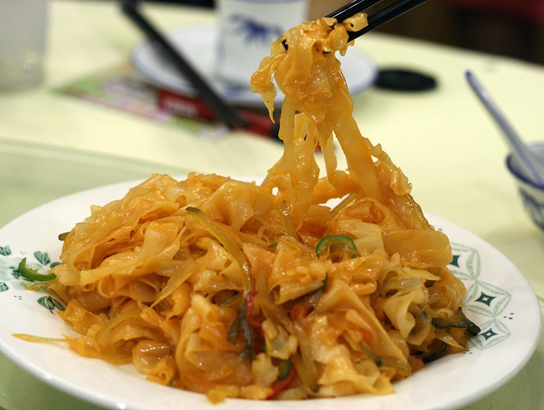
Rice noodles

Slide 10
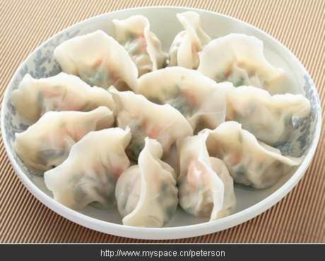
dumplings

Slide 11
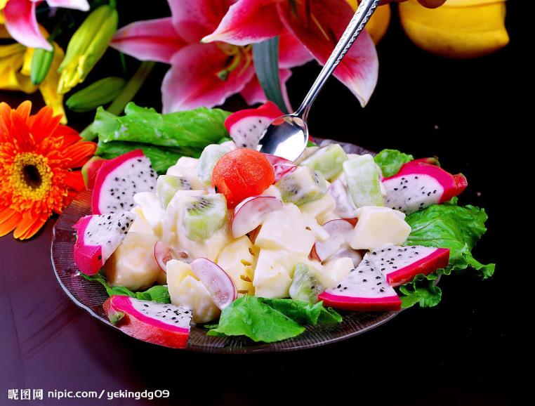
salad

Slide 12
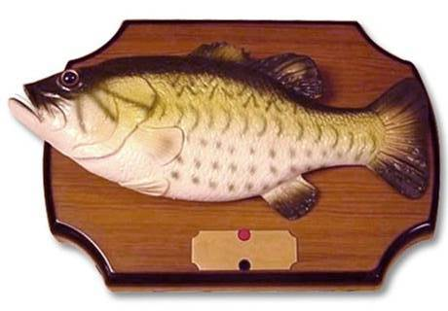
fish

Slide 13
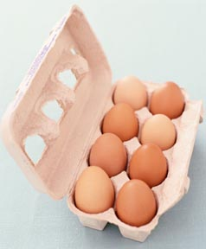
eggs

Slide 14
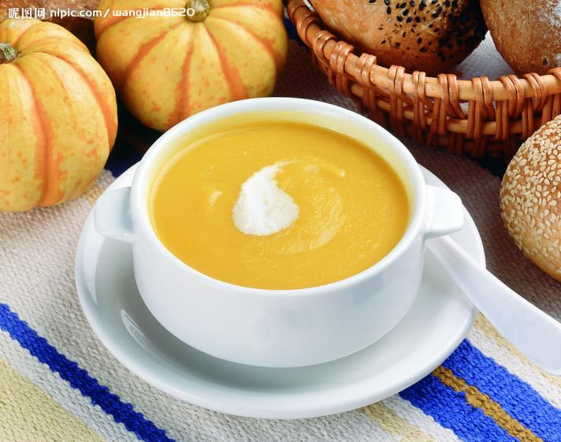
soup

Slide 15
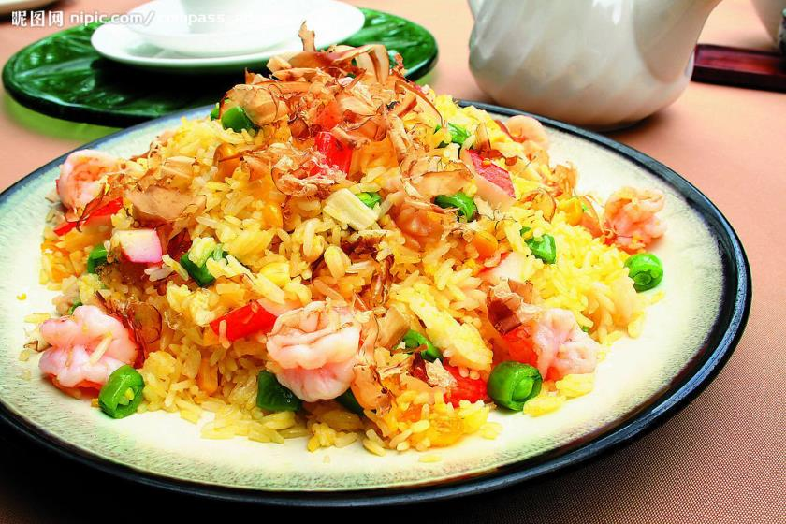
fried rice

Slide 16
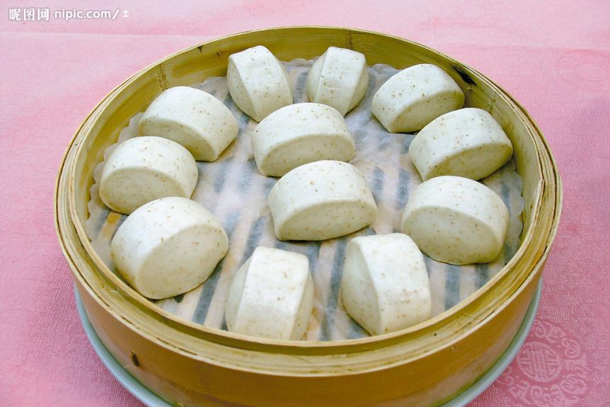
Steamed buns

Slide 17
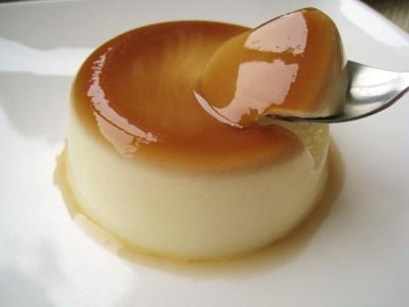
pudding

Slide 18
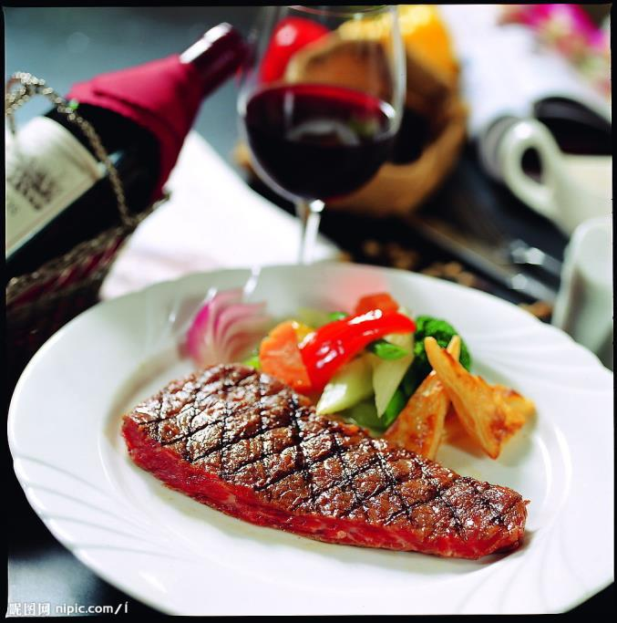
beefsteak

Slide 19
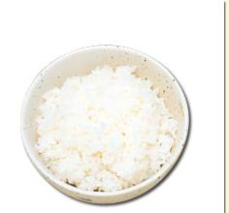
rice

Slide 20
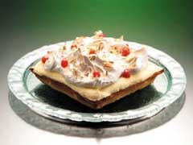
cake

Slide 21
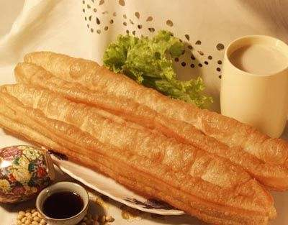
Fried bread stick

Slide 22
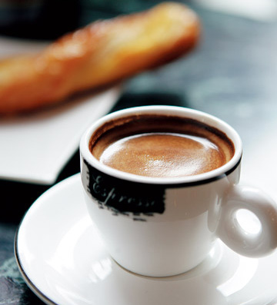
coffee

Slide 23
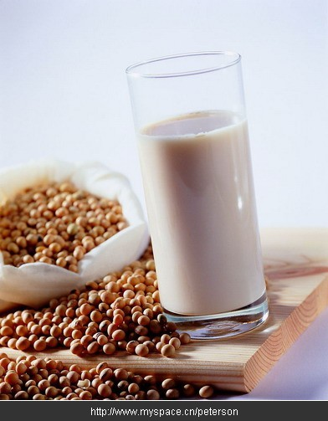
Soybean
milk

Slide 24
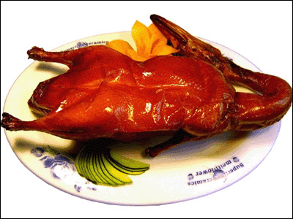
Beijing roast duck

Slide 25
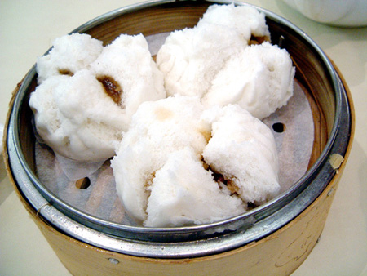
Barbecue pork buns

Slide 26
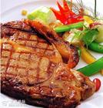
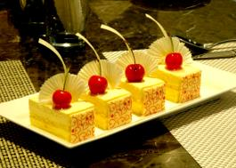
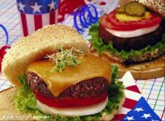
Western food

Slide 27
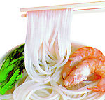
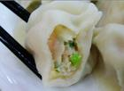
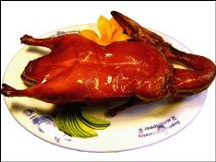
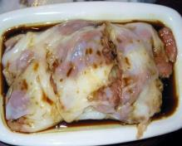
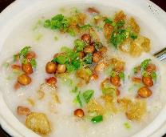
Chinese traditional food

Slide 28
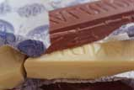
chocolate

Slide 29
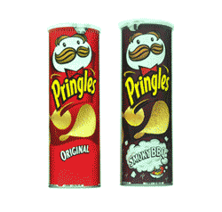
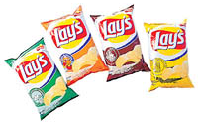
potato chips

Slide 30
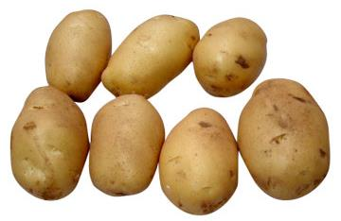
potato

Slide 31
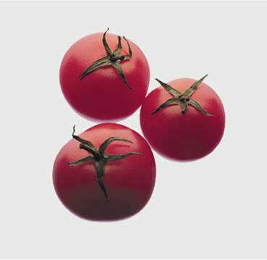
tomato

Slide 32
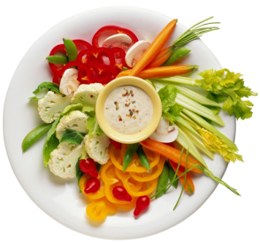
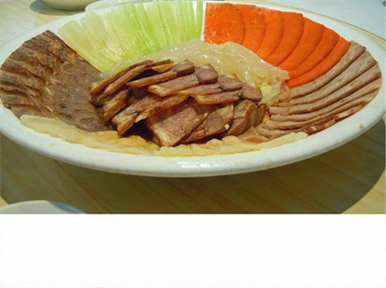
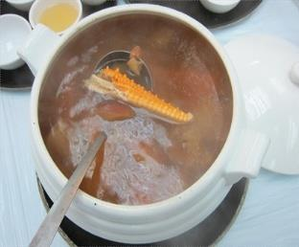
Unit 8
Starters
vegetable salad
cold meat
soup

Slide 33
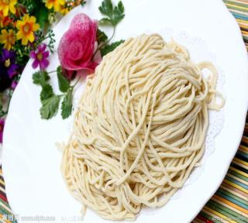
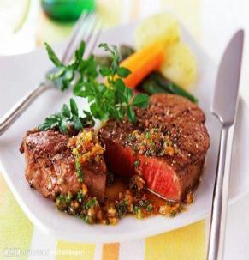
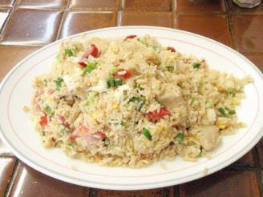
Unit 8
Main courses
fried rice
noodles
roast beef

Slide 34
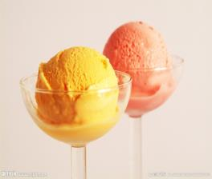
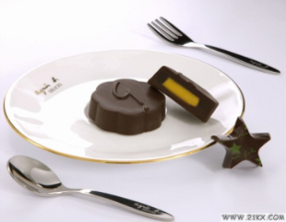
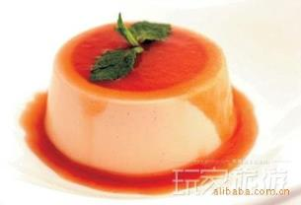
Unit 8
Desserts
ice cream
chocolate
pudding

Slide 35
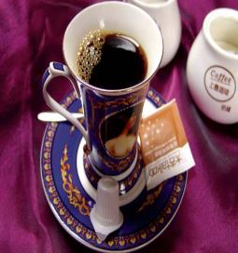
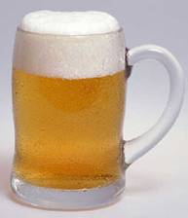
Unit 8
Drinks
coffee
juice
beer

Slide 36
Unit 8
Put the 25 words in the right groups.
Starters | Main courses | Desserts | Drinks
vegetable salad potato salad ox-tail soup tomato soup creamed mushroom soup cold meat and sausage | hamburger sandwich pizza noodles fried rice roast beef fish cutlet chicken curry ham and eggs | ice cream chocolate pudding cake jelly | coke coffee wine juice beer

Slide 37
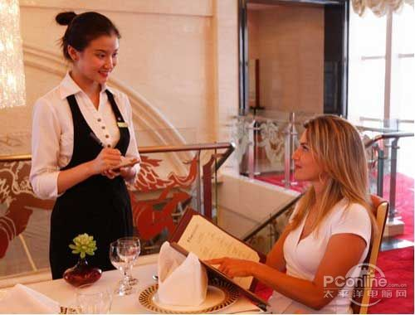
Take Customer’s Order
Unit 8

Slide 38
Unit 8
Desserts
pudding
pudding

Slide 39
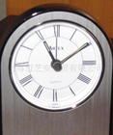
---- What would you like for
breakfast
lunch
---- I’d like….
dinner

Slide 40
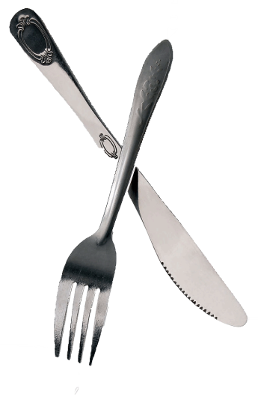
Different ways of eating
chopsticks
knife
Folk

Slide 41
new words and phrases

Slide 42
differ [‘difə] 不同
意见不一。
Opinions differ.
different adj.
difference n.
2. saying [‘seiiŋ] 说法，谚语
名言
a wise saying

Slide 43
3. consider [kən‘sidə] 认为
我认为能被邀请参加晚宴是很大的荣幸。
I consider it a great honor to be invited to dinner.
4. rudeness ['ru:dnis] n.
粗鲁，无礼
rude adj.
5. Relaxing [ri‘læksiŋ] adj.
relax v.

Slide 44
6. peaceful [‘pi:sfəl] 安宁的，和平的
中国是一个爱好和平的国家。
China is a peaceful country.
7. air [ɛə] 气氛
有种浪漫气氛。
There is romance in the air.
8. be regarded as 被认为
她被看作是这里最好的医生。
She is regarded as the best doctor.

Slide 45
美国人的饮食文化
Breakfast
Juice
Eggs
Milk
Bread

Slide 46
Lunch
随便又简单
12:00-14:00
Pizza
Hot dog
Hamburger
Drink

Slide 47
Dinner
begin at 6:00
Soup
Main course
Vegetable
Dessert
Drink

