Slide 1
Unit 4 Topic 2
How can we protect ourselves from the earthquake?
Section C
WWW.PPT818.COM

Slide 2
Pre-reading
1a
Check what we should do to protect ourselves in the earthquake based on your own knowledge.
 take a lift to go downstairs
 run out of a room
 stand in the middle of a room
 stand near a tall tree
 protect your head with your arms

Slide 3
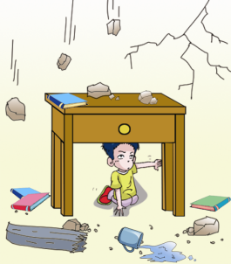
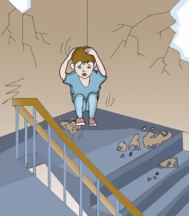
1b
Read 1a and write down the key words under each picture. Retell what we should do based on the key words.
If you are indoors
stay under a strong table or desk
sit on the floor in a doorway or close to the wall

Slide 4
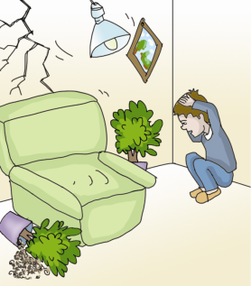
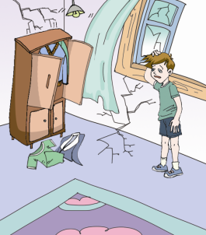
Listen to 1a and write down the key words under each picture.
If you are indoors
protect your head and neck with your arms
stay away from the window

Slide 5
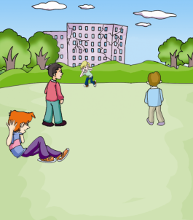
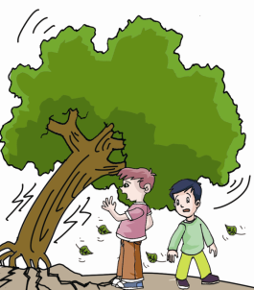
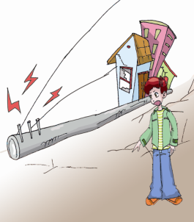
If you are outdoors
get away from buildings and trees
move to clear areas
be careful of
fallen power lines

Slide 6
1c
Read again and answer the following questions.
When can earthquakes be very serious ?
How do you understand “the danger is not over when the strong shaking stops”?
What does the word “aftershocks” mean ?
When the earthquakes happen near a city, they can be very serious.
There will be some shocks after most earthquakes.
It means “余震”.

Slide 7
Read again and answer the following questions.
4. What is the most important thing to remember in the earthquake ?
5. Do you know more ways to protect yourself in an earthquake ?
The most important thing to do is to stay calm.

Slide 8
Key points
Knowing some ways to protect yourself will help to keep you safe in an earthquake.
了解一些（在地震中）保护自己的方法，将会帮助你在地震中保护自己的安全。
keep sb. / sth. + adj. 保持 / 护某人 / 物 ……
Eg: keep our classroom clean 保持教室清洁
keep us healthy 保持健康

Slide 9
2. … or close to a wall is safer …
close to 靠近 / 接近 （介词短语）
Eg: You can ______________ the fire and you will feel warmer.
3. Stay away from windows …
stay away from = get away from 远离……
Eg: 我们应该远离一切危险的东西。
We _________________________ everything
dangerous.
sit close to
should stay away from

Slide 10
4. The danger is not over when the strong shaking stops.
当强震停止时，危险还没有结束。
be over 结束
e.g. _________________ , let’s have a rest.
课上完了，让我们休息吧。
The meeting __________ , but he was still sleeping.
会议结束了，他还在睡觉。
Class is over
was over

Slide 11
Retell the passage
Retell the passage one by one paragraph.
Paragraph 1 :
Many earthquakes happen … Some
of …near a city … hurt or die …Knowing
some ways …

Slide 12
Paragraph 2 :
If you … the safest place … Sitting on …
Remember to protect your head … Stay away
from windows … Do not try to …

Slide 13
Paragraph 3 :
If you are out of doors … Get away from … Be
very …

Slide 14
Paragraph 4 :
The danger is not over … There will be … We
call them …

Slide 15
Paragraph 5:
When it is … Some may … You may … That
is …

Slide 16
Group work
We knew how to protect ourselves from 1a.
Do you know how to protect ourselves in a fire ?
Let’s discuss what we should do and shouldn’t do in a fire in groups.

Slide 17
Match the phrases with the correct pictures. Then discuss in groups what you should and shouldn’t do in a fire.
2a
a. take the lift
b. call 119 for help
c. turn off the gas and lights
d. jump off a window
e. cover your face and leave the building

Slide 18
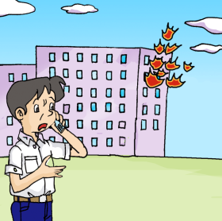
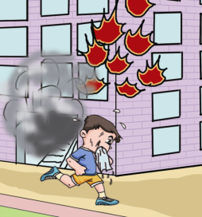
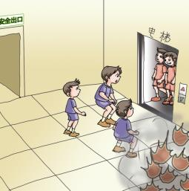
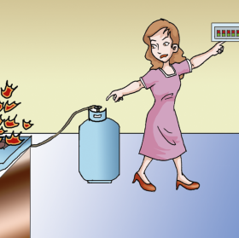
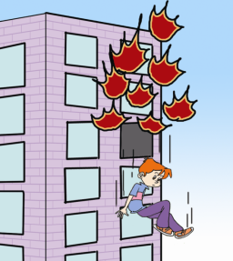
b
a
e
c
d

Slide 19
Find more useful expressions to use in the table with should and shouldn’t do. Then write down sentences based on 2a and exchange ideas with your partner.
2b
Should | Shouldn’t do
The most important thing to do is to … The safest place is… … is safer than … … | When you…, it can be more serious. … is more dangerous. Don’t … …

Slide 20
2c
Write a short passage with the title How to Protect Yourself in a Fire in your exercise book.

Slide 21
Do the exercises.
Make sentences with the phrases in 1a.
1. keep sb. / sth. + adj.
______________________________________.
2. close to
______________________________________.
3. stay away from = get away from
______________________________________.
4. be over
______________________________________.

Slide 22
summary
We learn : some phrases.
keep sb. / sth. + adj.
close to
stay away from = get away from
be over
2. We know some ways to protect ourselves in an earthquake.

Slide 23
Homework
熟读1a的文章。
收集其它灾害逃生的方法，在班里交流、分享、学习。

