Slide 1
Unit2 Lesson 3
She's my friend.
WWW.PPT818.COM

Slide 2
let's sing Hello Hello What's your name?
What's your name? What's your name?
Hello Hello What's your name?
What's your name? What's your name?
My name's Jenny.

Slide 3
前置性作业
一、借助点读笔或其他工具预习下列单词：认读并翻译。
1.he_________ he’s__________ she___________ she’s_________
friend________ let’s__________ play_________
二、借助点读笔或其他工具预习下列句子：认读并翻译。
1.This is Liu Lei.He’s my friend.__________________
2.This is Zhou Bing. She’s my friend.___________________
3.Let’s play.___________________

Slide 4
Listen and say
This is Liu Lei. He's my friend.

Slide 5
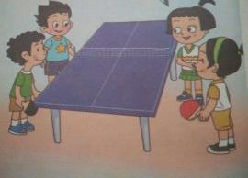
This is Zhou Bing. She's my friend.

Slide 6
Nice to meet you.
Nice to meet you,too.

Slide 7
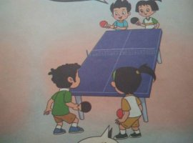
Let's play! OK!

Slide 8
Groupwork
choose any way you like to read the dialogue.
1. 小组齐读： read together.
2. 小组分角色： Role---play.
3. 小组分段读： One by one.

Slide 9
Pairwork
要求同学们拿出事先准备好的朋友图片，两人一组练习句型。
This is ....
She's/He's my friend.

Slide 10
Let's chant
Jenny,Jenny,this is Jenny.
Friend,friend,she’s my friend.
Danny,Danny,this is Danny.
Friend,friend,he’s my friend.

Slide 11
Homework
1.朗读并背诵本课课文，并运用所学句型介绍自己的朋友
2.借助点读笔复习chant.

