Slide 1
Unit 7 Shopping Study skills
WWW.PPT818.COM

Slide 2
Lead-in
How many phonemes are there in English?
48.
How many vowels are there in English?
28.
How many consonants are there in English?
20.
Notes:
2

Slide 3
Fun time
My favourite fruit
grape
My favourite animal
dog
My favourite sports
Running
swimming
My favourite colour
purple
Notes:
3

Slide 4
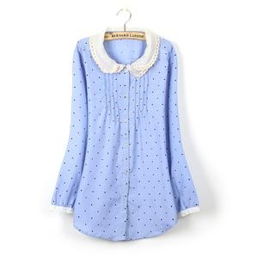
Presentation
What can you see on the screen?
I can see a blue blouse.
/bl/
/bl/
Notes:
4

Slide 5
Consonant groups
Consonant groups at the beginning of a word are like this:
black class floor glass plane sleep
/bl/
/kl/
/fl/
/gl/
/pl/
/sl/
bread cry friend grass pretty
/br/
/kr/
/fr/
/gr/
/pr/
sky small snow speak star
/sk/
/sm/
/sn/
/sp/
/st/
screen spring street
quiet sweet twenty
/skr/
/spr/
/str/
/kw/
/sw/
/tw/
Notes:
5

Slide 6
Presentation
What can you see on the cake?
I can see some candles.
/dl/
Notes:
6

Slide 7
Consonant groups
Consonant groups at the end of a word are like this:
table people uncle
noodle little pencil
/bl/
/pl/
/kl/
/dl/
/tl/
/sl/
cousin listen often
seven garden
/zn/
/sn/
/fn/
/vn/
/dn/
Notes:
7

Slide 8
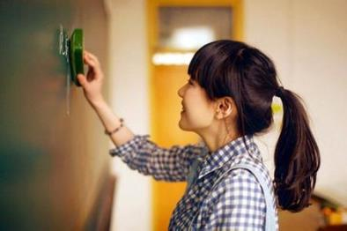
Practice
clean the __ackboard
pl
bl
practise in the __ayground
Notes:
8

Slide 9
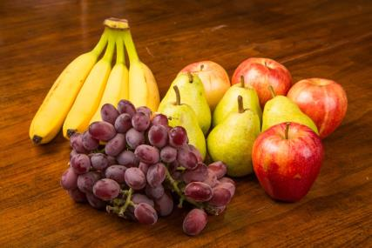
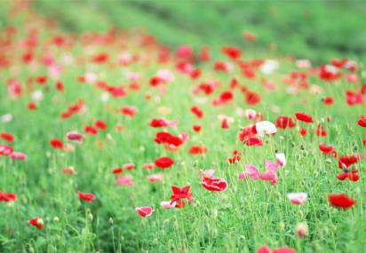
Practice
__owers in spring
fruit on the ta___
fl
ble
Notes:
9

Slide 10
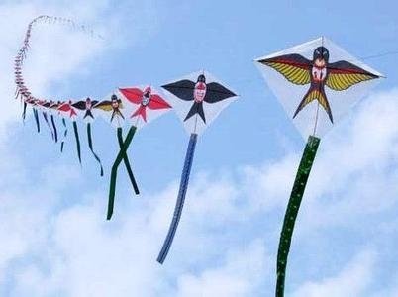
Practice
kites flying in the __y
sk
a group of little peo___
ple
Notes:
10

Slide 11
Practise saying the following sentences.
Our classrooms are clean and bright.
He speaks quite quickly.
Twinkle, twinkle, little star.
Twenty green bottles stand on the table.
The boys often play on the grass after class.
Notes:
11

Slide 12
Discovery
Try to find the consonant group in each word.
blouse clip flower glue plate slow bright cream fruit grass pretty
ski smile sneeze special start quiet sweater twice screen spring
strong bubble trouble bicycle uncle noodle middle little pencils
Notes:
12

Slide 13
Practice
Make sentences with the consonant groups we have learnt today. Each sentence should have at least two consonant groups.
Notes:
13

Slide 14
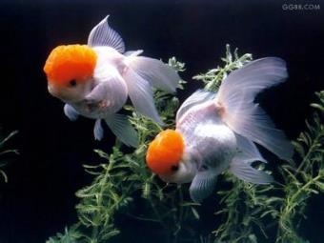
Practice
My goldfish is a wonderful pet.
She doesn’t need a bed.
She isn’t any trouble.
We don’t have to feed her much.
She doesn’t need a gentle touch.
Just bubbles,
Bubbles,
Bubbles.
Notes:
14

Slide 15
Conclusion
What have we learnt today?
Some consonant groups.
What are they?
/bl/ /kl/ /fl/ /gl/ /pl/ /sl/
/br/ /kr/ /fr/ /gr/ /pr/
/sk/ /sm/ /sn/ /sp/ /st/ /sk/ /sp/ /st/ /sr/
/kw/ /sw/ /tw/
/bl/ /pl/ /kl/ /dl/ /tl/ /sl/
/zn/ /sn/ /fn/ /vn/ /dn/
Notes:
15

Slide 16
Homework
1. Revise what we have learnt today.
2. Make consonant group cards by yourselves.
Notes:
16

