Slide 1
Unit 2 Travelling
Grammar 1
WWW.PPT818.COM

Slide 2
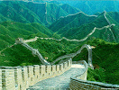
The Great Wall
I have been to ________.
We have been in _____ for five days.

Slide 3
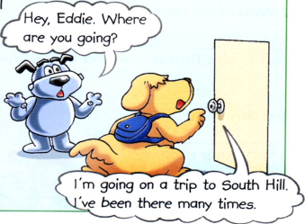
We use ‘have (has) been ’ to express the idea that someone went to some place and has already come back.
某人去过某地，现在已经回来了。
For example:
Eddie has been to South Hill many times.
It is very nice and he wants to go there
again.

Slide 4
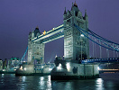
London
Tower Bridge
PPT模板：www.1ppt.com/moban/ PPT素材：www.1ppt.com/sucai/
PPT背景：www.1ppt.com/beijing/ PPT图表：www.1ppt.com/tubiao/
PPT下载：www.1ppt.com/xiazai/ PPT教程： www.1ppt.com/powerpoint/
资料下载：www.1ppt.com/ziliao/ 范文下载：www.1ppt.com/fanwen/
试卷下载：www.1ppt.com/shiti/ 教案下载：www.1ppt.com/jiaoan/
PPT论坛：www.1ppt.cn PPT课件：www.1ppt.com/kejian/
语文课件：www.1ppt.com/kejian/yuwen/ 数学课件：www.1ppt.com/kejian/shuxue/
英语课件：www.1ppt.com/kejian/yingyu/ 美术课件：www.1ppt.com/kejian/meishu/
科学课件：www.1ppt.com/kejian/kexue/ 物理课件：www.1ppt.com/kejian/wuli/
化学课件：www.1ppt.com/kejian/huaxue/ 生物课件：www.1ppt.com/kejian/shengwu/
地理课件：www.1ppt.com/kejian/dili/ 历史课件：www.1ppt.com/kejian/lishi/
My friend Lucy has gone to __________.
She will be back next week.

Slide 5
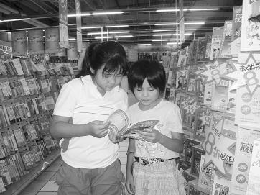
We use ‘have (has) gone’ to express the idea that someone went to some place and is still there.
某人去了某人，现在仍然在那儿，还没回来。
For example:
Millie and Amy have gone to the bookshop to buy some books on travelling.
They will be back in an hour.

Slide 6
Finish A1 on Page 26 by yourself.
Then work in pairs to check the answers.

Slide 7
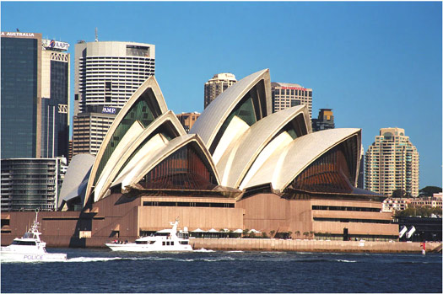
Exercise 1:
Millie in Australia
Daniel is asking Millie about travelling.
Complete their conversation. Use the
correct forms of the verbs in brackets.

Slide 8
Daniel: (1)_____ you ever ____(be) to
Hongkong, Millie?
Millie: No, but I (2)_________(be) to
Australia with my parents.
Daniel: Oh, that’s great! (3)_____ you
______(visit) the famous Opera House in Sydney?
Have
been
have been
Have
visited

Slide 9
Millie: Yes, we (4)_________ (be) to the
Opera House. It was wonderful!
Look at the photos.
Daniel: Wow! The Opera House is really
wonderful, and you look great in
the photos. Have you visited any
other interesting places?
have been

Slide 10
Millie: We (5)_________(be) to the
beach. Look at this one. Isn’t it
beautiful?
Daniel: Yes, the beach is very beautiful. I
saw Andy there, too.
Millie: Yes. He (6)_________(go) there
with his family.
have been
went

Slide 11
Daniel: Really? I (7)___________(not see)
him for some time. He
(8)___________(not come) back
yet.
Millie: He and his family (9)_________(go)
to Shanghai to visit his
grandparents. They will come
back tomorrow morning.
haven’t seen
hasn’t come
have gone

Slide 12
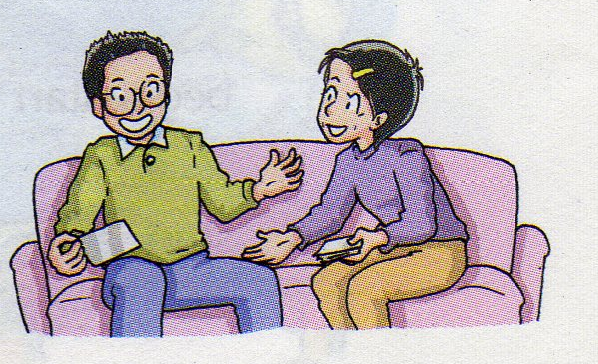
1.Finish A2 on P27first and check the answers.
2.Practice the dialogue and act.

Slide 13
小试身手
选用have been to或have gone to的适当形式填空。
has gone to
1.My father Beijing. He will
be back in two days.
2.The Greens the USA twice.
3.A:Where is your aunt now?I haven’t seen her
for a long time.
B:She Xiamen.
______ you ever ___________ Hong Kong
Disneyland?
5.A: Tom Nanjing?
B:Yes. He hasn’t come back yet.
have been to
has gone to
Have
been to
Has
gone to

Slide 14
Homework:
1. Go over Grammar A.
2. Finish the exercises in the workbook.

