Slide 1
Unit 1 Topic 1
Welcome to China!
Section A
WWW.PPT818.COM

Slide 2

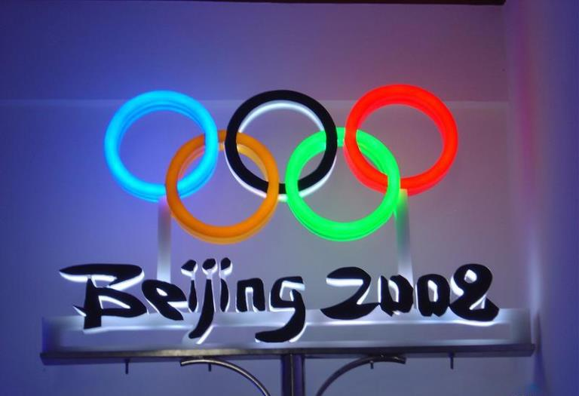
Enjoy the song

Slide 3

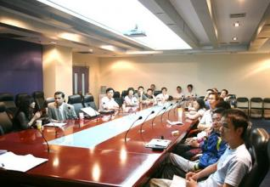
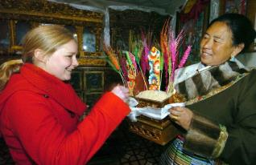
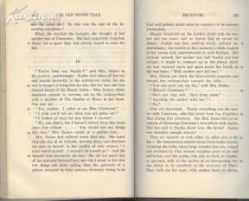
Please discuss why we should study English well.

Slide 4
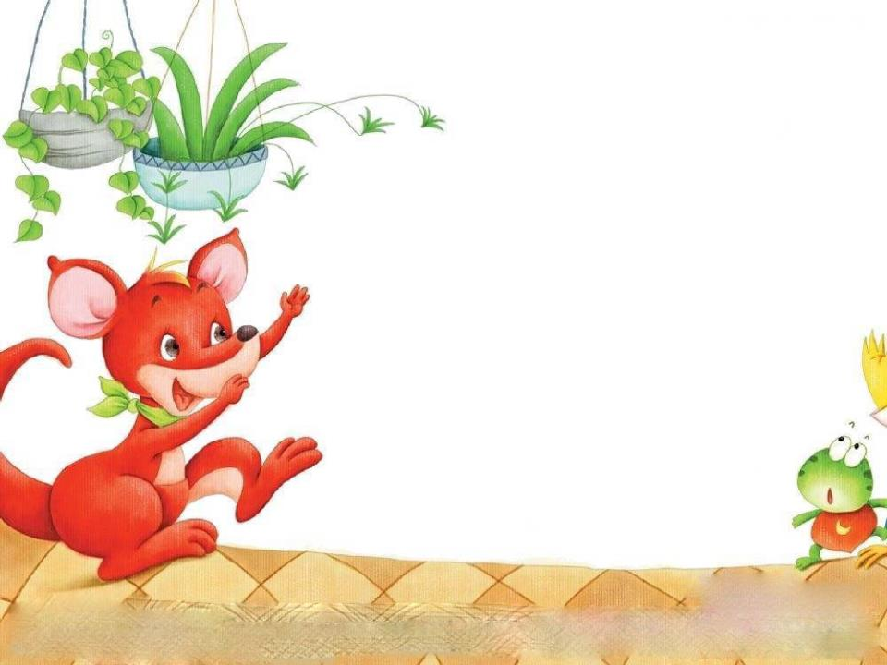
Greet and introduce yourself.
Good morning, I’m Tom, …

Slide 5
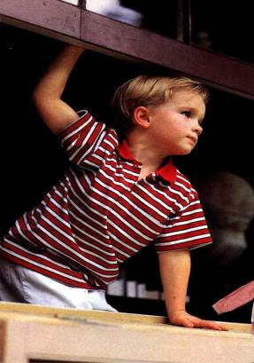
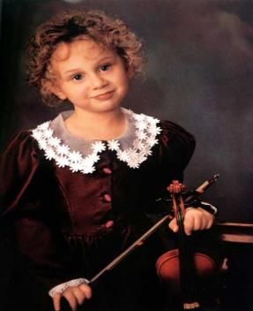
Good morning,
I am Maria.
PPT模板：www.1ppt.com/moban/ PPT素材：www.1ppt.com/sucai/
PPT背景：www.1ppt.com/beijing/ PPT图表：www.1ppt.com/tubiao/
PPT下载：www.1ppt.com/xiazai/ PPT教程： www.1ppt.com/powerpoint/
资料下载：www.1ppt.com/ziliao/ 范文下载：www.1ppt.com/fanwen/
试卷下载：www.1ppt.com/shiti/ 教案下载：www.1ppt.com/jiaoan/
PPT论坛：www.1ppt.cn PPT课件：www.1ppt.com/kejian/
语文课件：www.1ppt.com/kejian/yuwen/ 数学课件：www.1ppt.com/kejian/shuxue/
英语课件：www.1ppt.com/kejian/yingyu/ 美术课件：www.1ppt.com/kejian/meishu/
科学课件：www.1ppt.com/kejian/kexue/ 物理课件：www.1ppt.com/kejian/wuli/
化学课件：www.1ppt.com/kejian/huaxue/ 生物课件：www.1ppt.com/kejian/shengwu/
地理课件：www.1ppt.com/kejian/dili/ 历史课件：www.1ppt.com/kejian/lishi/
Good morning,
I’m Michael.

Slide 6

1b Listen and number the names you hear
2
3
Maria
Jane
4
Kangkang
1
Michael

Slide 7








Can you write the following letters?

Slide 8
Work alone
2b Listen and circle the
letters you hear. Then try
to find the rule.
A a
B b
C c
D d
E e
F f
G g

Slide 9
Play the English letter games:
① The first student in the first team says “A” quickly, the second student follows with “B”，and “C，D，E，F，G，A，B ...” , one by one.

Slide 10
②After all the students complete the first game, then the first one says “AB”, the second one follows with “BC” quickly, the third one “CD” and so on, until all the students take part in the game.

Slide 11
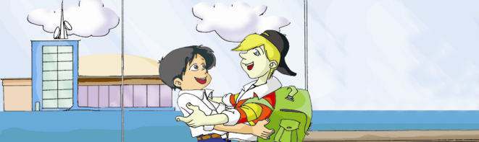
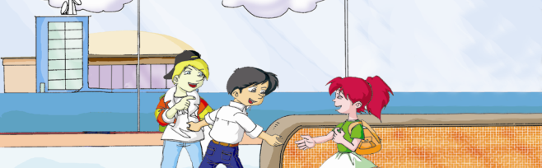
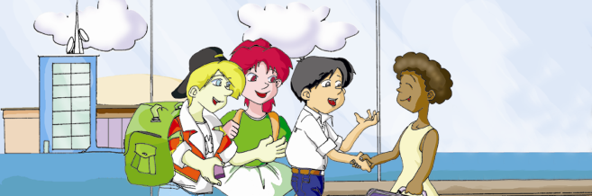
3a
Look, listen and say
Hello!
Hello!
Yes, I am.
I’m Kangkang.
Are you Michael?
Hello! Are you Maria?
No, I’m not. I’m Jane.
Oh, nice to meet you, Jane.
Nice to meet you, too.
Hi, Maria!
Hi, Kangkang!
Welcome to China!
Thanks.
Notes:
11

Slide 12

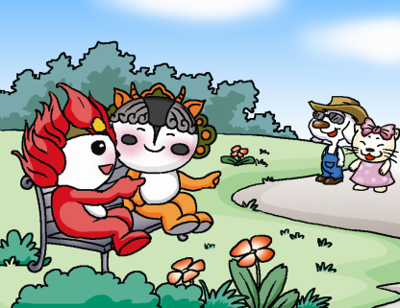
Practice 3a in groups, using your own
names.
Hello!
____!
I am … Are you …?
Yes, I am.

Slide 13
Practice
A: Hi/Hello, I am …
Are you …?
B: No, I’m not. I am …
A: Nice to meet you.
B: Nice to meet you, too.

Slide 14
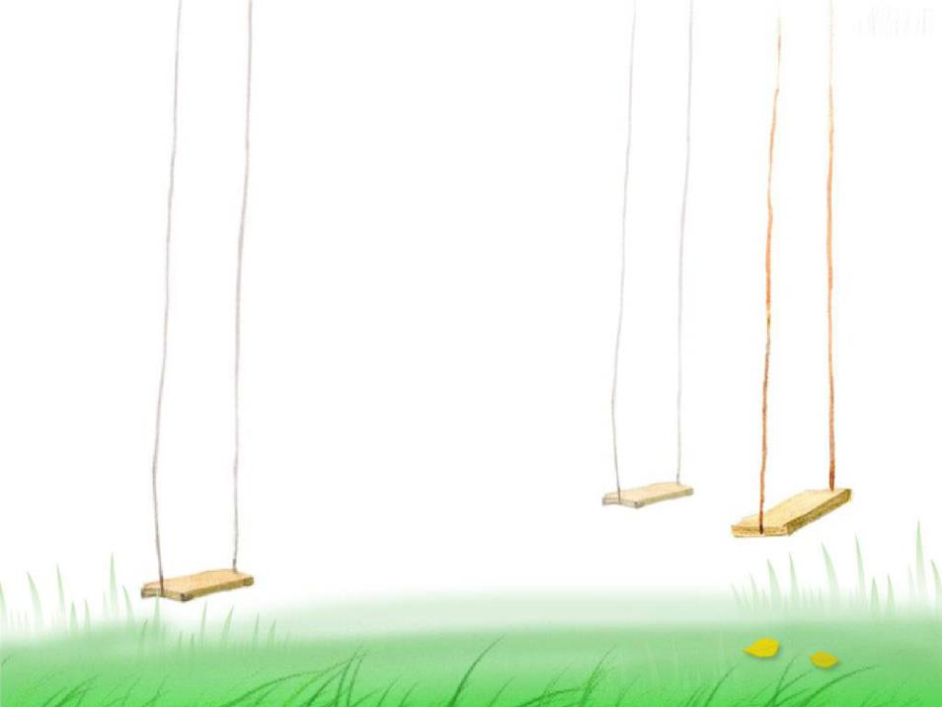
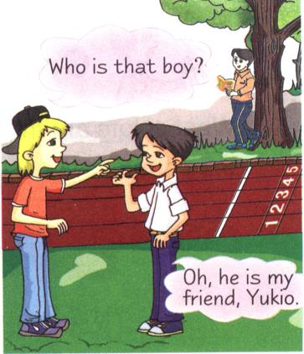
Are you Kangkang?
Yes,
I am.
Welcome to China !
Thanks.

Slide 15
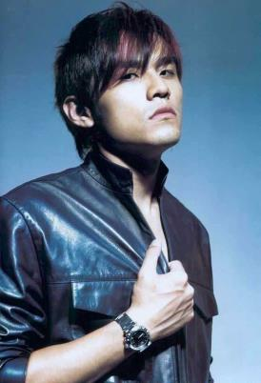
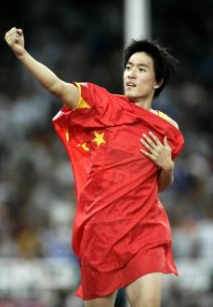
明星对对碰
句型:Good morning.
I am …
Nice to meet you.
Liu Xiang
Zhou Jielun

Slide 16
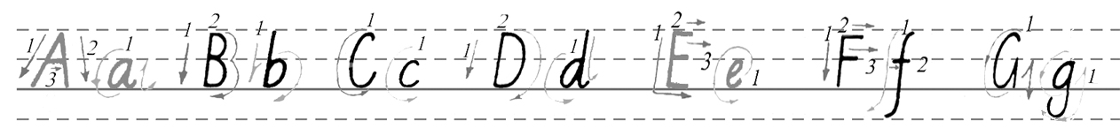
Sum up
Welcome to China !
Good morning.
Good morning. I’m Kangkang.
Hello! Hi!
Are you Jane? Yes, I am./No, I’m not. I’m Maria.
Nice to meet you. Nice to meet you, too.
Thanks.

Slide 17
Project
1. Please imagine and list some objects which have the same shape with the English letters.
Such as: The legs of a chair are like “A”，ears are like “B”. The moon is like C or D, etc.

Slide 18
2. Give yourself an English name after class.
3. Copy the letters on the signs beside the letters on the line.

