Slide 1
Unit 1 Going to Beijing
Lesson 5 What Are They Doing?
WWW.PPT818.COM

Slide 2
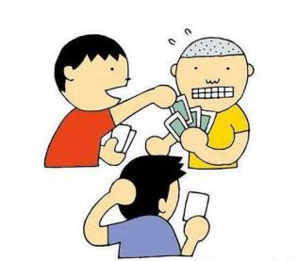
Warming up
Play cards
Read the newspaper

Slide 3
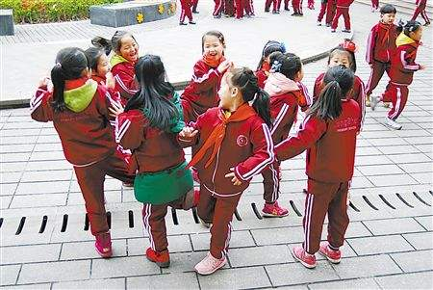
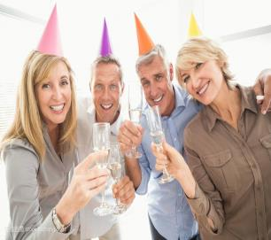
Warming up
Have fun
Play with

Slide 4
Leading in
What is the man in the picture doing?

Slide 5
Presentation
听录音
What is the baby in the picture doing?
The baby is playing with Danny.

Slide 6
Presentation
连线
The woman
is playing with the baby.
The man
is playing cards with his friends.
Danny
is reading the newspaper.

Slide 7
Consolidation and extension
自读课文提问
What is the baby doing?
What is the woman doing?
Where is Danny?
What is he doing?
Can Jenny play with the baby?

Slide 8
Summing up
重点句型
What…doing?
Where is...?
May I…?

Slide 9
Evaluation
内容 | 学生A | 学生B | 学生C | 学生D
积极发言
乐于合作
完成情况

Slide 10
Homework
用英语讲述今天所见的事情（使用课本句式）
完成Let’s do it!中的练习
1
2

Slide 11
参考答案：
He is reading a book.
You are singing.
She is swiming.
They are playing ping-pong.

