Slide 1
Unit 8 Topic 2
We can design our own uniforms.
Section B
WWW.PPT818.COM

Slide 2
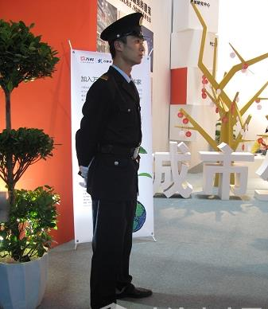
Can you guess his job from his uniform?
gatekeeper
n.门卫

Slide 3
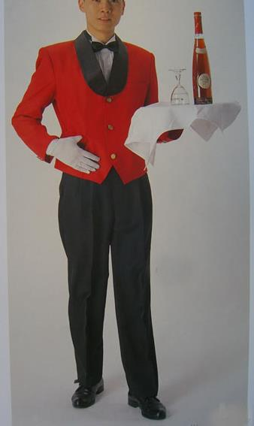
Can you guess his job from his uniform?
attendant
n.服务员,侍者

Slide 4
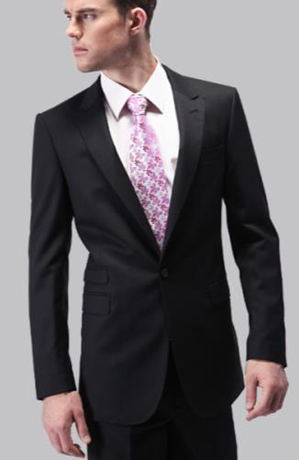
The man wears a business suit.
suit
n.套装，一套（衣服）
v.适合

Slide 5
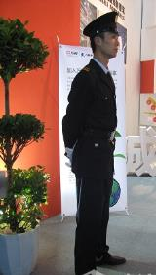
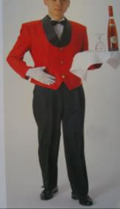
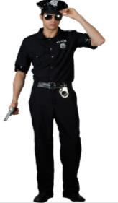
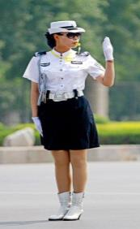
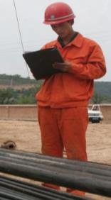
Do they wear uniforms everywhere?
People should wear different clothes on different occasions.
It’s important to wear suitable clothes on every occasion.
occasion
n.特别的事情（或仪式，庆典）；时机

Slide 6
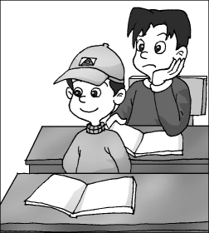
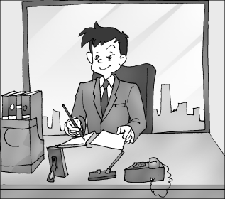
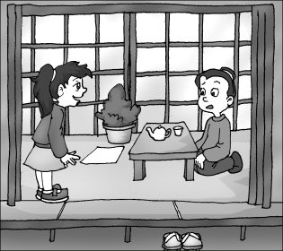
We should dress correctly on every occasion.
adv.正确地，精确地
1
2
3
1.It’s impolite for a student to wear a hat in class.
I think he should take off his hat in class.
脱下（衣服），摘掉
2.It’s suitable for him to wear a business suit in the office.
3.You should take off your shoes when you enter
someone’s home in Japan.

Slide 7
1b
Listen to 1a and Mark T(True) or F(False).
1.The gatekeeper asks the man to wear jeans there.
2.The customer wants to know where to find the special shoes.
3.The daughter will take her shoes off when entering a Japanese home.
4.Kangkang hurts his knees because he does too much sports.
( )
( )
( )
( )
F
T
T
F

Slide 8
1c
Read 1a and complete the passage.
It's impolite for the man to wear jeans to go to the formal meeting. So the gatekeeper tells him what________________. In the gym, the customer asks the attendant where she can _________ her leather shoes. And we know it's polite to _____________ our shoes before entering someone's home in Japan. In the last picture,we see it's necessary for us to wear sports clothes and sports shoes on the playground,or we may________ ourselves as Kangkang did. So we should dress ___________ on every accasion.
he should wear
change
take off
hurt
correctly

Slide 9
Key sentences
You should wear a business suit. You should take off your shoes when you enter someone’s home in Japan. You should wear your sports clothes.
Can you tell me what I should wear here? Could you tell me where the special shoes are? I don’t know why.
It is important to wear suitable clothes on every occasion.
(1) 本句型为：It is +adj.+(for sb.) to do sth. ，it是形式主语，真正的主语是to do sth. ，意为“（对于某人来说）做......是......的”。可以与It is +adj.+that ... 句型转换。
E.g:It is important for us to take care of the enviroment.=It is important that we should take care of the enviroment.
(2) on every occasion 在每一个场合，occasion为可数名词。

Slide 10
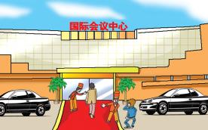
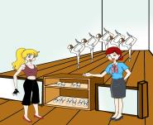
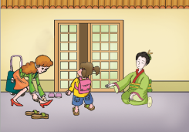
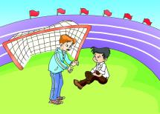
Listen to 1a and read after it. Then act it out in roles.
Gatekeeper: Sorry, sir. You can’t wear jeans here.
Man: I’m so sorry. Can you tell me what I
should wear here?
Gatekeeper: You should wear a business suit.
Attendant: Sorry, madam. You have to change your leather shoes.
Customer: Oh, sorry. Could you tell me where the special shoes are?
Attendant: This way, please.
Mother: You should take off your shoes when you enter
someone’s home in Japan.
Daughter: Yes, Mom.
Mr.Brown: What’s the matter, Kangkang?
Kangkang: My knees hurt, but I don’t know why.
Mr.Brown: You should wear your sports clothes.
Kangkang: Yes, Mr. Brown.

Slide 11
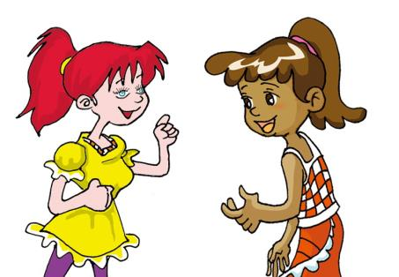
It is important to wear suitable clothes on every occasion.
That’s true. People should dress correctly.

Slide 12
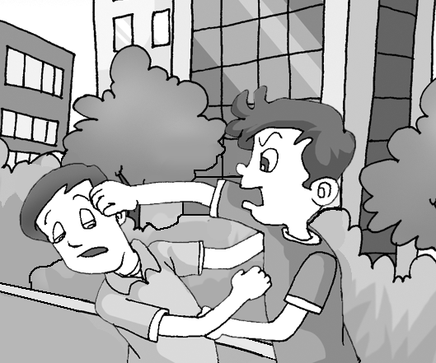
Are they polite to each other?
It’s impolite that they fight with each other.
It’s impolite (for them) to fight with each other.

Slide 13
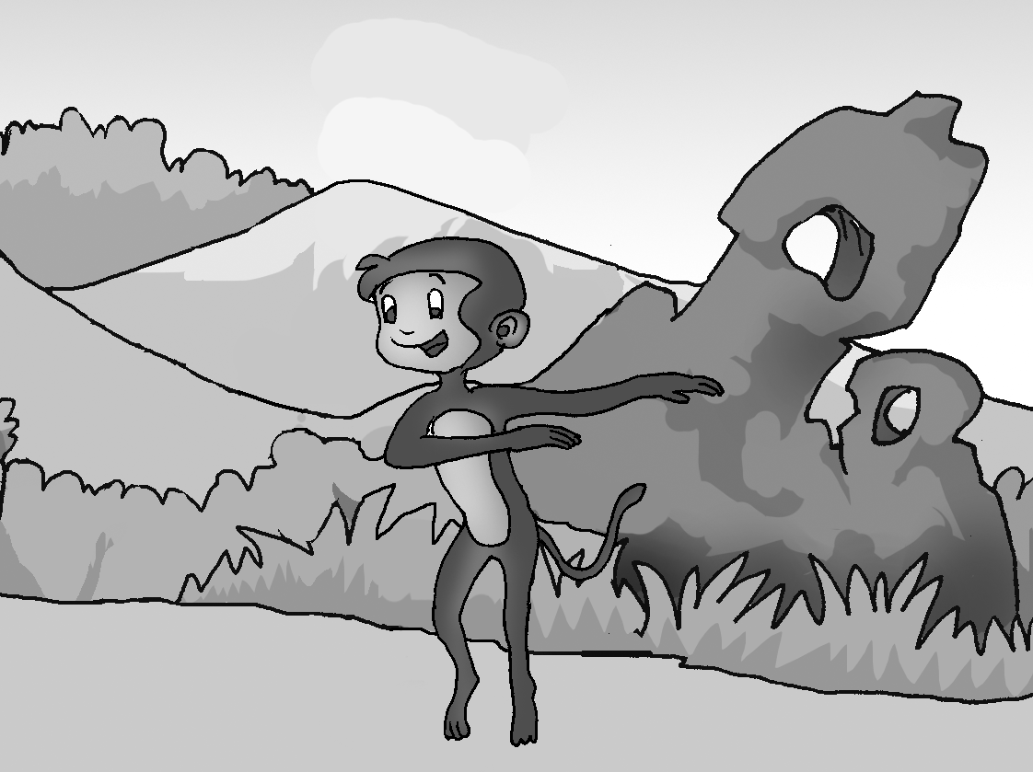
What’s the monkey doing? Is it funny?
It’s funny that a monkey performs ballet.
It’s funny (for a monkey) to perform ballet.

Slide 14
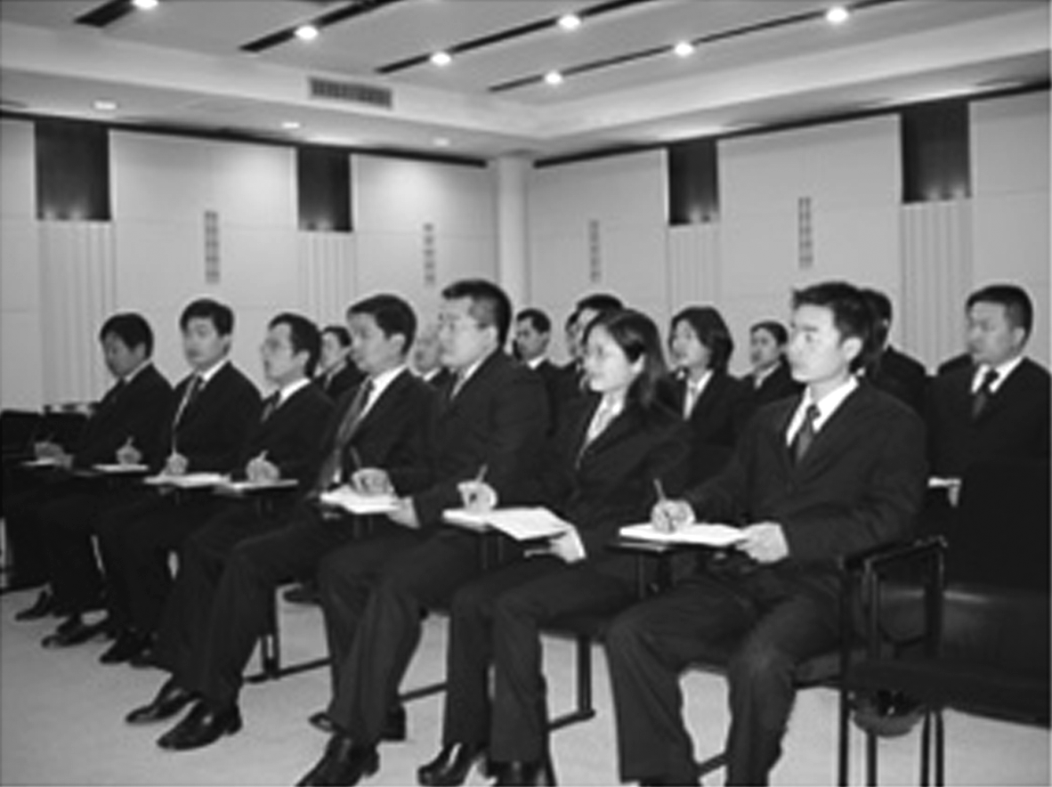
Where are they? What are they wearing?
I think it’s suitable that people wear business suits to meet business partners.
I think it’s suitable (for people) to wear business suits to meet business partners.

Slide 16
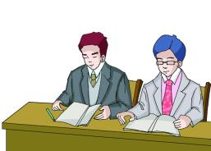
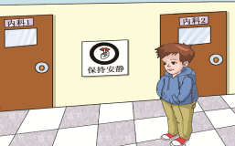
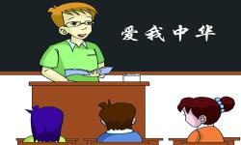
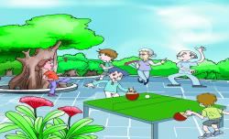
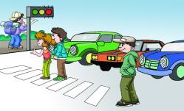
2
Make sentences with the following information, using It's +adj.+(for sb.) to do sth. or It's +adj.+that...
necessary suitable important right
Besides voice,special sentence structure is an effective way to stress.
Example:
It's suitable (for us ) to wear business suits in a meeting.
It's suitable that we wear business suits in a meeting.
1
1
2
wear business suits
keep quiet
listen to the teacher
3
4
3
do some exercise
obey the traffic rules

Slide 17
1
It's necessary/important/right that we keep quiet in the hospital.
It's necessary/important/right (for us) to keep quiet in the hospital.
keep quiet
2
It's necessary/important that they/the students listen to the teacher carefully in class.
It's necessary/important (for them/the students) to listen to the teacher carefully in class.
listen to the teacher
3
It's important that we/people do some exercise in the morning.
It's important (for us) to do some exercise in the morning.
do some exercise
4
It's necessary/important/right that everyone obeys the traffic rules.
It's necessary/important/right (for us) to obey the traffic rules.
obey the traffic rules

Slide 18
Project
Suppose you would go to a party. What should you wear? When you go out to do some exercise, what should you wear? Please discuss in groups of four. Then report your answers to us.
Activity | What to wear
attend a party
do some exercise
...

Slide 19
3
Read the sentences, paying attention to the intonation. Then listen and try to imitate.
The falling tone is a command while the rising tone is a more polite request.
1. Sorry,sir. You can't wear jeans here.
2. Sorry,madam. You have to change your leather shoes.
3. Excuse me, could you tell me when you wear your uniforms?

Slide 20
Exercises in class
单项选择。
( ) 1.It’s dangerous for you ______ the tree.
A. climb B. to climb C. climbing D. climbed
( ) 2. — Could you tell me______?
— In Beijing.
A. where does he work B. when does he work
C. when he works D. where he works
( ) 3.______ is important for children to get a good education.
A. This B. That C. What D. It
( ) 4.— Could you tell me ______ tomorrow morning?
— Well, it will start at 9 o’clock.
A. when the meeting will start B. where will the meeting start
C. where the meeting starts D. when the meeting would start
B
D
D
A

Slide 21
Exercises in class
句型转换。
1. It is important that we listen to the teacher carefully in class.
（改为同义句）
It’s important ___ ___ ___ listen to the teacher carefully in class.
2. Black clothes are suitable for a fat person.
（改为同义句）
____ suitable ____ a fat person wears black clothes.
3. Where did she park her car? Do you know?
（合并为一句）
______________________________________
4. Where is the Boda Park? Could you tell me?
（合并为一句）
___________________________________________________
for us to
It’s that
Do you know where she parked her car?
Could you tell me where the Boda Park is ?

Slide 22
Summary
We learn:
1.Some new words and phrases:
gatekeeper,suit,attendant,enter,knee,occasion,correctly,
take off,on every occasion
2.The object clauses:
Can you tell me what I should wear here?
Could you tell me where the special shoes are?
3.The patterns It’s + adj. + that …and It is + adj. + (for sb.) + to do sth.
It is important to wear suitable clothes on every occasion.
It’s impolite for the man to wear jeans to go to the formal party.
It's suitable that we wear business suits in a meeting.
We can:
◆Talk about suggestions of dressing on different occasions:
You should wear a business suit.
You have to change your leather shoes.
You should take off your shoes when you enter someone’s home in Japan.
You should wear your sports clothes.
People should dress correctly.

Slide 23
Homework
1.Collect some information about wearing suitable clothes in different countries.
2.Finish Section B in your workbook.
3.Preview Section C.

