Slide 1
Unit 10 Get Ready for the Future
Best Wishes
WWW.PPT818.COM

Slide 2
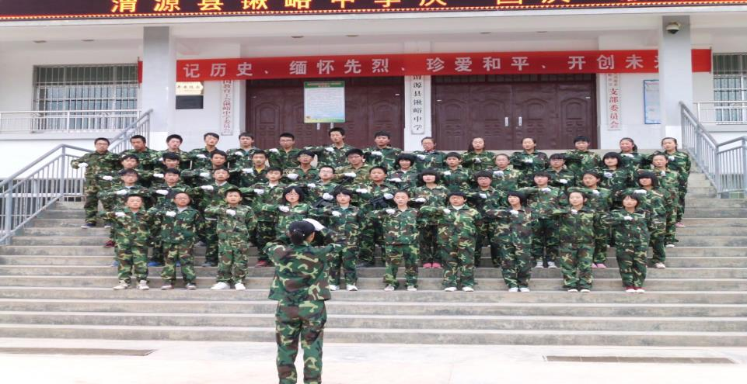
Think About It
1. What will you miss most about junior high school?
2. What would you like to say to your best friend when you graduate?

Slide 3
Objectives
1. To learn what the students say to their best friends
2. To learn some useful words, phrases and expressions
●wallet row owner senior
● junior high (school) senior high(school)
● stay/keep in touch
● best of luck/good luck with...
● Be sure to always stay in touch!

Slide 4
Words
wallet
owner
row
senior
n. 钱包
n. 主人
v. 划（船）
adj. 级别高的

Slide 5
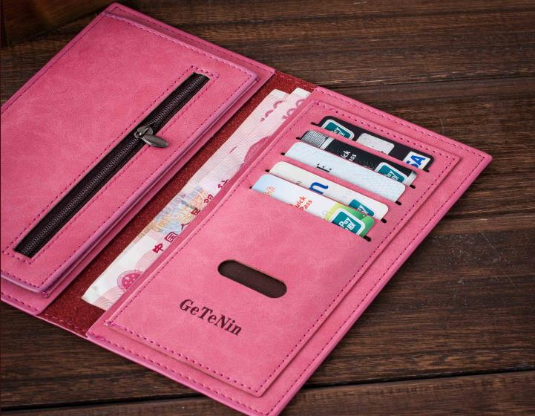
This is a wallet , but who is the owner of it ?

Slide 6

He is rowing a boat.

Slide 7
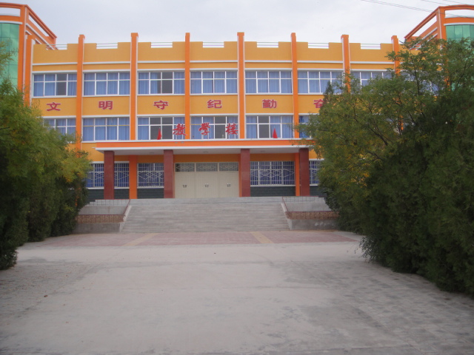
junior high school
senior high school

Slide 8
Listening
Listen to the text and then answer these questions.
1. What will Steven never forget?
2. What does Jenny believe her and her classmates will always have?
He’ll never forget Danny’s Desk-Cycle.
They will have great memories of their time together.

Slide 9
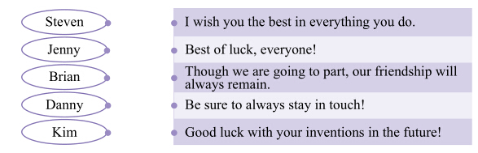
Fast Reading:
Read the lesson and match the names with the sentences. (P 151)

Slide 10
Detailed Reading:
Read the lesson again and write true(T) or false(F).
1.Steven will never forget Danny’s Desk- Cycle.( )
2.It won’t be easy to remember all Brian’s friends in Cannada. ( )
3.Danny is going to junior high school.( )
4.Jenny will always have great memories of their time together.( )
5.Kim is confident that they’ll all do very well .( )
T
F
F
T
T

Slide 11
Language points

Slide 12
1. Good luck with your inventions in the future.
good luck with.../the best of luck.用于表示祝愿.
eg: Good luck with your study!
good luck to sb 表示“祝愿某人……”
eg: Good luck to you
in the future 在将来(的某时间)
in future (= from now on) 从今往后
将来我的梦想会实现的。
My dream will come true in the future.
我打算将来当科学家，所以今后必须努力学习。
I am going to become a scientist, so I must study hard in future.

Slide 13
2. Be sure to always stay in touch.
be sure to 一定要，务必
be sure(that)+句子
be sure and+原形动词
一定要作某事
你一定要准时来。
Be sure to come on time.
= Be sure(that) you come on time.
= Be sure and come on time.

Slide 14
stay in touch 联系，接触
stay/keep/be in touch (with sb.)(与某人)保持联系
be/get in touch (with sb.) (与某人)取得联系
lose/out of touch (with sb.) (与某人)失去(不)联系
我们必须跟父母保持联系。
We must keep/stay in touch with our parents.
我一到那里就跟你联系。
I’ll be in touch with you as soon as I get there.
她与朋友失去联系了吗？
Did she lose touch with her friend?

Slide 15
Practice
Ⅰ.单项选择：
1．—I'm going to enter an English speaking competition tomorrow.
— ！ (中考•广安)
A．Good luck B．Have a nice trip
C．No problem D．Congratulations
2．Lily is only five years old, she can swim very well.(中考•邵阳)
A．Though; but B．Because; so
C．Though; / D. but; although
3. We have to say goodbye; __ __ time flies! (中考•常德)
A．what B．how C．what a D. How a
A
C
B

Slide 16
Ⅱ. 翻译下列句子：
1.天一定会下雨。
2.我希望将来我能成为一名医生。
3. 今后你应该改掉这个坏习惯。
4. 他们通过发送电子邮件保持联系。
It is sure to rain.
I hope I’ll be a doctor in the future.
You should get rid of the bad habit in future.
They stay in touch with each other by sending emails.

Slide 17
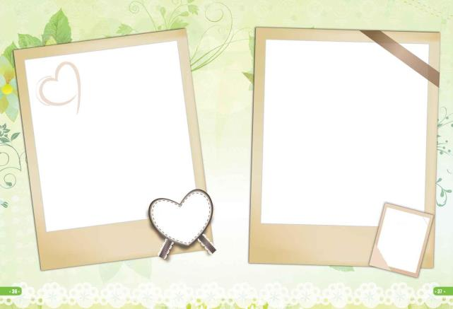

Writing:
What would you like to say to your classmates, friends or teachers? Write it down.

Slide 18

For example:
a graduation message

Slide 19
Summary:
1. Four words and two phrases
wallet,owner,row, senior
junior high school, senior high school
2. How to write graduation messages in
English.

Slide 20
Homework:
1. Recite the new words and phrases by heart after class.
2. Design a graduation card by yourselves.
3.Write a graduation message in English.

Slide 21
At last, on behalf of all the teachers, I’d like to give my best wishes and congratulations to the graduating class.
My Best Wishes
You are not only my students, but also my best friends. Remember to stay in touch with each other whatever you will be in the future. Believe you are the best all the time. Don`t forget your promise: Today you are proud of our school, and our school will take pride in you tomorrow! At last, I must tell you it`s our duty to achieve our China Dream.

Slide 22

Good Luck!

