Slide 1
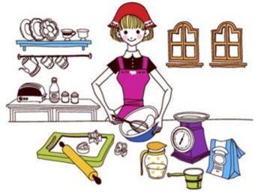
Unit2 I’m Cooking in the Kitchen
陕旅版
四年级下册
第四课时
WWW.PPT818.COM

Slide 2
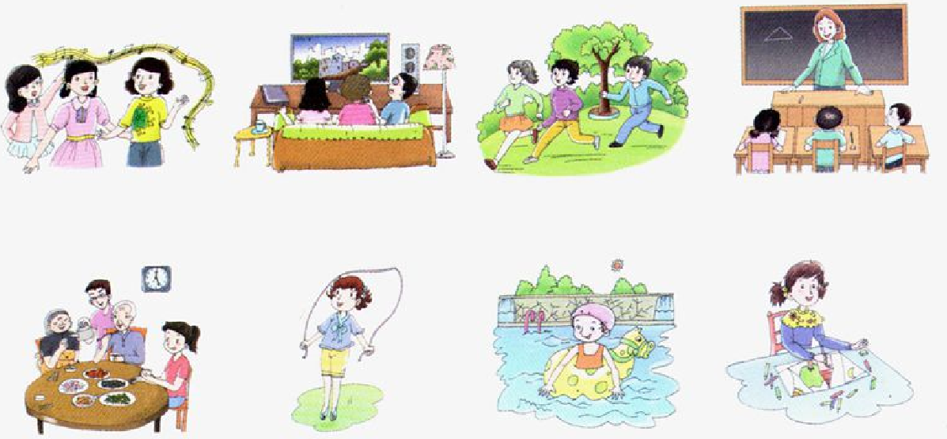
>>Lead-in
Look and say
sing a song
watch TV
run
have a class
have dinner
jump rope
swim
draw a picture

Slide 3
>>Lead-in
Ask and answer
A: What is he/she doing?
B: He / She is …
A: What are they doing?
B: They are …

Slide 4
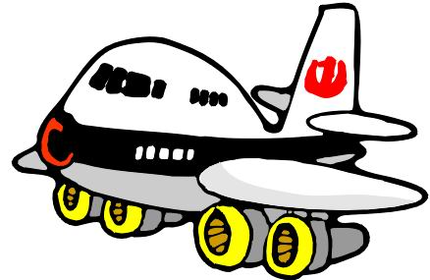
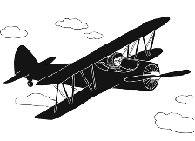
>>Presentation
Let’s learn
make a plane
fly

Slide 5
>>Presentation
Ask and answer
Picture 1: What are the boys doing?
Picture 2: Where are the boys?
What are they doing now?
Picture 3: How about now?
Picture 4: How many people are there?
What are the boys doing?
Picture 5: What are the three children doing?

Slide 6
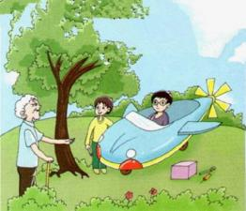
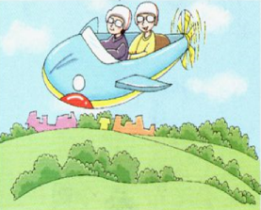
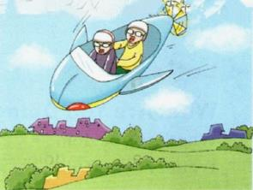
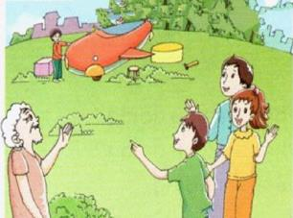
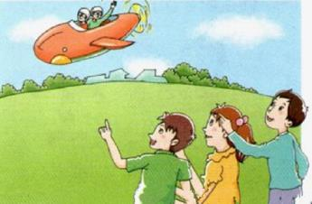
>>Presentation
Look and answer

Slide 7
>>Presentation
Read a story
Hi, boys! What are you doing?
We are making a plane.
We are making a plane.

Slide 8
>>Presentation
Read a story
Wow! We are flying.
Wow! We are flying.

Slide 9
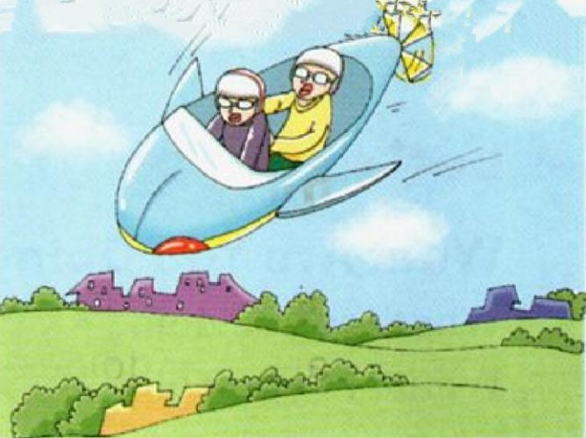
>>Presentation
Read a story
Oh, no!
Oh, no!

Slide 10
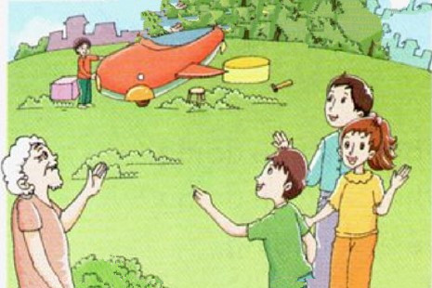
>>Presentation
Read a story
Hi, Grandpa! What are they doing?
Hi, Grandpa! What are they doing?
Hi, Grandpa! What are they doing?
They are making a plane.

Slide 11
>>Presentation
Read a story
Great! We are flying!
Great! We are flying!
Cool! They are flying!
Cool! They are flying!
Cool! They are flying!

Slide 12
>>Practice
Read it by yourselves for one minute .
自读课文一分钟。
一分钟倒计时
60
Learning tip :
10
50
当你自己朗读时，遇到不会读或不明白意思的单词或句子，可以把它圈起来，请教同学或老师！
20
40
30
开始

Slide 13
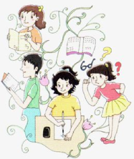
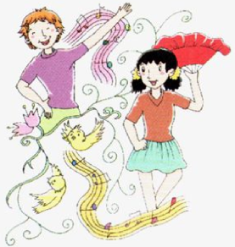
>>Practice
What Are You Doing?
What are you doing?
What are you doing?
We are reading.
What are you doing?
We are writing.
What are you doing?
We are busy every day.
We are singing.
We are dancing.
We are happy every day.

Slide 14
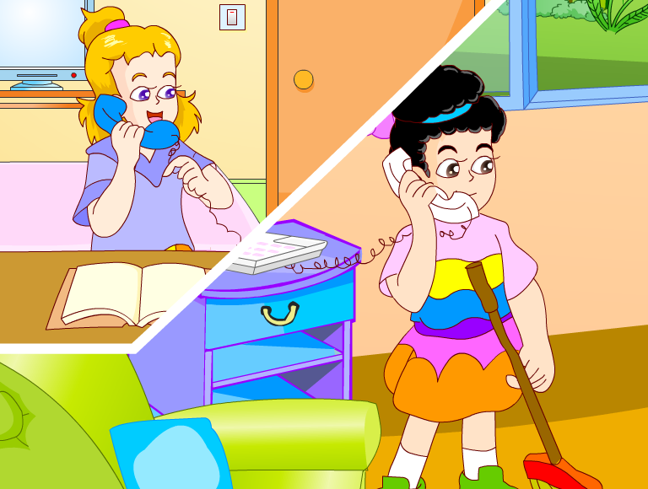
>>Practice

Slide 15
>>Summary
如何用现在进行时询问你们正在
做什么及其答语？
-What are you doing?
-We are + v-ing.
-What are you doing?
-We are standing.

Slide 16
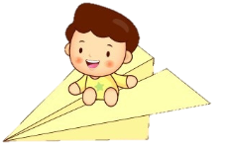
>>Homework
1.听课文录音并跟读，按照正确的语音、语调朗读并表演课文对话。 2.学唱本节课歌曲，并给家长演唱。
3.预习Unit3 A Let’s learn。
close

