Slide 1
Unit 1 Topic 2
Where are you from?
Section A
WWW.PPT818.COM

Slide 2



A: Excuse me, are you Jane?
B: Yes, I am.
A: Excuse me, are you Michael?
B: No, I am not.
Discuss with your desk mates

Slide 3
A: My name’s Sally. What’s your name?
B: My name’s Li Ming. What’s your
name?
C: My name’s … What’s your name?
D: My name’s …

Slide 4

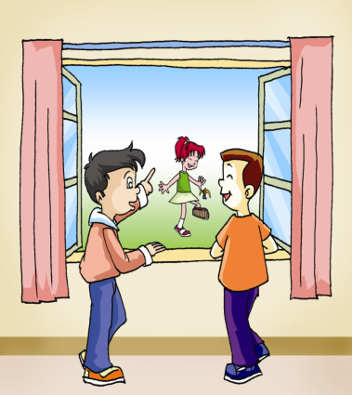
1b Ask and answer in pairs, using
What …? and Where …? Then make your own conversations according to 1a.
What’s your name?
________________
Where are you from?
__________________

Slide 5
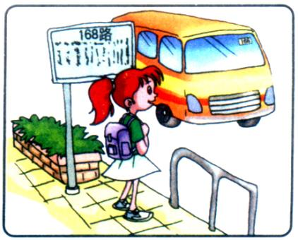
Is she Jane?
Yes, she is.
Where is she from?
She is from Canada.
Jane
Canada

Slide 6
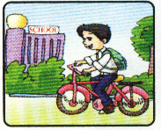
Is he Kangkang?
Yes, he is.
Where is he from?
He is from China.
Kangkang
China

Slide 7
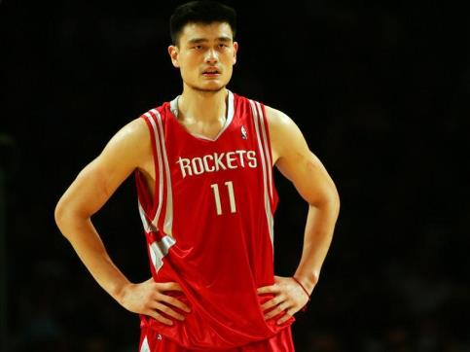
Is he Liu Xiang?
No, he isn’t.
He is Yao Ming.

Slide 8
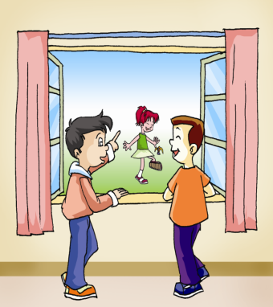
2b Practice the coversations
above with your partner.
A: Is he/she …
B: Yes/No, …
A: Where is he/she from?
B: He/She …

Slide 9
Match the questions with the correct answers.
And then practice in pairs.
What’s your name? a. He is from Canada.
2. Are you from Beijing? b. No, she isn’t. She is Kumiko.
3. Is she Zhou Lu? c. Yes, we are.
4. Where are you from? d. I’m from England.
5. Where is he from? e. My name is Maria.
1-e 2-c 3-b 4-d 5-a

Slide 10


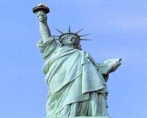


Match them together.
England
Canada
the U.S.A.
Japan

Slide 11
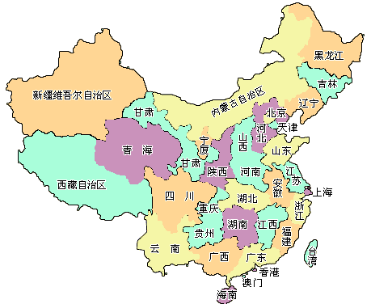
— Where are you from?
— I am from China.

Slide 12
— Where are you from?
— I am from Canada.

Slide 13
— Where are they from?
— They are from Japan.

Slide 14
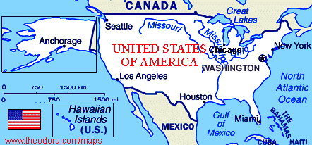
— Where is he from?
— He is from the U.S.A.

Slide 15
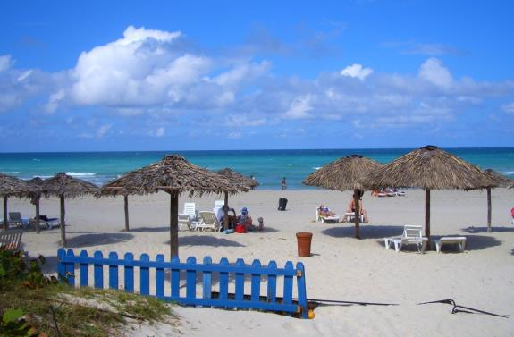
Cuba (古巴)
— Where is Maria from?
— She is from Cuba.

Slide 16







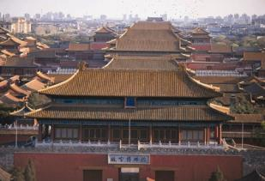


Listen and number the pictures.
4
3
Canada
the U.S.A.
1
1
2
Japan
China

Slide 17
Sum up
— Where are you from?
— I’m from Canada.
(2) — Are you from Washington D.C.?
— No, I’m not.
(3) — Is she Jane?
— Yes, she is.
(4) — Is he Li Ming?
— No, he isn’t.

Slide 18
Homework
(1)抄写课文5的句子，注意首字母和
标点符号。
(2)抄写本课的生词、单词、音标及汉
语各两遍。
(3)背诵课文1a和2a。

