Slide 1
Unit3 Is It Snowing?
陕旅版
四年级下册
第三课时
WWW.PPT818.COM

Slide 2
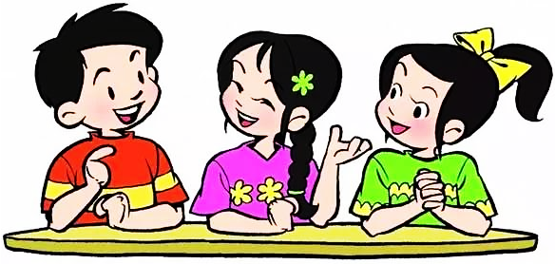
>>Review
Let’s act

Slide 3
>>Review
请将下列句子变成一般疑问句吧！
Lily/She is reading a book.
Is Lily/She reading a book?
Grandma/She is cooking.
Is Grandma/she cooking?
They are watching TV in the living.
Are they watching TV in the living?

Slide 4
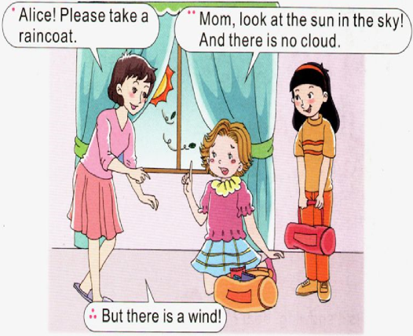
>>Presentation
Ask and answer
Is it raining?
Yes, it is.
Are there any clouds in the sky?
No, there aren’t.
Is there a wind?
Yes, there is.

Slide 5
>>Presentation
Let’s learn more

Slide 6
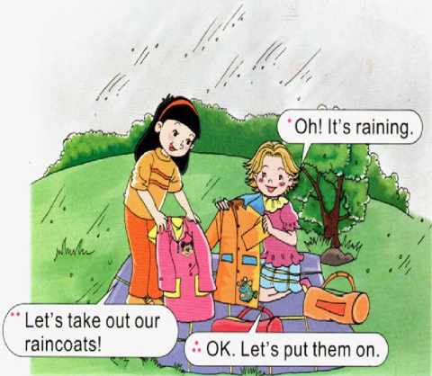
>>Presentation
Ask and answer
Is it raining?
Yes, it is.
What does “take out” mean?
拿出
What does “put …on” mean?
穿上

Slide 7
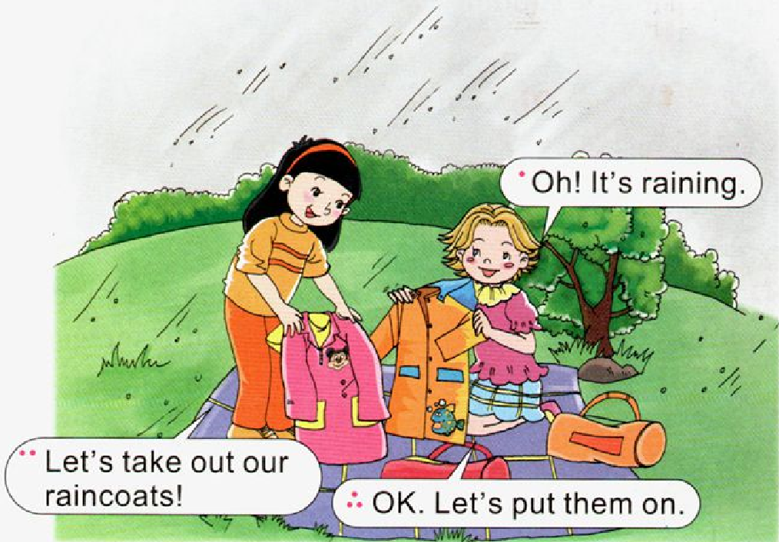
>>Presentation
Let’s learn more

Slide 8
>>Practice
Read it by yourselves for one minute .
自读课文一分钟。
一分钟倒计时
60
Learning tip :
10
50
当你自己朗读时，遇到不会读或不明白意思的单词或句子，可以把它圈起来，请教同学或老师！
20
40
30
开始

Slide 9
>>Practice
Super Mary:表演我最棒！
小组合作：
1.2-3人一小组
2.根据课文分角色练习
3.适当加上一些动作辅助表演
4.课文基础上进行新对话创编
Make a new dialogue 创编新对话

Slide 10
>>Practice
Show time
小组合作，练习对话并表演，其他同学评价。
 | 模仿录音中的语音语调，有感情地朗读。
 | 可以脱离课本，适当改动其中部分，语音地道。
 | 适当添加内容，意思完整，有创新，表演生动。
good
great
Excellent

Slide 11
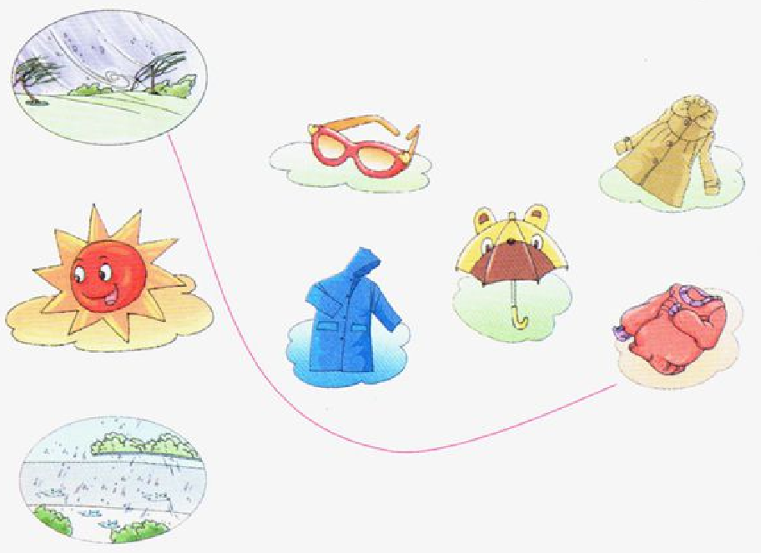
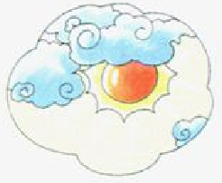
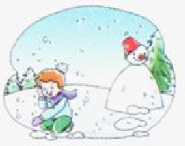
>>Practice
Match and say

Slide 12
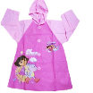
>>Presentation
Let’s read
take an umbrella
take a raincoat
put on a coat
put on a raincoat
put on glasses

Slide 13
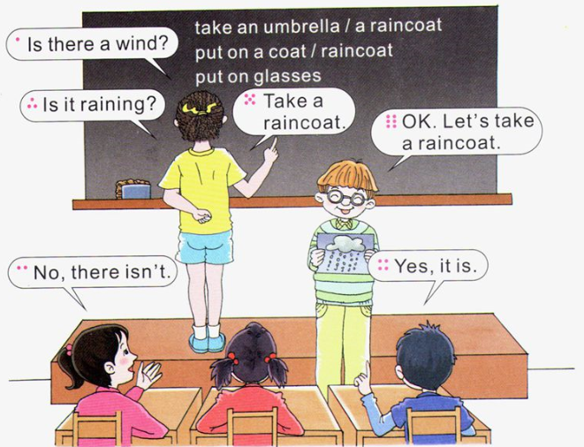
>>Practice
Let’s play

Slide 14
>>Summary
重点词汇：
please, them, take, take out, put on
重点句子：
Please take a raincoat.
-Let’s take out our raincoats!
-OK. Let’s put them on.

Slide 15
>>Homework
1.听课文录音并跟读，按照正确的语音、语调朗读并表演课文对话。 2.用本节课所学的现在进行时句型结构，向自己的家人提问，并操练该句型。
3.预习B Read a story。
close

