Slide 1
Unit3 Look at my nose.
人教精通版三年级上册
WWW.PPT818.COM

Slide 2
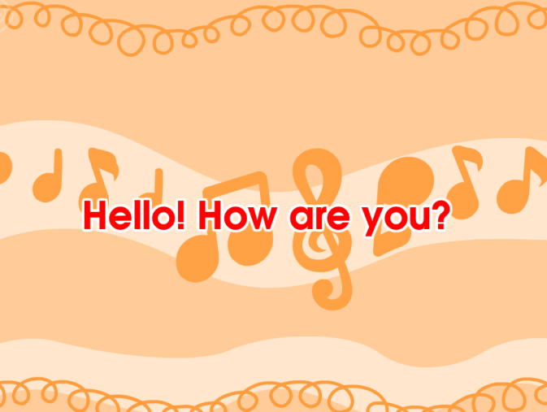
Review
Let’s sing

Slide 3
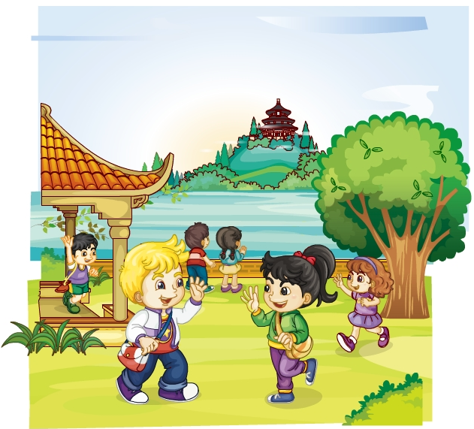
Review
Role-play
Hello, Li Yan! How are you?
Good! And you?
I’m fine. Thanks!

Slide 4
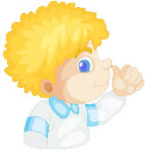
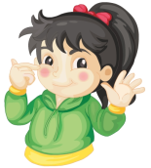
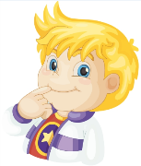
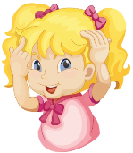
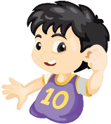
Lead-in
Play a game
Touch your nose/eye…

Slide 5
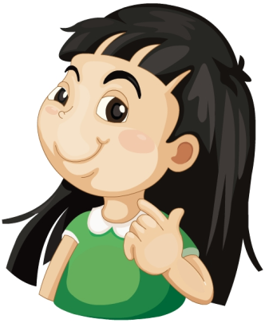
Presentation
Just learn
neck

Slide 6
Presentation
Just learn
arm

Slide 7
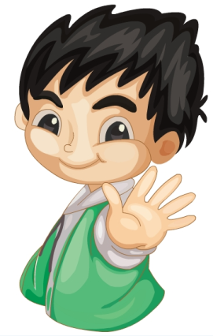
Presentation
Just learn
hand

Slide 8
Practice
Game 1
大小声
neck arm hand

Slide 9
Practice
Game 2
魔法手指
neck arm hand

Slide 10
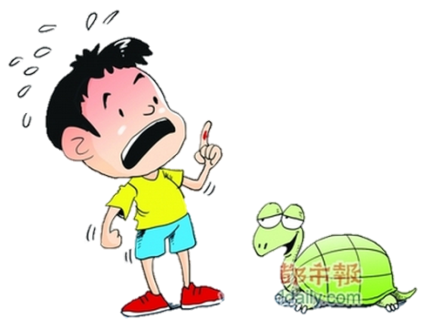
Presentation
Look and guess
Not very well.
Hello! How are you?
Oh, I’m sorry.
His ____ is hurt(受伤).
hand

Slide 11
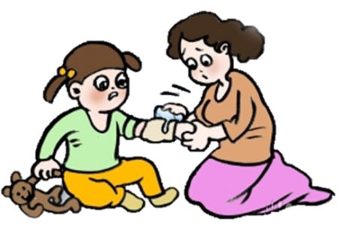
Presentation
Look and guess
Hello! How are you?
Not very well.
Oh, I’m sorry.
Her ____ is hurt(受伤).
arm

Slide 12
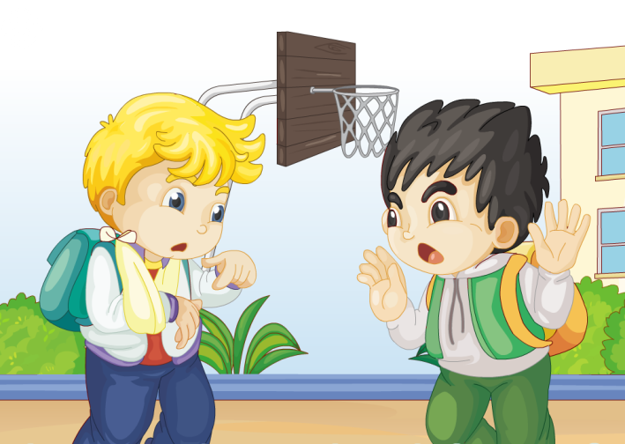
Presentation
Look and say
Peter怎么了？他们在说些什么？

Slide 13
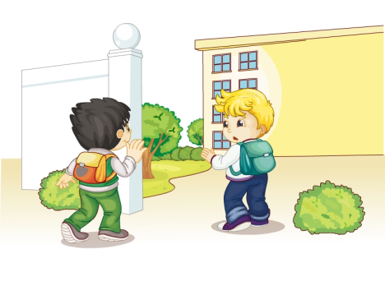
Presentation
Listen and imitate
Good morning, Peter. How are you?
Look at my arm!
Not very well.
Oh, I’m sorry.

Slide 14
Show time
两人一组，练习对话并表演，其他同学评价。
 | 模仿录音中的语音语调，有感情地朗读。
 | 可以脱离课本，适当改动其中部分，语音地道。
 | 适当添加内容，意思完整，有创新，表演生动。
Good
Great
Excellent

Slide 15
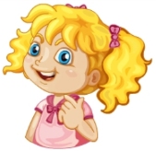
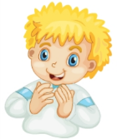
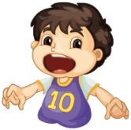
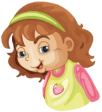
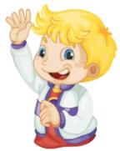
Practice
Look and match
Nod your head.
Open your mouth.
Close your eyes.
Touch your neck.
Clap your hands.
Wave your arm.

Slide 16
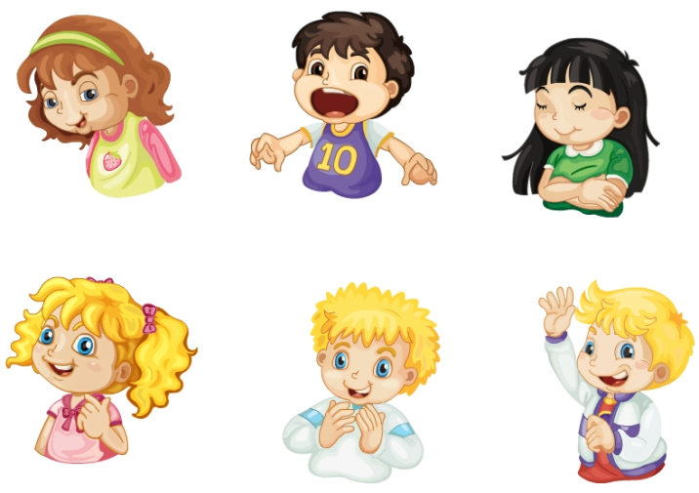
Practice
Let’s do
Nod your head.
Open your mouth.
Close your eyes.
Touch your neck.
Clap your hands.
Wave your arm.

Slide 17
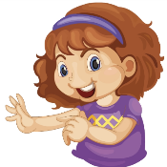
Summary
本课学习的身体部位类的单词有:
neck
arm
hand

Slide 18
Summary
当询问身体状况时，如何表达身体不适并做相关应答呢？
—Hello! How are you?
—Not very well.
—Oh, I’m sorry.

Slide 19
Homework
1.跟读Just talk部分的课文录音，并注意语音、语调。
2.运用本课所学知识，询问你的父母或朋友他们的身体状况，并将你们的对话记录下来。
3.预习Lesson17。
Close

