Slide 1
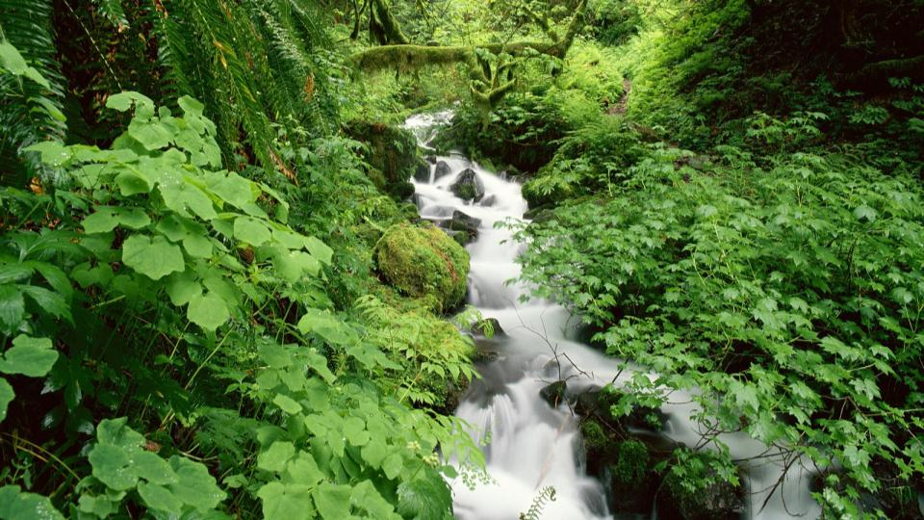
Unit 4 Stage and screen
Period Five Writing—Writing a movie review
WWW.PPT818.COM

Slide 2
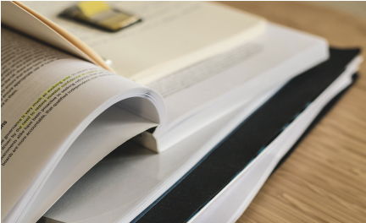
PART 1
技法点拨
PART 2
写作训练

Slide 3
PART
1
技法点拨
文体分析 把握写作动脉

Slide 4
◆写作指导
本模块要求写一篇影评，影评就是观众在看完电影以后的所感所想。从体裁上看，影评属于夹叙夹议文或议论文。这种文体主要是以一般现在时介绍剧情并就自己感兴趣的地方发表观点。影评要求评论者就影片特点进行评论，叙议结合，以分析、议论为主。影评一般可分为三个部分。

Slide 5
第一部分：简介背景。对电影名称、导演等作简单介绍。(此部分可以省略。)
第二部分：简述情节。包括主演及影片内容概述。影片概述只需要叙述大概情节，最主要的是分析人物和情节，重点突出自己要评述的内容。
第三部分：发表评论。就影片中自己感兴趣和有价值的故事情节发表观点，可有选择性地就电影的结构、节奏、演员角色等方面展开评论，最后还可对电影进行总体评价。

Slide 6
◆常用表达
1.Recently I saw a movie，the name of which is...
2.The movie is a comedy directed by...and starred by...
3.I like the film “...” very much！...is brave and funny.
4.I will be a person like...He is warm-hearted.Most importantly，he is a real hero！He is my idol!
5.The movie also sends such a message to us...
6.The movie is intended to tell people that...by this character.

Slide 7
7.My favorite part of the film is that...
8.The film is more than just an action film and is a work of art.
9.I think the subject is more instructive—we need peace and we don’t want war.
10.I think it is well worth watching/it is a masterpiece.

Slide 8
PART
2
写作训练
弄清文络 写作妙笔生花

Slide 9
电影《哈利·波特与魔法石》是根据英国作家J.K.Rowling的小说改编而成的。现请你根据下表中的提示写一篇80词左右的影评。
片名 | Harry Potter and the Sorcerer’s Stone
故事梗概 | 小哈利失去双亲，在姨母家受到虐待。11岁生日时，他被邀请到霍格沃兹(Hogwarts)魔法学校上学，这是一个神奇莫测的魔幻世界。在Hogwarts，哈利学习了魔法，经历了许多冒险和神奇的事情，同时还学会了怎样获得真正的友谊，学会了勇敢。
我的评价 | 这是一部非常成功的电影，风靡了全世界。通过这部电影，我们应该学会信任自己和帮助别人。

Slide 10
◆审题谋篇
审题
1.确定体裁：本文为议论文——影评。
2.确定中心人称：本文人称主要为第三人称。
3.确定主体时态：主要使用一般现在时和一般过去时。
谋篇
第一部分：简介背景。对电影的名称、特点、导演等作简单介绍。
第二部分：情节概述。
第三部分：作出评论。

Slide 11
◆遣词造句
核心词汇
1.根据，以……为基础 ________________
2.受到虐待 _______________
3.受到……的欢迎 ________________
4.全世界 ________________
5.信任 __________
be based on/upon
be badly treated
be popular with
all over the world
believe in

Slide 12
连词成句
1.《哈利·波特与魔法石》是一部幻想影片。
_________________________________________________
2.影片基于英国小说家J.K.罗琳的小说。
______________________________________________________
3.哈利失去了双亲，在姨母家受到虐待。
____________________________________________________________
4.11岁生日时，他被邀请去了霍格沃兹，一所魔法学校。
_________________________________________________________________
5.在那里他学会了魔法。
_____________________
Harry Potter and the Sorcerer’s Stone is a fantasy film.
The film is based on the novel of the English writer J.K.Rowling.
Harry’s parents are dead.He is badly treated at his aunt’s home.
On his birthday of eleven，he is invited to go to Hogwarts，a magic school.
He learns magic there.

Slide 13
句式升级
1.请按括号内的要求合并句1和句2。
(1)_________________________________________________________________________________________________________(which引导的定语从句)
(2)________________________________________________________________________________________________(过去分词短语作定语)
2.请用whose引导的非限制性定语从句改写句3。
______________________________________________________________
3.请用where引导的定语从句合并句4和句5。
_________________________________________________________________________________________
Harry Potter and the Sorcerer’s Stone is a fantasy film，which is based on the novel of the English writer J.K.Rowling.
Harry Potter and the Sorcerer’s Stone is a fantasy film based on the novel of the English writer J.K.Rowling.
Harry，whose parents are dead，is badly treated at his aunt’s home.
On his birthday of eleven，he is invited to go to Hogwarts，a magic school where he learns magic.

Slide 14
◆组句成篇
用适当的过渡词语，把以上词汇和句式，再加上联想内容，组成一篇80词左右的英语短文。

Slide 15
参考范文
Harry Potter and the Sorcerer’s Stone is a fantasy film，which is based on the novel of the English writer J.K.Rowling.
In the movie，Harry，whose parents are dead，is badly treated at his aunt’s home.But fortunately，on his birthday of eleven，he is invited to go to Hogwarts，a magic school where he learns magic.It is a world full of magic and wonders.Having experienced many adventurous and wonderful things there，he learns how to get true friendship and how to be brave.
It is a great success and it’s popular with people all over the world.
Through it，we learn to believe in ourselves and help others.

