Slide 1
陕旅版四年级上册
Unit8 Boys Like to Play Ball 第4课时
WWW.PPT818.COM

Slide 2
Free talk
What do you like to do?
What does your father/ mother like to do?

Slide 3
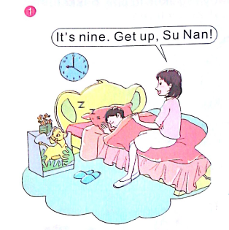
Read a story

Slide 4
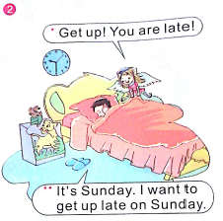
Read a story

Slide 5
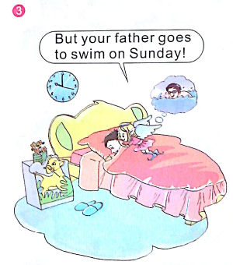
Read a story

Slide 6
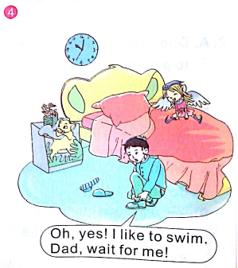
Read a story

Slide 7
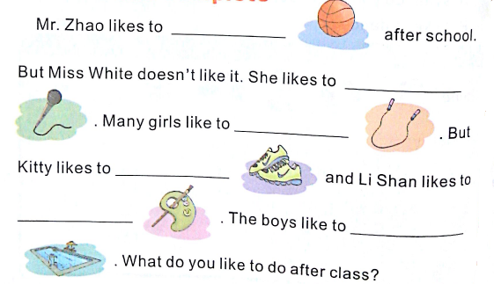
Read and complete
play basketball
sing songs
jump rope
run
draw pictures
swim

