Slide 1
陕旅版英语六年级上册
Unit7 I Had a Good Time
第4课时
WWW.PPT818.COM

Slide 2
教学目标：
1.能说唱Let’s chant部分的歌摇，且能通过说唱歌谣进一步复习巩固动词过去式及一般过去时态。
2.培养学生热爱生活的良好品质。

Slide 3
Let’s play—Simon says
take a walk play the violin
do eye exercises watch a show
go skating drive a car
make a cake go on a picnic

Slide 4
If you are happy and you know it

Slide 5
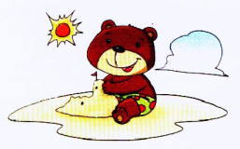
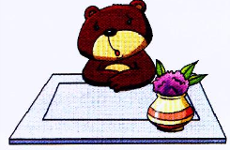
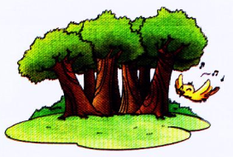
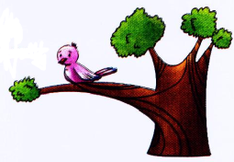
Bear 1
Bear 2
Bird 1
Bird 2
Q1: What’s in the picture?
Q2: Was Bear 1 happy?
Q3: What did Bird 2 do?
Q4: Would you like to be happy?

Slide 6
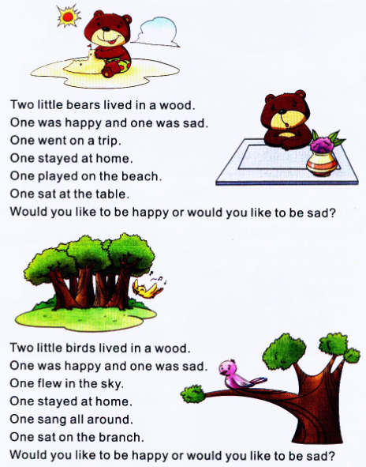
Let’s chant

Slide 7
小贴士
one的用法
1. 作数词用，表示数字“一”或者“一个”；
2. 作形容词用，表示“同一的、一致的”；如：
One world, one dream.同一个世界，同一个梦
3. 作代词用：
(1) 泛指某种意义上的一个人或物；如：
One must believe in something.人一定要有信仰。
(2) 为了避免重复，用来代替上文提到过的某一个可数名词；如：There are many flowers here. A yellow one, a pink one and a blue one.
这儿有许多花。一朵黄的、一朵粉的和一朵蓝的。

Slide 8
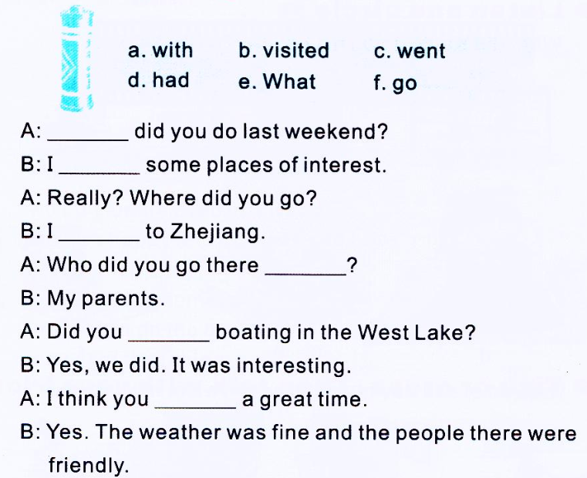
Choose, complete and act
e
b
c
a
f
d

Slide 9
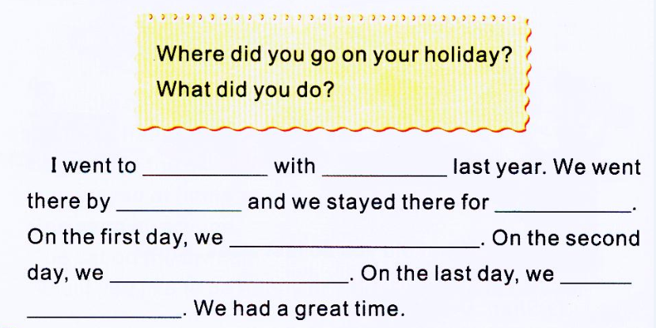
Part C Answer and write

Slide 10
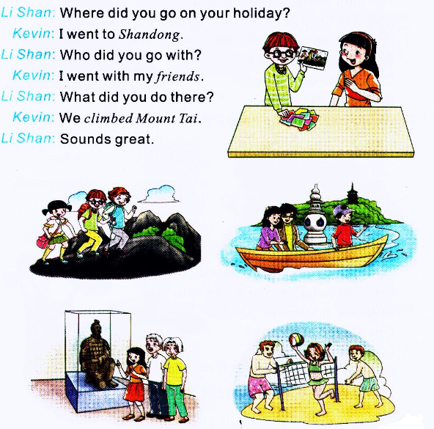
Part B Look and talk

