Slide 1
Unit 6
Is it your skirt
WWW.PPT818.COM

Slide 2
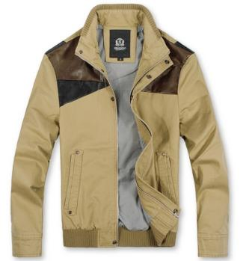
Let’s learn
coat
外套

Slide 3
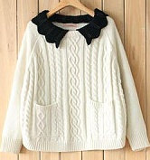
sweater
毛衣

Slide 4
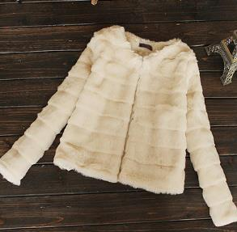
Look and say
This is a __________.
coat

Slide 5
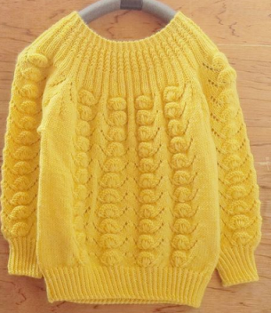
This is a __________.
sweater

Slide 6
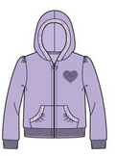
Let’s learn
A: Is this your coat?
B: Yes, it is.

Slide 7
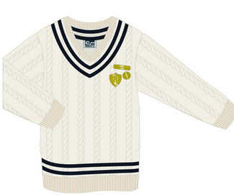
A: Is that your sweater?
B: No, it isn’t. This is my sweater.

Slide 8
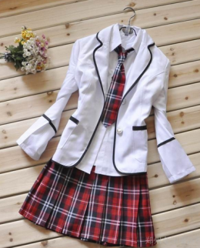
Let’s do
A: ___________________?
B: Yes, it is.
Is this your uniform

Slide 9
A: ___________________?
B: No, it isn’t. __________.
Is that your uniform
This is my uniform

Slide 10
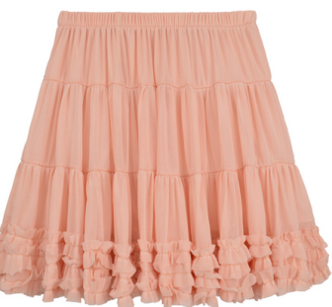
A: ___________________?
B: Yes, it is.
Is this your skirt

Slide 11
A: ___________________?
B: No, it isn’t. __________.
Is that your skirt
This is my skirt

Slide 12
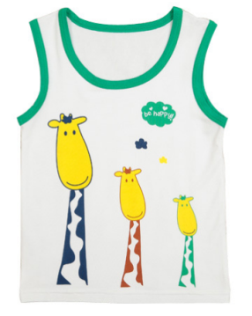
A: ___________________?
B: Yes, it is.
Is this your vest

Slide 13
A: ___________________?
B: No, it isn’t. __________.
Is that your vest
This is my vest

Slide 14
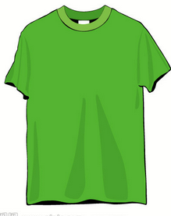
A: ___________________?
B: Yes, it is.
Is this your T-shirt

Slide 15
A: ___________________?
B: No, it isn’t. __________.
Is that your T-shirt
This is my T-shirt

Slide 16
同桌间互相做对话练习

Slide 17
Homework:
1.熟读本课对话;
2.抄写本课重点单词3遍。

