Slide 1
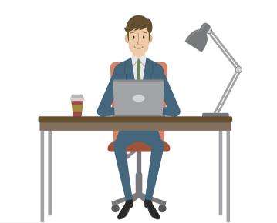
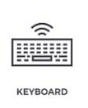
Module 7 Computers
Unit 2 When do you use a computer?
WWW.PPT818.COM

Slide 2
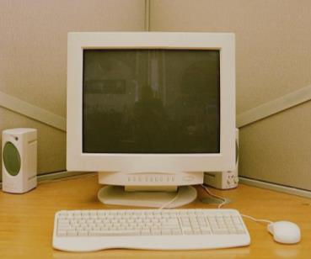
screen
1
keyboard
mouse

Slide 3
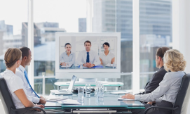
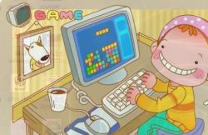
New words
talk to customers
play computer games

Slide 4
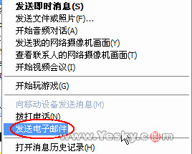
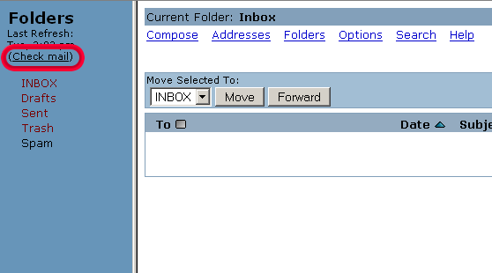
send emails
check emails

Slide 5
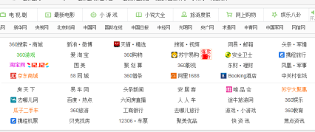
make travel plans
visit a website
浏览网页

Slide 6
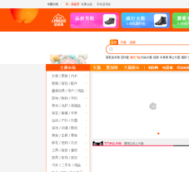
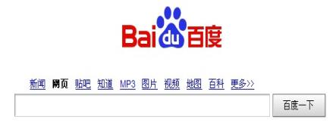
do some shopping
search for information

Slide 7
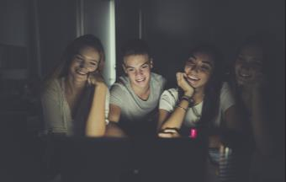
watch movies
listen to music
see films

Slide 8
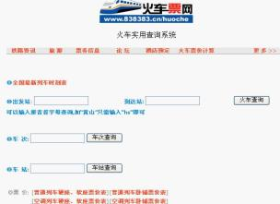
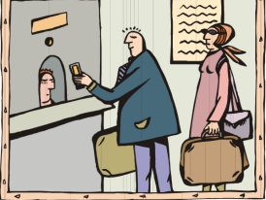
check the times of a train
buy tickets

Slide 9
Match the words.
buy
check
go on
make
play
share
talk to
search for
watch
work for
a company
a computer
customers
email
games
information
the Internet
movies
tickets
travel plans

Slide 10
Fast reading.
Read the passage and answer the questions.
1. Who can use the computer on Sundays?
Mike.
2. Who shares a computer with his father?
Jack.
3. Who has a friend in Australia?
Alice.

Slide 11
Read againand check T or F.
F
Jack
1. Jack’s father uses the computer every Friday night.
2. Alice checks emails at home.
3. Mike likes playing computer games.
4. Mike and his parents use their home computer.
F
at school
T
F

Slide 12
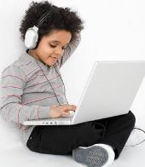
Read Para. 1 and answer the questions.
1. What does Jack’s father do on the computer?
He often talks to his customers on the computers.
He also goes on the Internet to check the times of trains, make travel plans, and buy tickets.
2. Does Jack use the computer every night?
No, he doesn’t. He uses the computer every Friday night.
3. What does Jack do on the computer?
He listens to music and watches movies on the computer.

Slide 13
Read Para. 2 and answer the questions.
1. Does Alice have a computer at home?
No, she doesn’t.
2. What does Alice do on the Internet?
She searches for information, does her homework, checks her email, and sees and talks with her friends on the Internet.

Slide 14
Read Para. 3 and answer the questions.
1. Do Mike’s parents use a computer at home?
No, they don’t.
2. What does Mike usually do on the computer?
He sends emails to his friends and plays computer games.

Slide 15
Complete the passage with the correct form of the words from the box.
check customer information Internet movie plan search send share ticket
You can use your computer to do lots of things on the _________. You can ________ for ___________ about things to do. Are you _________ an evening at the cinema? What time does your _______ start? You can ______
Internet
search
information
planning
movie
check

Slide 16
on the Internet. What about shopping? Many _________ buy books, clothes and many other things on the Internet. And do you want to visit friends or family? Many people buy train __________ on the Internet. You can also _________ emails or speak to friends. But remember to __________ the computer with your parents!
customers
tickets
send
share

Slide 17
Things you can do on the computer:
do homework play computer games
make travel plans listen to music
check the times of trains check e-mails
send e-mails visit websites
search for information watch movies= see films
do some shopping talk to customers
buy tickets go on the I ternet

Slide 18
全国青少年网络文明公约：
要善于网上学习,不浏览不良信息。
要诚实友好交流,不侮辱欺诈他人。
要增强自护意识,不随意约会网友。
要维护网络安全,不破坏网络秩序。
要有益身心健康,不沉溺虚拟时空。

Slide 19
Writing
如今，电脑已成为人们生活、学习与工作中必不可少的工具之一。请根据自己的实际经历，谈谈你会在什么时候用电脑，以及用电脑来做些什么，写一篇不少于50词的短文，要求思路清晰、语句通顺。

