Slide 1
Welcome to my new home!
人教精通版四年级下册
WWW.PPT818.COM

Slide 2
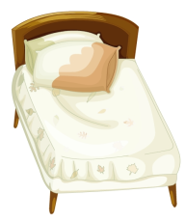
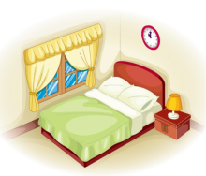
Review
Which is missing?

Slide 3
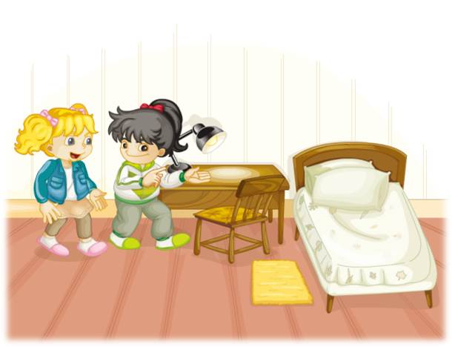
Review
Look at my bedroom. There is…

Slide 4
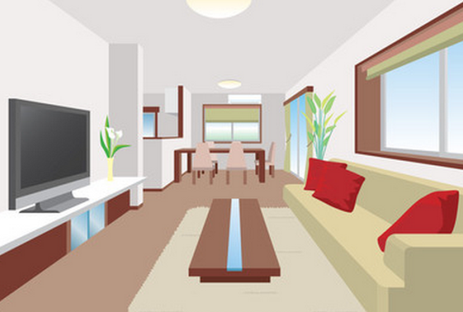
Lead-in
Is this a bedroom, too?
What’s it?

Slide 5
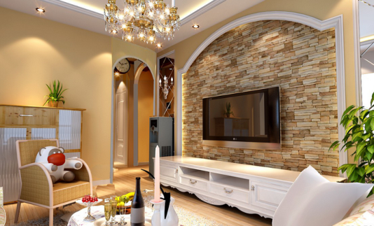
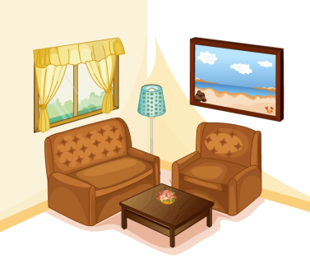
Presentation
living room
I watch TV in the living room.

Slide 6
Presentation
Discussion
Look at the living room. What’s in it?
There is a TV and a sofa.
There are two tables and four chairs.

Slide 7
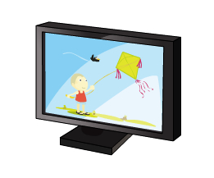
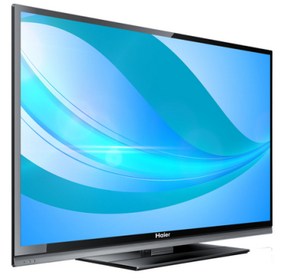
Presentation
TV
Eg: There is a TV in the living room.

Slide 8
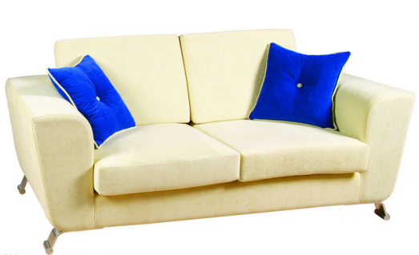
Presentation
sofa
Eg: There are two sofas in the living room.

Slide 9
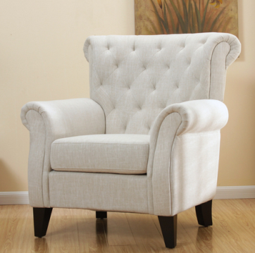
Presentation
armchair
Eg: There are two armchairs in the living
room.

Slide 10
Presentation
ball
Eg: There is a ball in the bedroom.

Slide 11
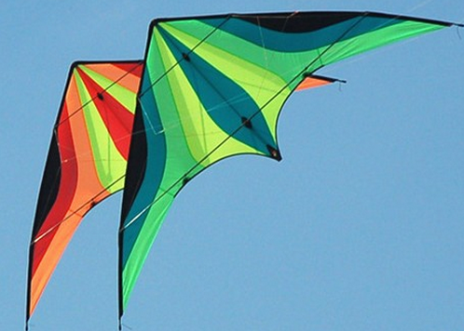
Presentation
kite
Eg: There are two kites in the sky.

Slide 12
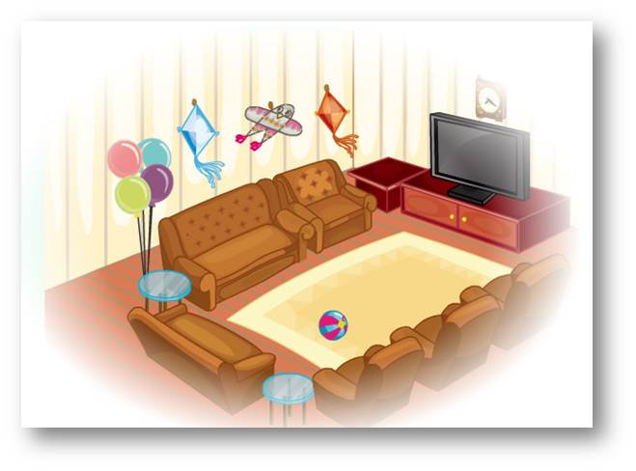
Presentation
Let’s talk
What’s in Li Yan’s living room?
（单击图片可播放动画）

Slide 13
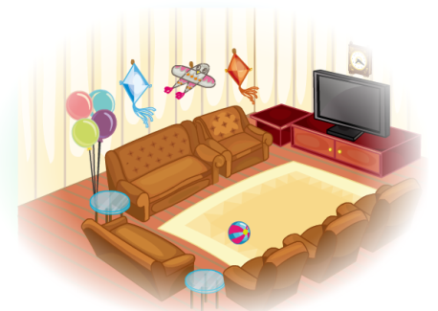
Presentation
There is a new TV.
There are two sofas.
There are four armchairs.
There are three kites and four balloons.

Slide 14
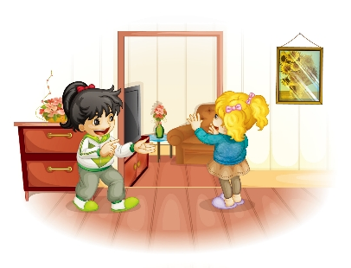
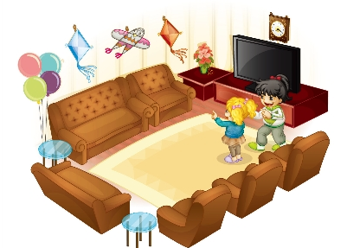
Presentation
Listen and number
1
Look at the living room.
Wow! There is a new TV.
2
And there are three kites and four balloons.
4
Oh, There are two sofas and four armchairs.
3

Slide 15
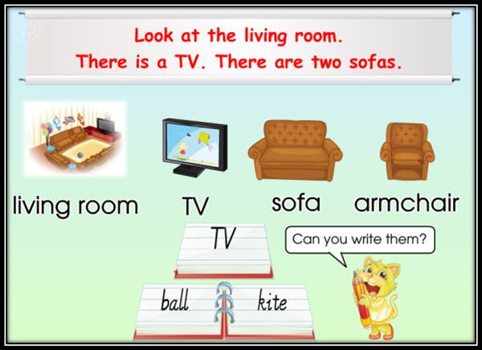
Presentation
Read and write
（单击图片可播放动画）

Slide 16
Presentation
Let’s read
录音 | 课文句子
L: Look at the living room!
K: Wow! There is a new TV.
K: Oh, There are two sofas and four armchairs.
L: And there are three kites and four balloons.

Slide 17
Practice
Role-play
分角色表演课文对话。

Slide 18
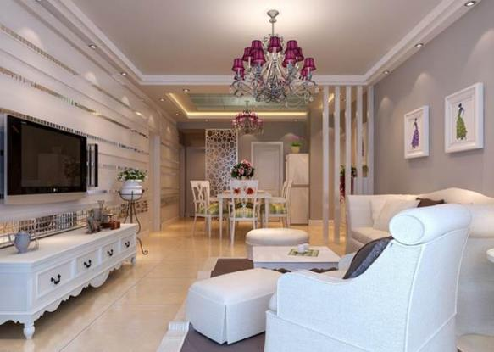
Practice
用本课所学的句型描述一下这幅图片吧！
There is/are ...

Slide 19
Practice
Game
我说你做
规则：老师说句子，学生画画。如老师说：There is a TV in the living room. 学生画出对应的图片，看谁画的又快又准确。

Slide 20
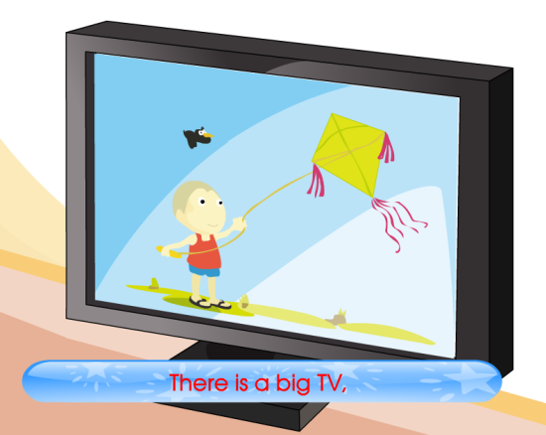
Consolidation
Let’s chant
（单击图片可播放动画）

Slide 21
Summary
1.本节课的重点单词有哪些？
living room
TV
sofa
armchair
kite
ball
2.本节课的重点句型有哪些？
There is ...
There are ...

Slide 22
Homework
1.模仿Just talk语音、语调朗读对话。
2.将本课新单词抄写5遍，汉语写1遍。
Close

