Slide 1
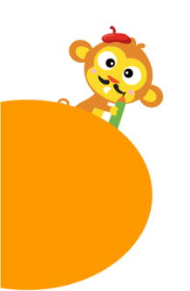
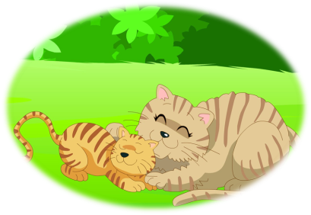
Unit 6 Me
6
Are you my mum?
第三课时
WWW.PPT818.COM

Slide 2
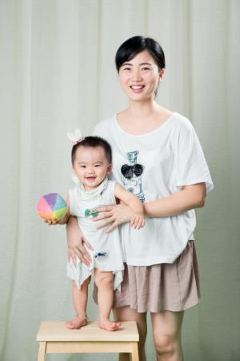
Notes:
2

Slide 3
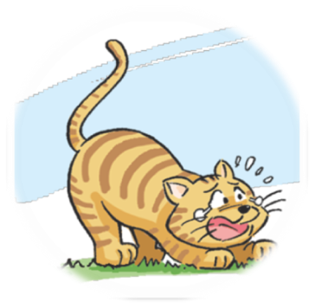
Hello. I’m Mimi.
I’m a boy.
I’m small and fat.
My face is round.
My eyes are big.
My ears are small.
My mouth is small.
My nose is small.
My hair is short and brown.
My tail is long and brown.
Notes:
3

Slide 4
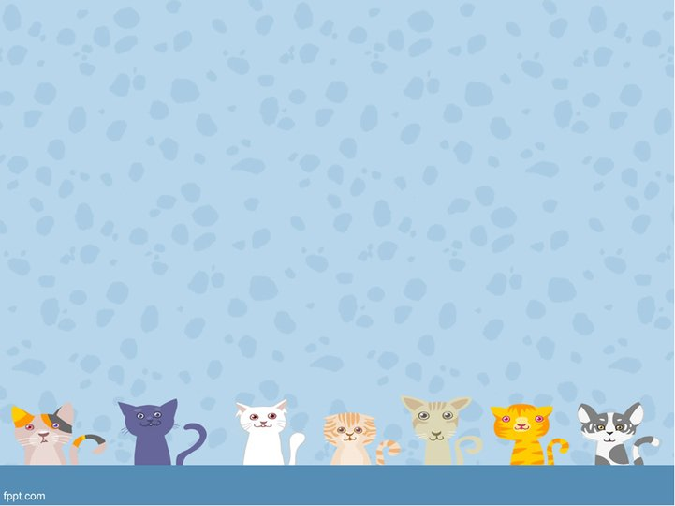
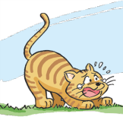
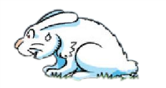
Tail, tail, long and brown.
My tail is long and brown.
Tail, tail, ______________.
short and white
My tail is short and white
_______________________.
My tail is …
…
…
…
…
…
…
Notes:
4

Slide 5
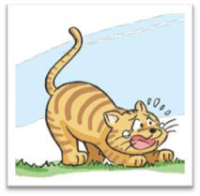
Your face is round.
____ eyes are big.
____ ears ____ small.
Your
Your
are
Your mouth is small.
____ nose __ small.
____ hair __ short and brown.
____ tail __ long and brown.
You are not happy.
Your
is
Your
is
You are Mimi.
You ___ a boy.
You ___ small and fat.
are
Your
is
are
Notes:
5

Slide 6
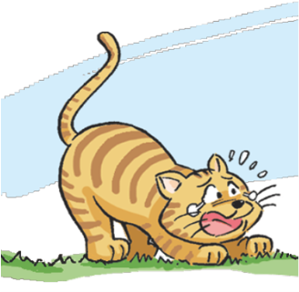
Mimi is not happy, why?
He’s hungry .
He can’t see his mum.
He is lost.
Notes:
6

Slide 7
Mimi is not happy, why?
He’s hungry.
He can’t see his mum.
He is lost.
Notes:
7

Slide 8
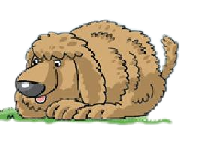
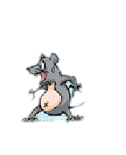
Who does he see?
rabbit
dog
mouse
Notes:
8

Slide 9
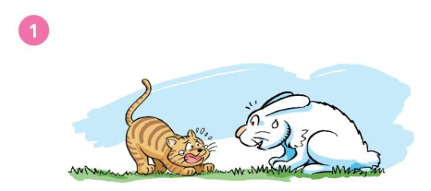
Are you my mum?
No. My ears are long.
My tail is short.
Notes:
9

Slide 10
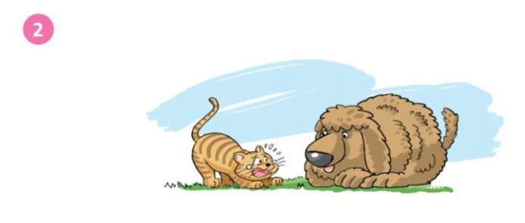
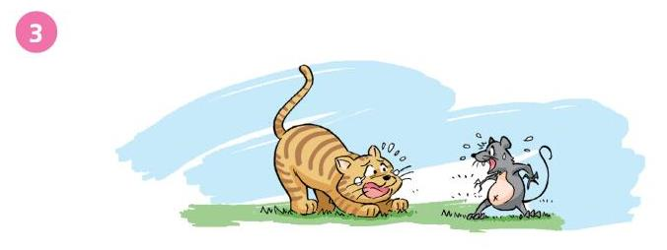
No. My eyes are small.
My nose is big.
Are you my mum?
Are you my mum?
No.
Notes:
10

Slide 11
No.
I’m not your mum.
My ears are long.
Are you my mum?
Your ears are short.
My tail is short.
Your tail is long.
No.
I’m not your mum.
are small
My eyes _________.
eyes are big
Your ____________.
is big
My nose _______.
Are you my mum
______________ ?
nose is small
Your ____________.
Notes:
11

Slide 12
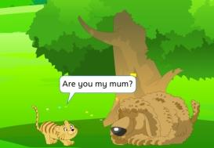
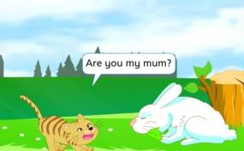
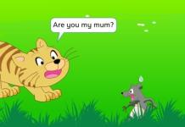
Mum! Mum!
Mum! Mum!
?
…
Notes:
12

Slide 13
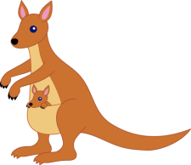
Mum! Mum!
Mum! Mum!
?
…
…
?
Notes:
13

Slide 14
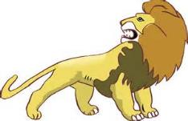
Mum! Mum!
Mum! Mum!
…
…
?
Notes:
14

Slide 15
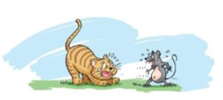
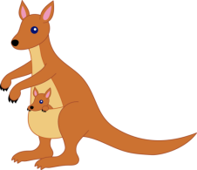
face eyes ears mouth nose hair tail
round big small tall short long fat thin
grey brown black
Choose one picture with your partner.
Circle the
difference on the pictures.
Complete
the dialogues.
Pair work:
Make new stories
1
Mimi: Are you my mum?
face is small and thin
Mouse: No. My _________________.
face is big and round
Your ____________________.
I’m not your mum.
2
Mimi: Are you my mum?
Kangaroo: No. I’m _____ and _____.
You’re _____ and _____.
Look! This is my baby.
I’m not your mum.
3
Mimi: Are you my mum
Lion: No. ____________________.
___________________.
I’m not your mum.
Notes:
15

Slide 16
Say and act
1
Mimi: Are you my mum?
Mouse: No. My ________________.
Your ____________________.
I’m not your mum.
2
Mimi: Are you my mum?
Kangaroo: No. I’m _____ and _____.
You’re _____ and _____.
Look! This is my baby.
I’m not your mum.
3
Mimi: Are you my mum
Lion: No. ____________________.
___________________.
I’m not your mum.
Notes:
16

Slide 17
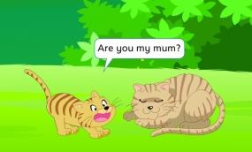
Mum! Mum!
Mum! Mum!
…
…
…

Slide 18
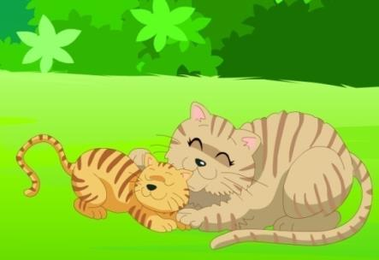
 | eyes | ears | mouth | nose | tail
big
short
small
small
long
big
short
small
small
long
Yes. My ... Your ...
I'm your mum. Come here, baby!
…?

Slide 19
1
2
3
4
5
6
Notes:
19

Slide 20
Mum! Mum!
Mum! Mum!
…
…
…

Slide 21
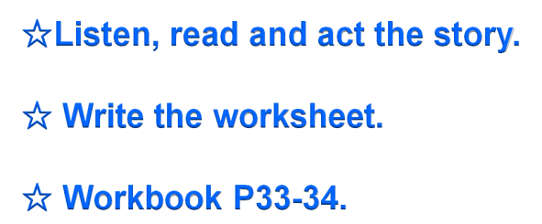

Slide 22
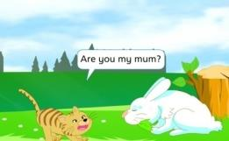
Mimi: Are you my mum?
Rabbit: No. My ears ___ long. Your ears ___ short. My tail ___ short. Your tail __ long. I’m not your mum.
Mimi: ____ you my mum?
Dog: No. My eyes ___ small.
Your ____ are big. My nose ___ big. Your ____ is small.
I’m not your mum.
Mimi: ____________?
Mouse: No. My face is ___
and _____. Your face is _____and _____. I’m not your mum.
Mimi: _______________?
Lion: No. ____ hair __ long.
____ hair __ short.
I’m not your mum.
Mimi: _______________?
Kangaroo: No. I’m big and tall. You are _____ and _____. Look! This is my baby. I’m not your mum.
Mimi: _____________?
Mum: Yes. My __________. Your _______________.
My _______. Your_______. My _______. Your _______. I'm your mum.
Come here, baby!
Notes:
22

